Slide 1


ENERGY-PROPORTIONAL
IMAGE SENSING
FOR
CONTINUOUS MOBILE VISION
Robert LiKamWa
Bodhi Priyantha
Matthai Philipose
Victor Bahl
Lin Zhong
http://roblkw.com
http://research.microsoft.com

Slide 2
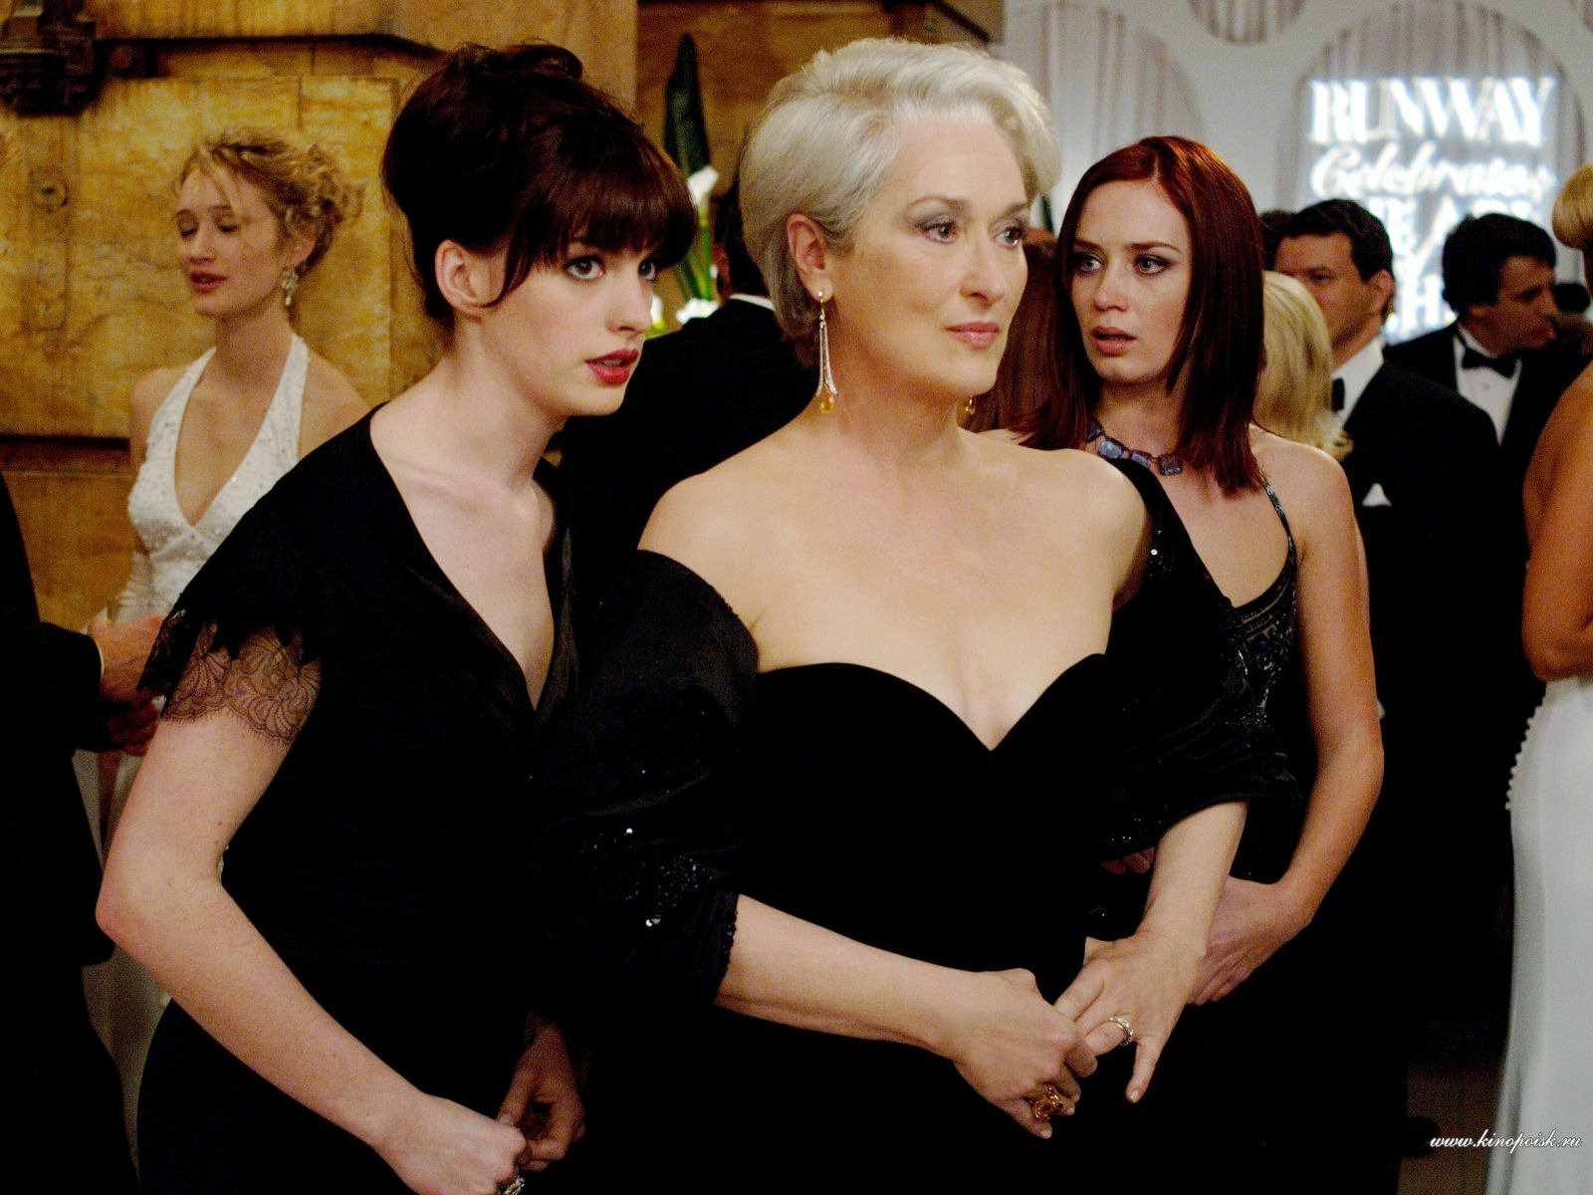
Conversational
Face Detection
CONTINUOUS MOBILE VISION
CONTINUOUS
MOBILE
VISION
The Devil Wears Prada

Slide 3
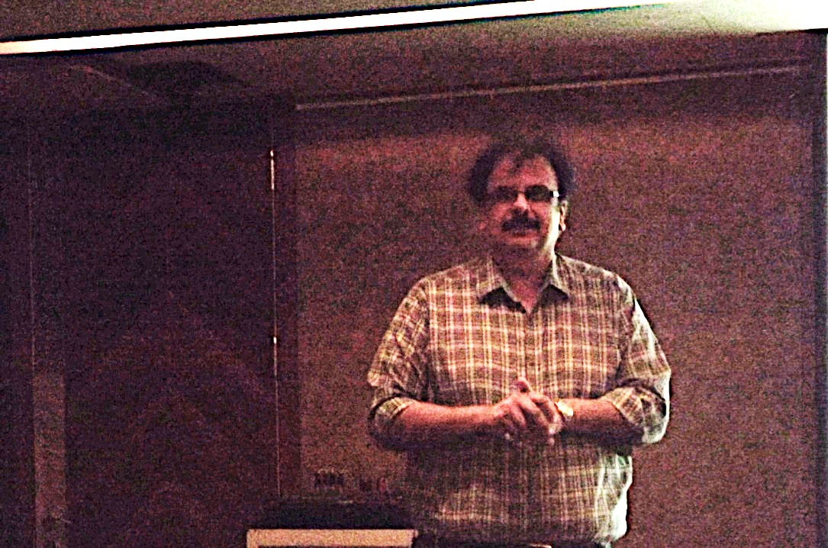

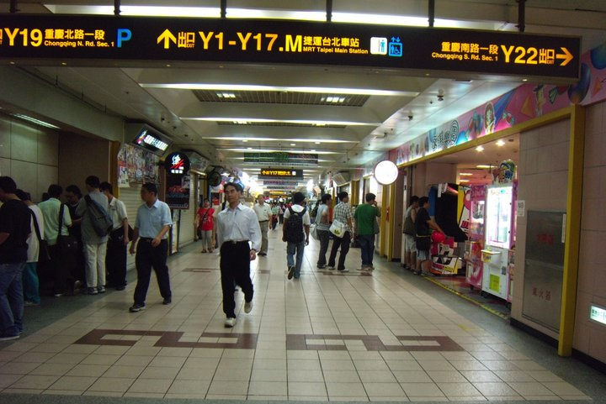

Face Recognition
Object Memory
Victor
CONTINUOUS MOBILE VISION
CONTINUOUS
MOBILE
VISION
Fine-grained Localization
Gestures

Slide 4
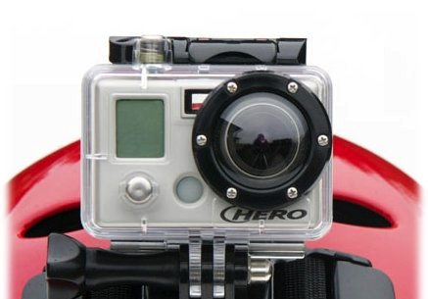
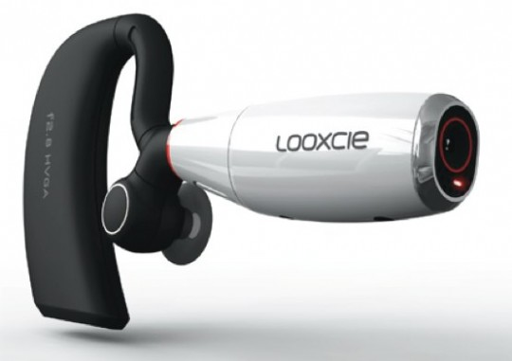

BATTERY DEATH
BATTERY LIFE
GoPro Hero
2-3 hours
LooxCie
2-3 hours
Google Glass
2-3 hours

Slide 5
2000
mWh
200
mW
10 h

Slide 6
Image Sensor
Goal < 25 mW
Sensors
~ 5 mW
Network Stack
~20 mW
Processor
~150 mW
Notes:
Ballpark estimates with heterogeneous processing, duty-cycling the network stack

Slide 7
Image Sensor
Goal < 25 mW
Image Sensor
Reality > 250 mW

Slide 8
KEY IDEA: ENERGY α QUALITY
Power
Power
Frame rate
Resolution
Notes:
Don’t need 4K 60 frame per second video
High resolution, don’t mind spending high power
At low resolution, we really don’t want to spend power.

Slide 9
ENERGY PROFILE OF AN IMAGE SENSOR
Goal:
< 25 mW
1 MP, 15 fps
295 mW
1 MP, 5 fps
250 mW
0.3 MP, 15 fps
245 mW
0.3 MP, 5 fps
232 mW
Reality:
> 230 mW

Slide 10
ENERGY-EFFICIENT
IMAGE SENSING
Image Sensor Characterization
Energy Reduction Techniques
Energy vs. Vision Performance

Slide 11
IMAGE SENSOR MEASUREMENT
*
Camera
Module
Power Rail
Resistors
Power
VDD
CLK
Programmable Clock (I2C)
NI DAQ Device
* Profiled 5 state-of-the-art
image sensors from 2 manufacturers

Slide 12
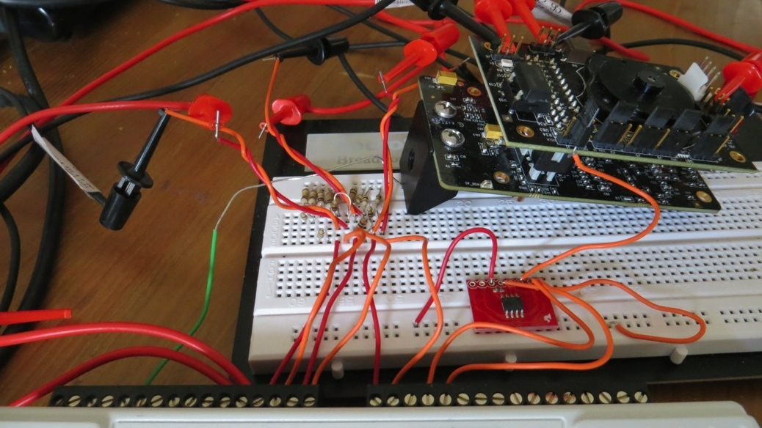
IMAGE SENSOR MEASUREMENT
Power Rail
Resistors
Camera
Module
Programmable Clock (I2C)
NI DAQ Device

Slide 13
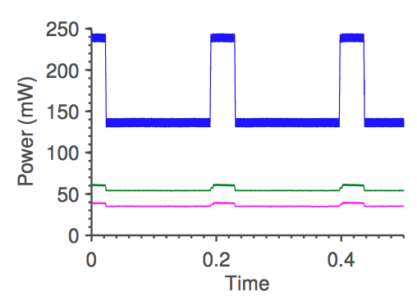
IMAGE SENSOR WAVEFORMS
Active Period
Analog
Idle Period
Digital
PLL
Notes:
All image sensors look something like this

Slide 14
IMAGE SENSOR WAVEFORMS
Active Period
Idle Period

Slide 15
IMAGE SENSOR WAVEFORMS
Active Period
Pixel Count
divided by
Clock Frequency
Idle Period
Frame Time
minus
Active Time

Slide 16
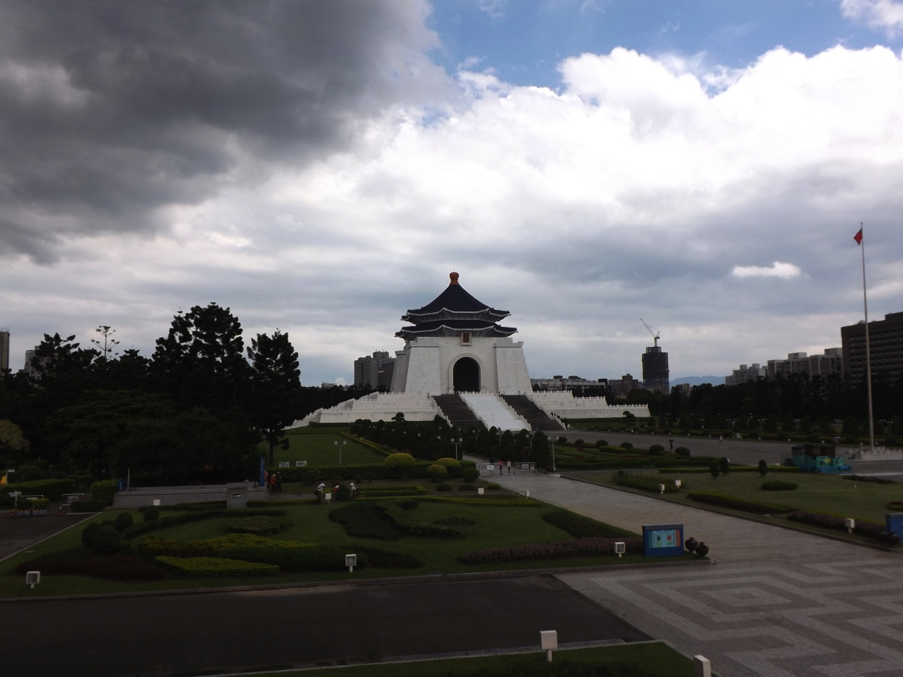


IMAGE SENSOR PIXEL COUNT (N)
Scaled Resolution
(Pixel Skipping)
Region-of-Interest
(Windowing)
Active
Active
Power
Power
Time
Time

Slide 17
IMAGE SENSOR PIXEL COUNT (N)
Video (30 FPS)
Power vs. Resolution
Active
Active
Power
Power
Time
Time

Slide 18
IMAGE SENSOR FRAME RATE (R)
Active
Frame
Readout
Active
Active
Active
Frame
Readout
Active
Active
Active
Active
Active
Active
Power
Power
Time
Time
1.0s
Video (0.1 MP)
Power vs. FPS

Slide 19
CHARACTERIZATION CONCLUSION:
NO ENERGY PROPORTIONALITY
Video (30 FPS)
Power vs. Resolution
Video (0.1 MP)
Power vs. FPS

Slide 20
ENERGY-EFFICIENT
IMAGE SENSING
Image Sensor Characterization
Energy Reduction Techniques
Energy vs. Vision Performance

Slide 21
TECHNIQUE #1: AGGRESSIVE STANDBY
Active
Active
Active
Active

Slide 22
AGGRESSIVE STANDBY
CAVEAT TO
Active
Active
Active
Active
Active
Active
This won’t work for long active periods,
i.e., high resolution, high frame rate.
Not enough exposure time

Slide 23
TECHNIQUE #2: CLOCK SCALING (f)
One pixel per clock period

Slide 24
TECHNIQUE #2: CLOCK SCALING (f)
Lower Active Time
Faster clock
Higher Active Power
Higher Idle Power
Higher Active Time
Slower clock
Lower Active Power
Lower Idle Power
Notes:
Tradeoff

Slide 25
TECHNIQUE #2: CLOCK SCALING (f)
Active
Low Pixel Count
Low Frame Rate
Slowed Clock
Active
Optimal clock frequency depends on
Pixel Count & Frame Rate

Slide 26
AGGRESSIVE STANDBY + CLOCK OPTIMIZATION
Active
Readout
Aggressive
Standby
Active
Read
out
Sped-up
Clock
Optimal clock frequency depends on
Pixel Count & Frame Rate
Exposure Time

Slide 27
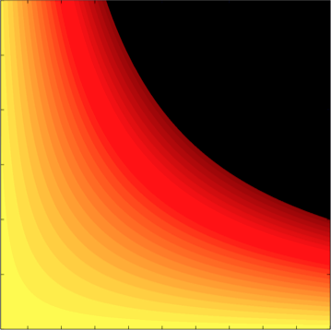
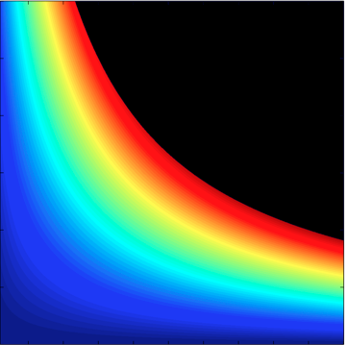
ENERGY α QUALITY
Aggressive Standby &
Clock Optimization
Unoptimized
30
30
350
350
25
300
25
300
20
250
20
250
200
200
Frame rate (FPS)
Frame rate (FPS)
Power (mW)
15
Power (mW)
15
150
150
10
10
100
100
5
5
50
50
0
0
0
0
1
2
3
4
5
1
2
3
4
5
Resolution (MP)
Resolution (MP)

Slide 28
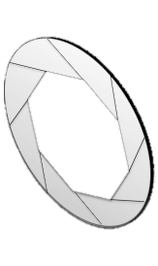
Driver
CPU

Slide 29

Notes:
Driver-level tweaks so far. What about Clean-slate design?

Slide 30
CURRENT IMAGE SENSOR DESIGN
Analog Signal Chain
70-85% Power Consumption
Gain, ADC
Pixel Array
Column Output
Image Processor

Slide 31
HETEROGENEOUS SENSOR DESIGN
Heterogeneous
Analog Signal Chain
High-Speed ADC
Pixel Array
Column Output
Gain
Mid-Speed ADC
Image Processor
Low-Speed ADC

Slide 32
ENERGY α QUALITY
Power vs. Framerate
(at 0.1 MP)
Power vs. Resolution
(at 5 FPS)
Default
Default
Clock select
Clock select
Standby
Standby
HW Fix
HW Fix

Slide 33
ENERGY-EFFICIENT
IMAGE SENSING
Image Sensor Characterization
Energy Reduction Techniques
Energy vs. Vision Performance

Slide 34
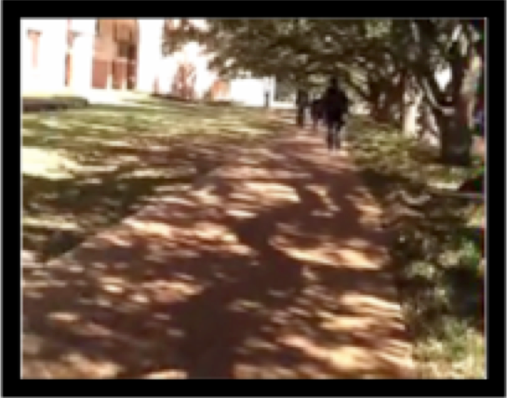
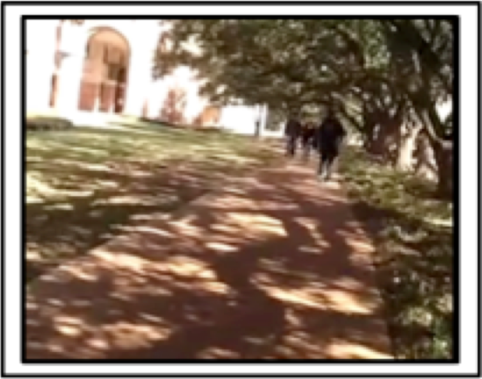
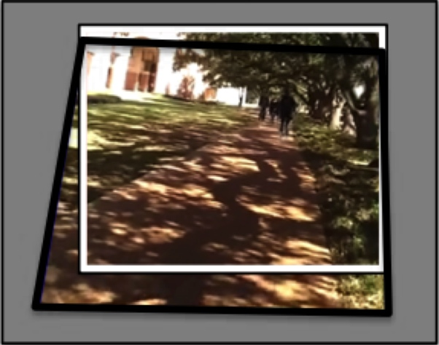
ENERGY vs. VISION: VISION TASK
IMAGE REGISTRATION

Slide 35
ENERGY vs. VISION: PERFORMANCE
 | Image Registration Success | Power Reduction with software assist | Estimated Power Reduction with hardware assist
Full VGA Resolution 0.1 MP, 30 FPS | 99.9% | 51% | 84%
Frame Rate Reduction 0.1 MP, 3 FPS | 95.7% | 95% | 98%
30% Window 0.06 MP, 30 FPS | 96.5% | 63% | 91%
Subsampled by 2 0.3 MP, 30 FPS | 91.8% | 71% | 94%
Typical
Average Power
With aggr. standby
& optimal clock
With heterogeneous
analog signal chain
185 mW
10 mW
3 mW
Notes:
Actual numbers in paper

Slide 36

Scalable
Computer
Vision
Algorithms
Energy
Proportional
Image
Sensing
Developer
Support
Integrated
Systems
Design

Slide 37
Continuous
Mobile Vision

Slide 38

ENERGY-PROPORTIONAL IMAGE SENSING
FOR
CONTINUOUS MOBILE VISION
Image sensors are
not energy-proportional…
…but we can make them
energy-proportional…
… and this is just the beginning.
30
Aggressive Standby
Clock Optimization
Sensor Modifications
20
Frame rate (FPS)
CMV
10
0
1
3
5
Resolution (MP)
http://roblkw.com
http://research.microsoft.com
Notes:
More detailed analysis in the paper

