Slide 1
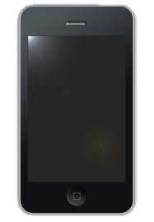
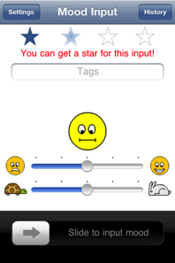
MoodScope: Sensing mood from smartphone usage patterns
Asia
Robert Likamwa
Lin Zhong
Yunxin Liu
Nicholas D. Lane

Slide 2
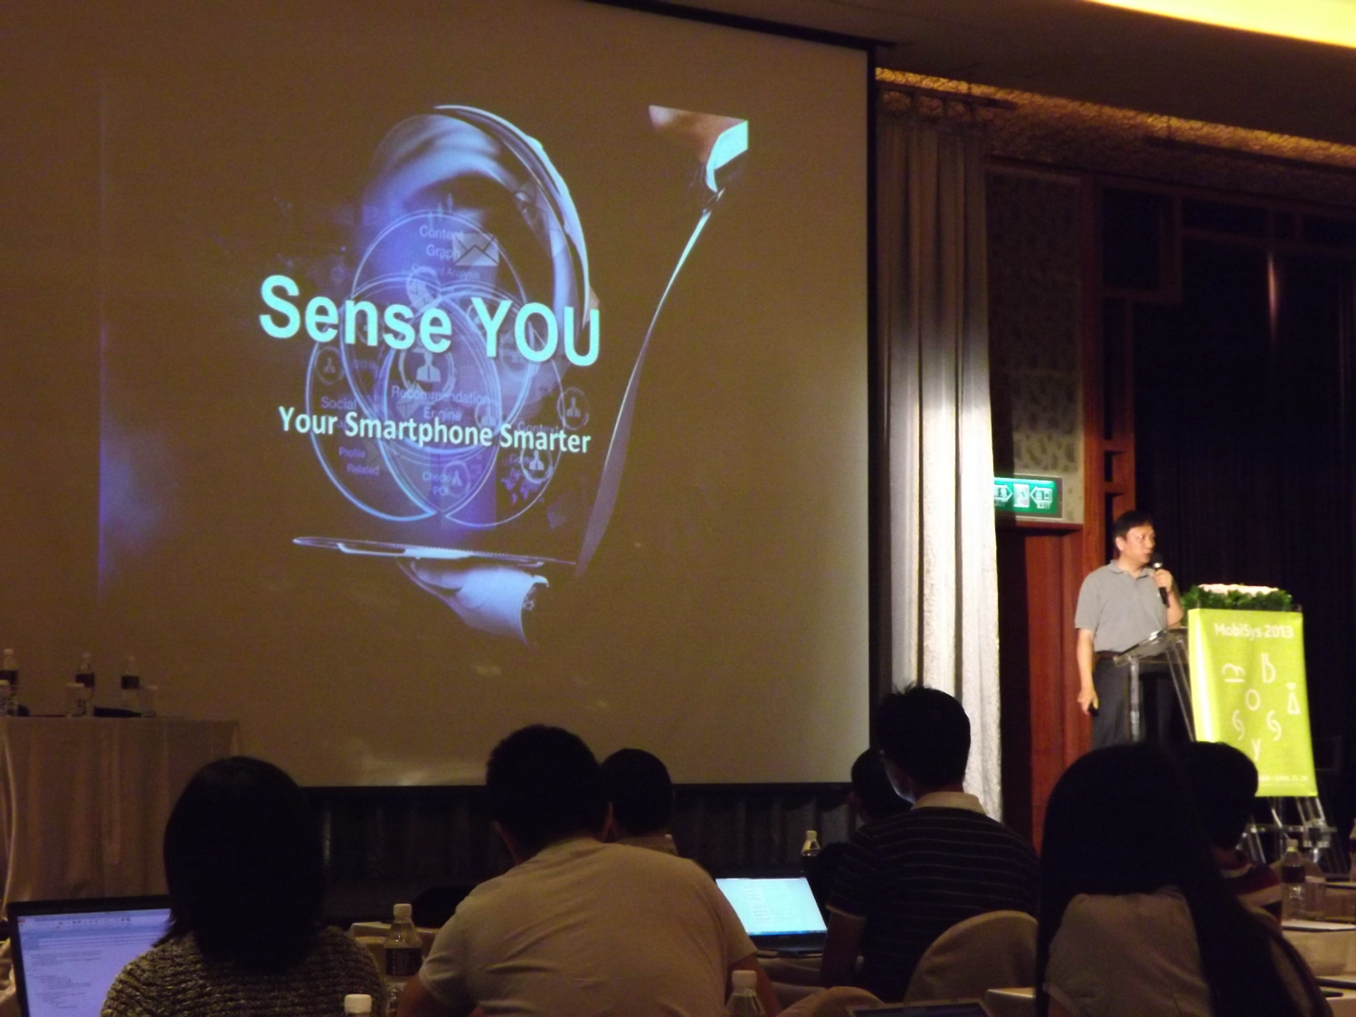
Earlier today…
Notes:
HTC VP of Tech Dr. Edward Chang described a rich set of sensors that are already available on smartphones.
But as he pointed out, it’s still an open problem to understand use states.

Slide 3
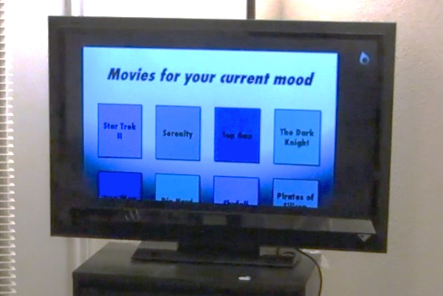
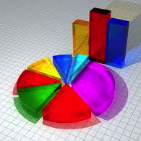
Mood-Enhanced Apps
Some time in the future…
Personal analytics
Social ecosystems
Media recommendation
Notes:
Example personal analytics
Compare your mood calendar with your event calendar, food journal
Social Ecosystems

Slide 4
Affective Computing (Mood and Emotion)
Audio/Video-based
(AffectAura, EmotionSense)
Biometric-based
(Skin conductivity,
Temperature, Pulse rate)
Captures expressions
Power hungry
Slightly invasive
Highly temporal
High cost of deployment
Hassle
Notes:
Encompasses Mood and emotion
Proxy for affect

Slide 5
Can your mobile phone infer your mood?

Slide 6
Can your mobile phone infer your mood?
From already-available, low-power information?*
* No audio/video sensing, no body-instrumentation
Notes:
No external sensors, no instrumenting of the user, No Power overhead

Slide 7
MoodScope ∈ Affective Computing
Usage Trace-based
(MoodScope)
Passive, Continuous
How to model mood?
Audio/Video-based
Captures expressions
Power hungry
Slightly invasive
Biometric-based
Very direct, Fine-grained
High cost of deployment

Slide 8
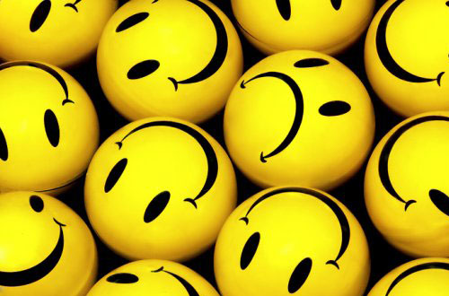
Mood is…
… a persistent long-lasting state
Lasts hours or days
Emotion lasts seconds or minutes
… a strong social signal
Drives communications
Drives interactions
Drives activity patterns
Notes:
Psychology textbook definition
A lot of good emotions can put you in a good mood
And a person in a good mood will experience more good emotions

Slide 9
Circumplex model (Russell 1980)
depressed
nervous
calm
excited
sad
stressed
bored
attentive
relaxed
happy
Notes:
How do we want to measure mood? We need a model to quantify it.
Introduce the Circumplex Model, developed by Social Scientists
Widely used, Well- validated

Slide 10
Mood is…
… a persistent long-lasting state
Lasts hours or days
Emotion lasts seconds or minutes
… a strong social signal
Drives communications
Drives interactions
Drives activity patterns
… a strong social signal
Drives communications
Drives interactions
Drives activity patterns
Notes:
The smartphone knows these things because it is the portal of communication and activity. Must manifest in the data.

Slide 11
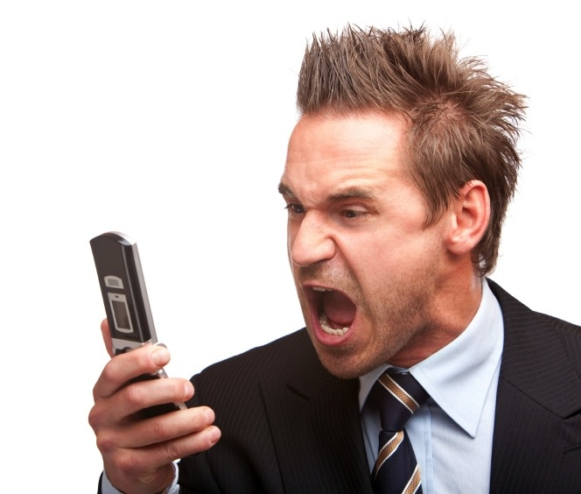
How is the user communicating?
Notes:
Maybe people text more when they’re happy and call more when they are angry
Call mom when sad
Longer text messages

Slide 12
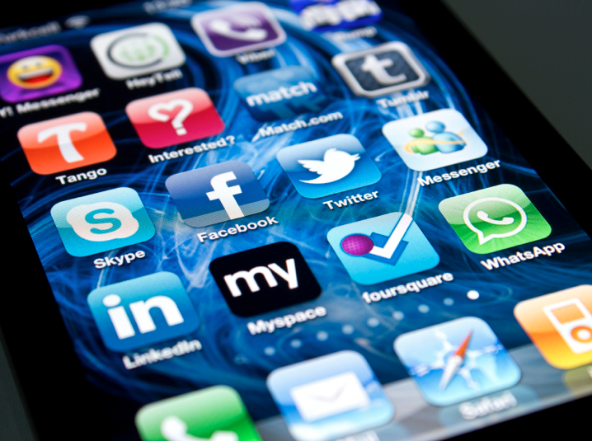
What apps is the user using?
Notes:
Social applications
Games
Web Browser

Slide 13
f ( ) = mood
usage
Notes:
Smartphone usage and mood are related.
We don’t know which one causes which.
But we know there’s some relationship there.
We believe that we can train a machine to recognize mood from smartphone usage. This is the crux of MoodScope.

Slide 14
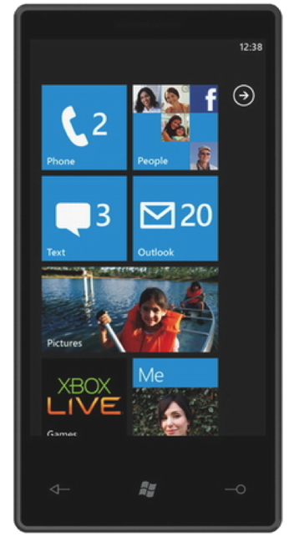
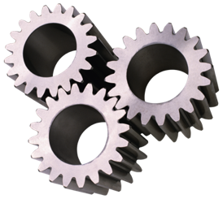
iPhone Livelab Logger
Web history
Phone call history
Sms history
Email history
Location history
App usage
Adapted From C. Shepard, A. Rahmati, C. Tossel, L. Zhong, And P. Kortum, "Livelab: Measuring Wireless Networks And Smartphone Users In The Field," In Hotmetrics, 2010.
Notes:
Our team back at Rice

Slide 15
iPhone Livelab Logger
Web history
Phone call history
Sms history
Email history
Location history
App usage
Runs as shell
Hash private data
Uploads logs to our server nightly
How can we generate mood labels?

Slide 16
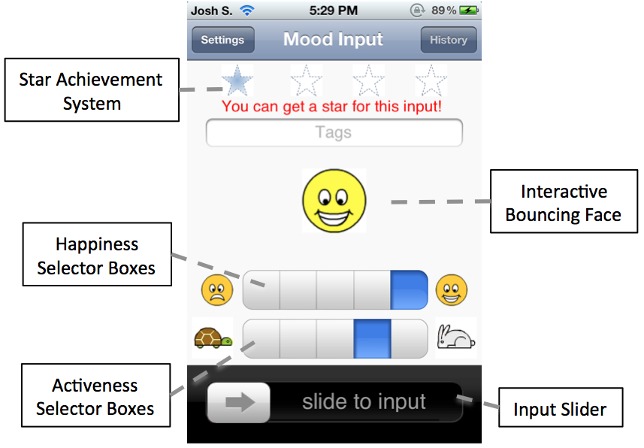
Mood Journaling App
User-base
32 users aged between 18 and 29
11 females
Notes:
Simple, motivates users to use it
Emphasize: No numbers

Slide 17
Inference
Detect a mood pattern
Validate with only 60 days of data
Wide range of candidate usage data
Low computational resources
Notes:
Train our mood labels

Slide 18
Daily Mood Averages
Separate pleasure, activeness dimension
Take the average over a day
Σ( )
_______________
4
Notes:
Train our mood labels.
So that the problem is tractable.
This is an accepted methodology to cope with the noise inherent with experience sampling.

Slide 19
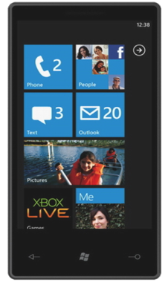
Exploring Features
Communication
SMS
Email
Phone Calls
To whom?
# messages
Length/Duration
Consider “Top 10” Histograms
How many phone calls were made to #1? #2? … #10?
How much time was spent on calls to #1? #2? … #10?
?
?
Notes:
Easy Generalizable features to use across different types of usage data and different types of users

Slide 20
Exploring Features
Communication
SMS
Email
Phone Calls
To whom?
# messages
Length/Duration
Usage Activity
Applications
Websites visited
Location History
Which (app/site/location)?
# instances

Slide 21
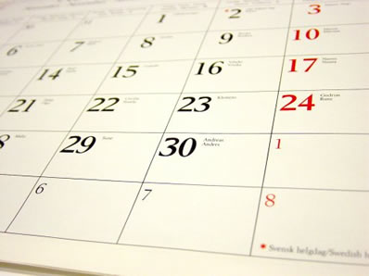
Previous Mood
Use previous 2 pairs of mood labels
Notes:
Use prior states to predict future states.
Angry yesterday, less angry today

Slide 22
Data Type | Histogram by: | Dimensions
Email contacts | # Messages | 10
 | # Characters | 10
SMS contacts | # Messages | 10
 | # Characters | 10
Phone call contacts | # Calls | 10
 | Call Duration | 10
Website domains | # Visits | 10
Location Clusters | # Visits | 10
Apps | # App launches | 10
 | App Duration | 10
Categories of Apps | # App launches | 12
 | App Duration | 12
Previous Pleasure and Activeness Averages | N/A | 4
Notes:
128 candidate features

Slide 23
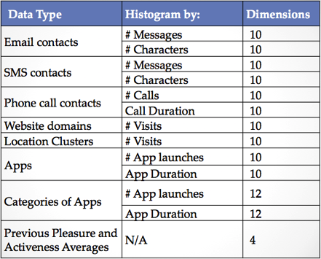
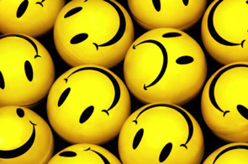
Model Design
??
Multi-Linear Regression
Minimize Mean Squared Error
Leave-One-Out Cross-Validation
Sequential Forward Feature Selection during training
Notes:
Now that we have our Candidate features and mood labels, we need to design a model

Slide 24
Sequential Feature Selection
(Each line is a different user)
Notes:
Consider your set o candidate features. Pick the one that will minimize the MSE. Add it to your feature table. Pick the next one that will further minimize. Etc.
This greedily selects a set of features to train the model.

Slide 25
Sample Prediction

Slide 26
Error distributions
Error² of > 0.25 will misclassify a mood label
93% < 0.25 error²
Notes:
That is, if they selected 4, it would correctly label them between 3.5 and 4.5
For half of the users, all of the mood labels fall under our accuracy metric.
For the other half, 90% of their mood labels are accurate.
Over the whole dataset, that gives us 93% accuracy

Slide 27
vs. Strawman Models
Models using full-knowledge of a user’s data with LOOCV
Model A: Assume User’s Average Mood
73% Accuracy
Model B: Assume User’s Previous Mood
61% Accuracy
MoodScope Training: 93% Accuracy.

Slide 28
Personalized Training
All-user model accuracy
Notes:
But if we start from the all-user model and slowly add personalized data, we can have a nice hybridized training.

Slide 29
Personalized/All-user Hybrid Training
Notes:
But if we start from the all-user model and slowly add personalized data,giving more and more wieght to the personalized data, we can have a nice hybridized training.
This gives us promising results, as we can see a robust trianing.
But training is expensive

Slide 30
Resource-friendly Implementation
Phone
Cloud
Inferred Mood
Mood Model
Mood Model
Current Usage
Model Training
Mood Inputs/
Usage Logs
Mood and Usage History
Notes:
But training is expensive

Slide 31
Inferred
Mood
API
Notes:
We also provide a simple API for reading the mood, which allows developers to make their own mood-enabled applications

Slide 32
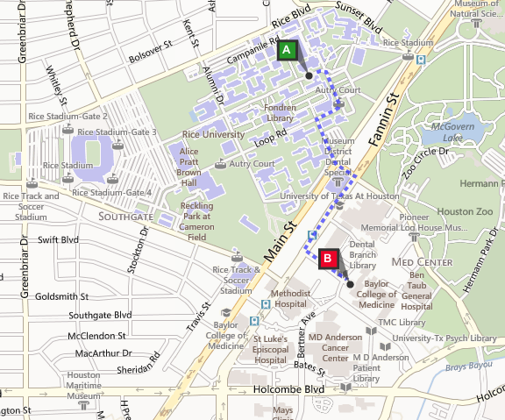
RICE UNIVERSITY
TEXAS MEDICAL
CENTER
Notes:
Rice has the privilege of being literally across the street from the Texas Medical Center, the largest med center in the world.
Along with Ashu Sabharwal and a team of undergraduate researchers, we have ongoing efforts at Rice to use this mood for assistance to psychologists and psychiatrists.
We’ve spoken to many doctors in the Texas Medical Center, and learned they have a need to fill in their incomplete information, namely, what happens inbetween therapy sessions?
It’s not that the patient is lying, but they may just not remember everything.
These researchers and doctors have reacted enthusiastically about the prospect of being able to have their patients’ track their moods between appointments and help their analysis of how they can help their patients.
There are many important challenges to using it for these types of sensitive scenarios

Slide 33
Inferred
Mood
API
Notes:
Ongoing efforts at Rice to use this mood for assitance to psychologists.
Rice has the privilege of being literally across the street from the Texas Medical Center, the largest med center in the world.
We’ve spoken to many in the Texas Medical Center, including psychologists and psychiatrists. They have a need to fill in their incomplete information, namely, what happens inbetween therapy sessions?
It’s not that the patient is lying, but they may just not remember everything.
These researchers and doctors have reacted enthusiastically about the prospect of being able to have their patients’ track their moods between appointments and help their analysis of how they can help their patients.
There are many important challenges to using it for these types of sensitive scenarios
But with thi and with other apps created by developers, moodscope will pave the way for a world of mood-enabled applications.

Slide 34
MoodScope: Sensing mood from smartphone usage patterns
Robustly (93%) detect each dimension of daily mood
On personalized models
Starts out with 66% on generalized models
Validate with 32 users x 2 months worth of data
Simple resource-friendly implementation
Notes:
MoodScope is an end-to-end system that allows a smartphone to understand the user’s mood from statically available usage data with very high accuracy.
We hope there will be many more works that will make phones and other devices truly smart through understanding user personal state.
And with this work, when you’re happy, and you know it, your smartphone will too.

Slide 35
Discriminative Features
Relevant features

Slide 36
Discriminative Features

Slide 37
TODO
Wider, longer-term evaluation
How does the model change over time?
In-use accuracy metrics
Not cross-validation
Social Factors/Impact
Study Mood-sharing
Provide assistance to psychologists

