Slide 1


Many-Antenna MU-MIMO Channels
Clayton Shepard Jian Ding Ryan Guerra Abeer Javed Lin Zhong

Slide 2

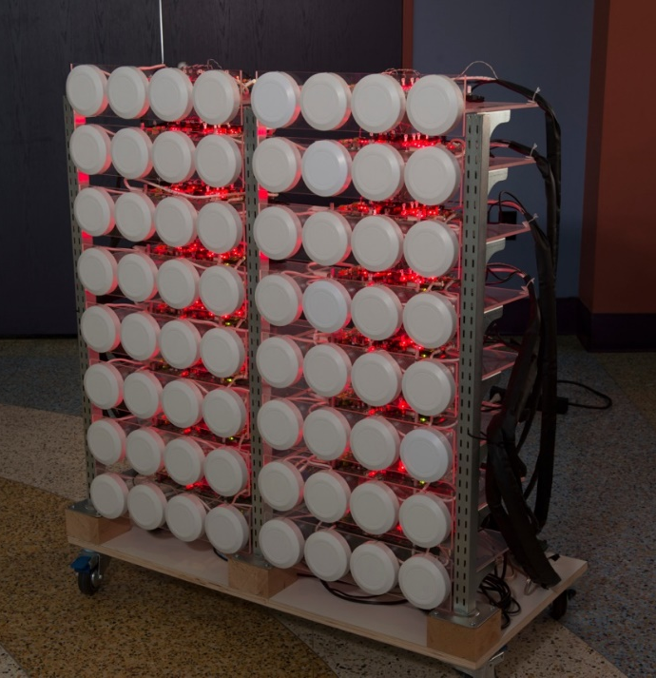
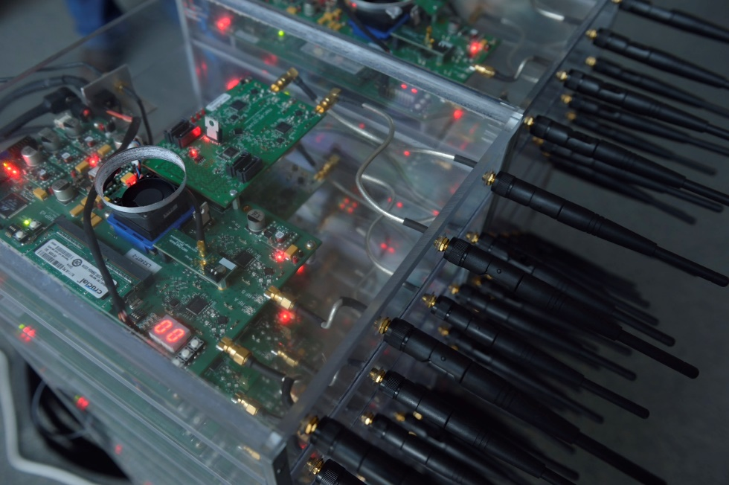
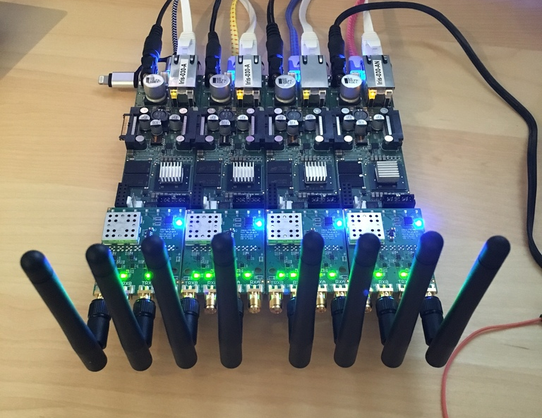


Argos | Many-Antenna MU-MIMO Systems
Notes:
I am a systems engineer – I started building Massive MIMO systems 5 years ago.
Dr. Treichler missed “massive MIMO”. Which is also just now becoming economically viable.
We say many-antenna MIMO because our results apply to everything from relatively small systems to “massive” systems

Slide 3
How do MU-MIMO channels behave?
Notes:
As a systems engineer I like being able to poke things and see how they react. I need the intuition of how channels behave, as well as realistic measurements to guide system design.

Slide 4
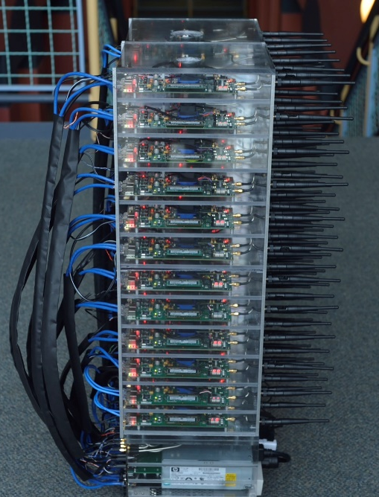
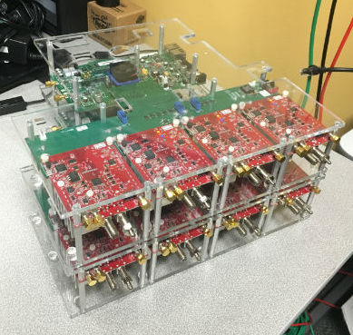
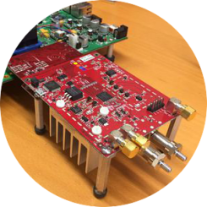
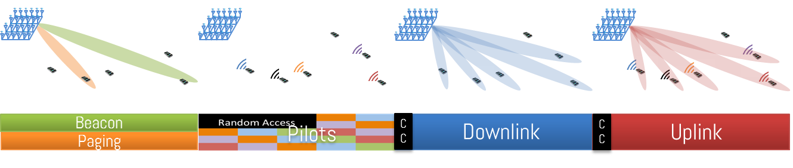
Measurement System Design
ArgosV2
Whitespace UHF Radio Card
Faros
Python
Accelerated in C
Notes:
So I built a system to measure realtime wideband MU-MIMO channels.

Slide 5

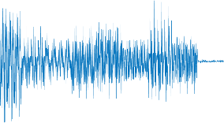
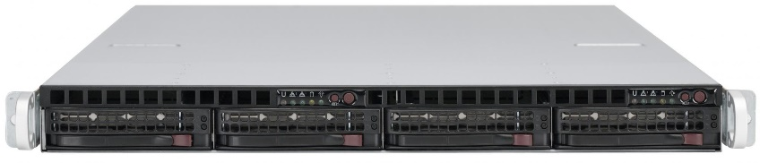
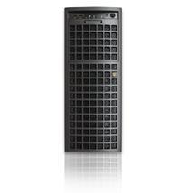

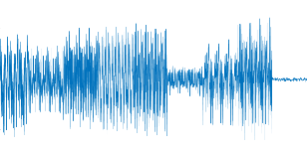
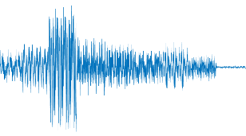
How it works
User 2
User K
User 1
…
Noise
…
IQ
Central
Controller
Notes:
The measurement system is based on a scheduled frame, and leverages the Faros mechanisms for time-frequency synchronization with the mobiles.
The base station sends a beacon, which provides the users synchronization, then they send orthogonal pilots; in this case we use TDMA to achieve orthogonality.
After the pilot phase each base station antenna reports the raw IQ samples to the central controller, which saves them.
This happens every frame (thus the frame length is the collection interval).

Slide 6
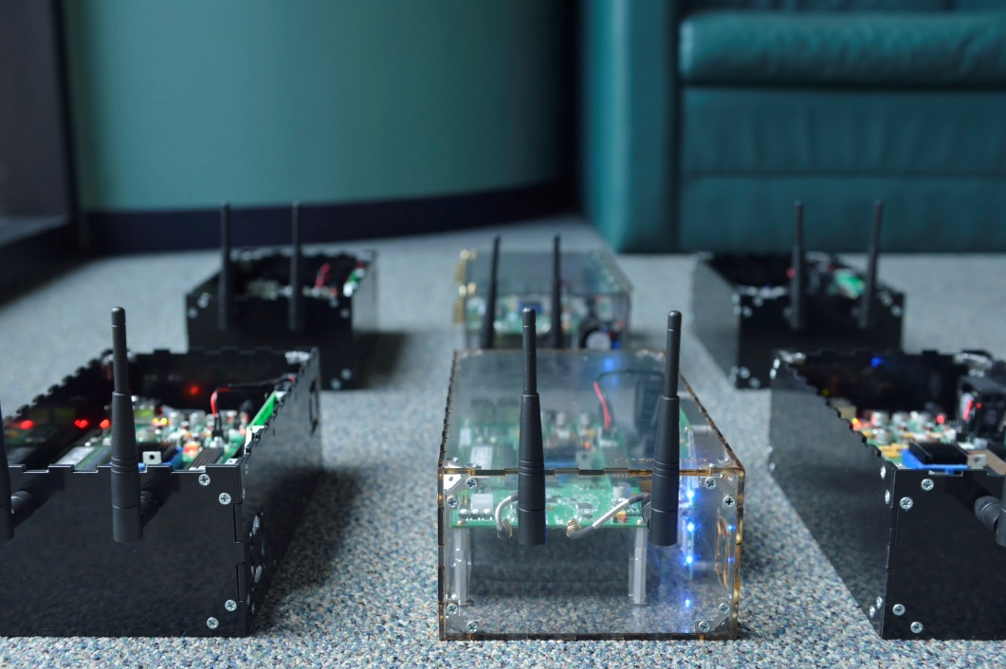
Measurement System Features
Fully wireless and mobile
Automatic Gain Control
High time-frequency resolution
20 MHz, sub-ms intervals
Single-user continuous measurement flow
Narrowband Mode
Very flexible
Very reliable
Billions of measurements without a single drop
Notes:
There are three flows: realtime wideband, narrowband, and single-user continuous. The realtime wideband can achieve sub-ms time resolution at 20 MHz for a few users, and sub-2ms time resolution for 8 users. The narrowband mode can support hundreds of users at sub-ms resolution. The continuous mode supports 1 user and buffers continuous IQ samples to memory on the WARP, and thus is limited to a few seconds of estimation.

Slide 7
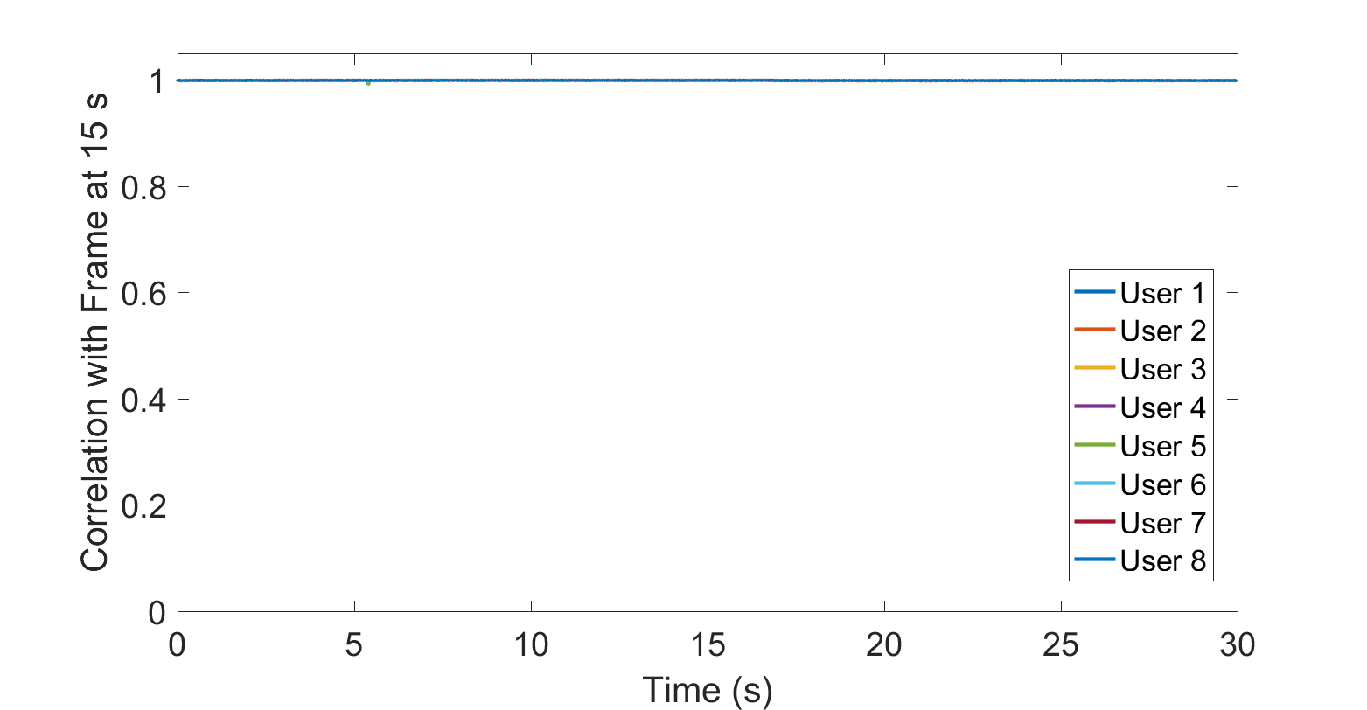
Highly Accurate and Reliable
Outdoor 96x8 5 GHz Correlation with 1 Frame
Frame
Notes:
This is not a straight line – it is the correlation of over 10 million measurements (15,000 96x8) taken in 30 seconds. No dropouts, no fluctuations. Yes, this is how stable stationary channels are in the real world.
This is also a sanity check – it indicates everything is functioning properly, including time-frequency sync across BS antennas and mobiles

Slide 8
Measurement Campaign
2. 4 and 5 GHz at 96x8
UHF at 8x6
Indoor LOS/NLOS, Outdoor LOS
Static, Environmental Mobility, Mobile, Controlled Track, Longitudinal
Fully Mobile!
Notes:
Environmental mobility: things in the environment (e.g. people) are moving
Mobile: the devices themselves are moving
Controlled Track: Linear motor-controlled track with constant speed
Longitudinal: 10+ minutes in real-world office environment

Slide 9
Measurement Campaign Scale
Over 100 scenarios
Over 10 locations
Over 1 billion channel measurements
Over 1 terabyte of data

Slide 10

Notes:
Outdoor Environment

Slide 11
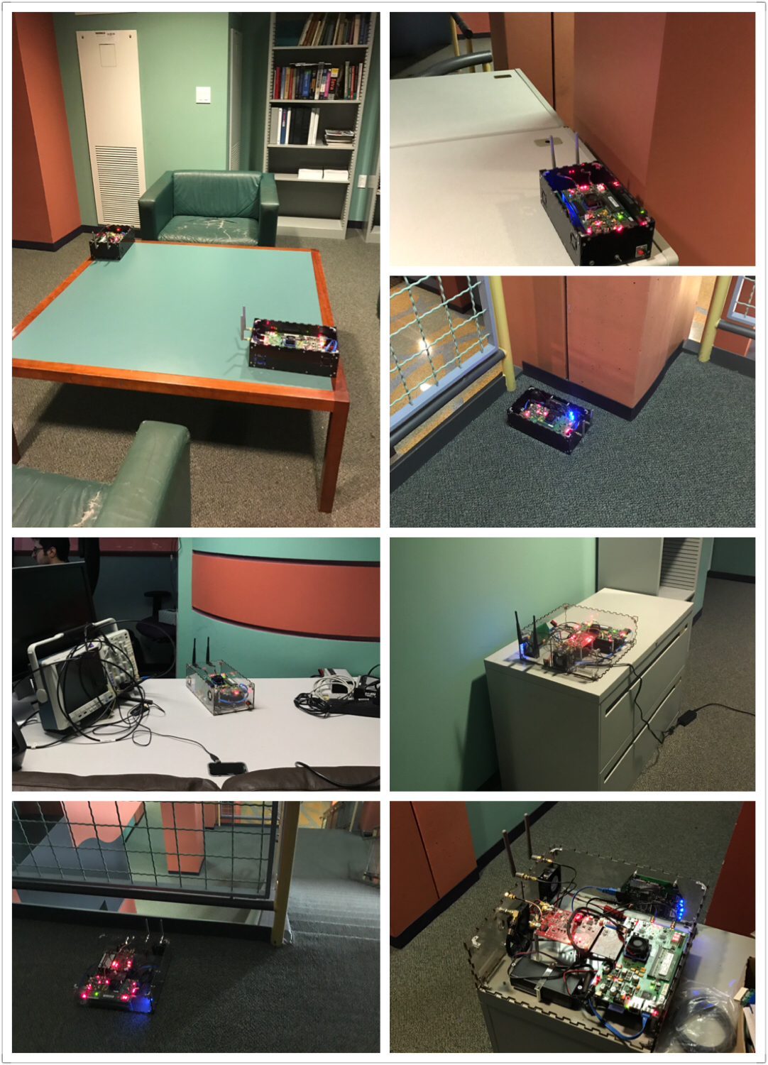
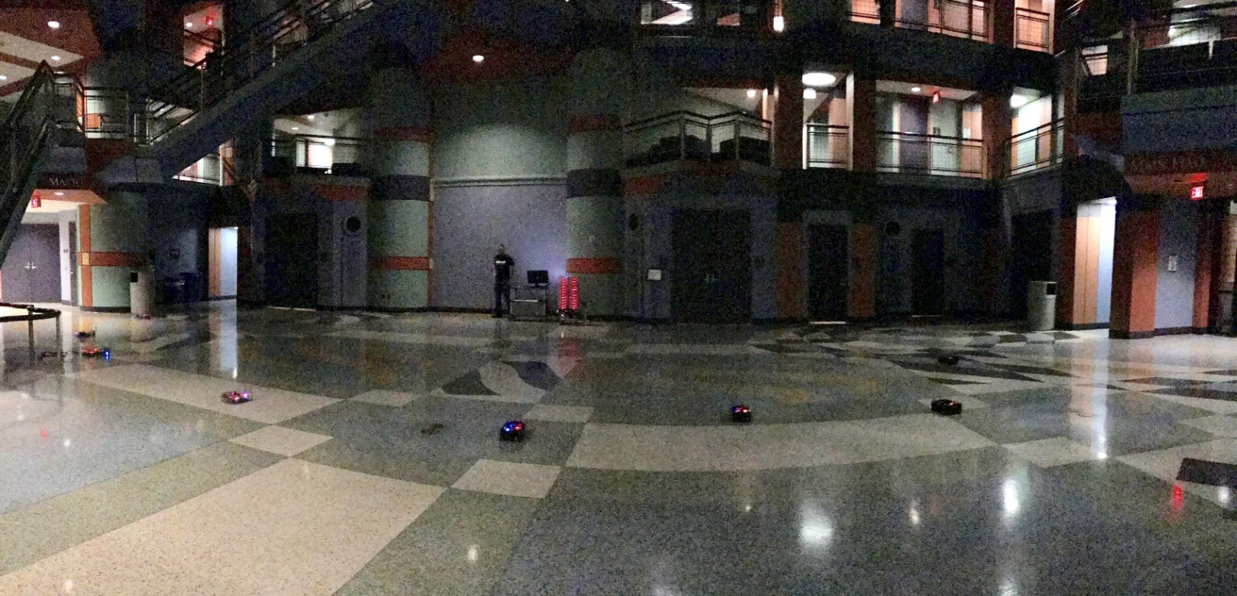
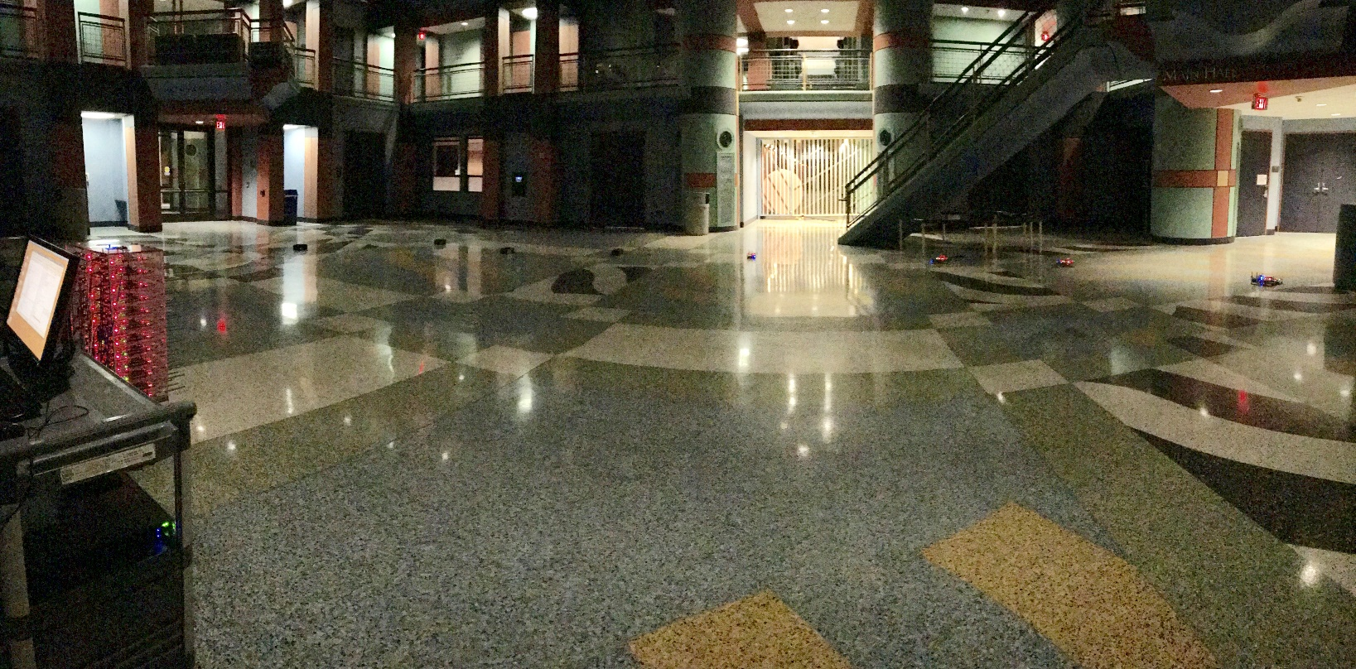
Notes:
Indoor NLOS (left) and LOS (right)

Slide 12
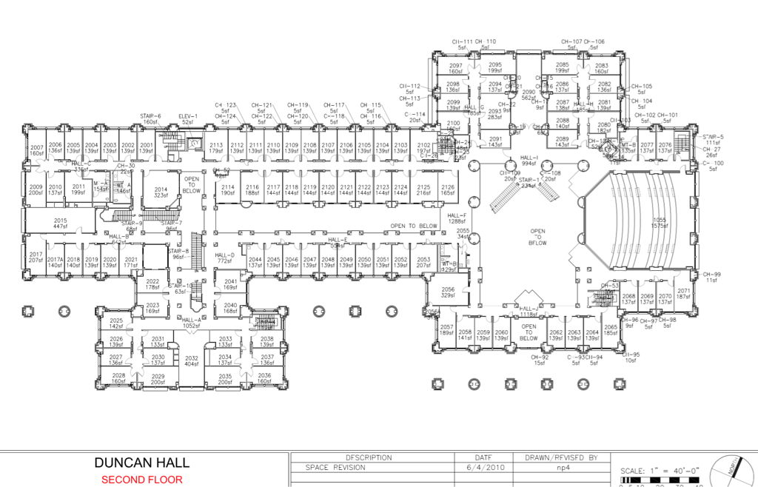
Base Station Locations
User Locations
4
1
2
8
3
6
12
Notes:
Example of NLOS environment. Two more users are upstairs.

Slide 13
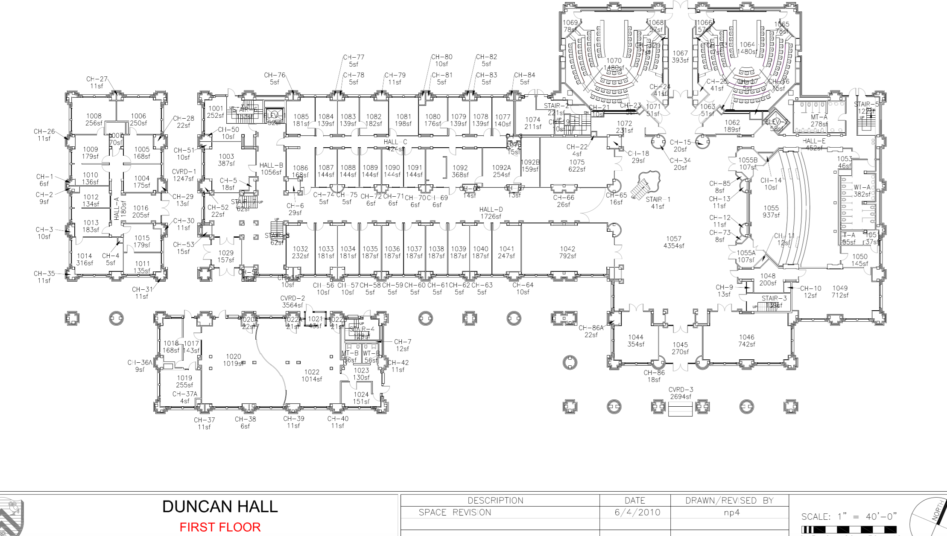
Base Station Locations
User Locations
8
7
6
5
4
3
2
1
13
Notes:
Example of indoor NLOS

Slide 14
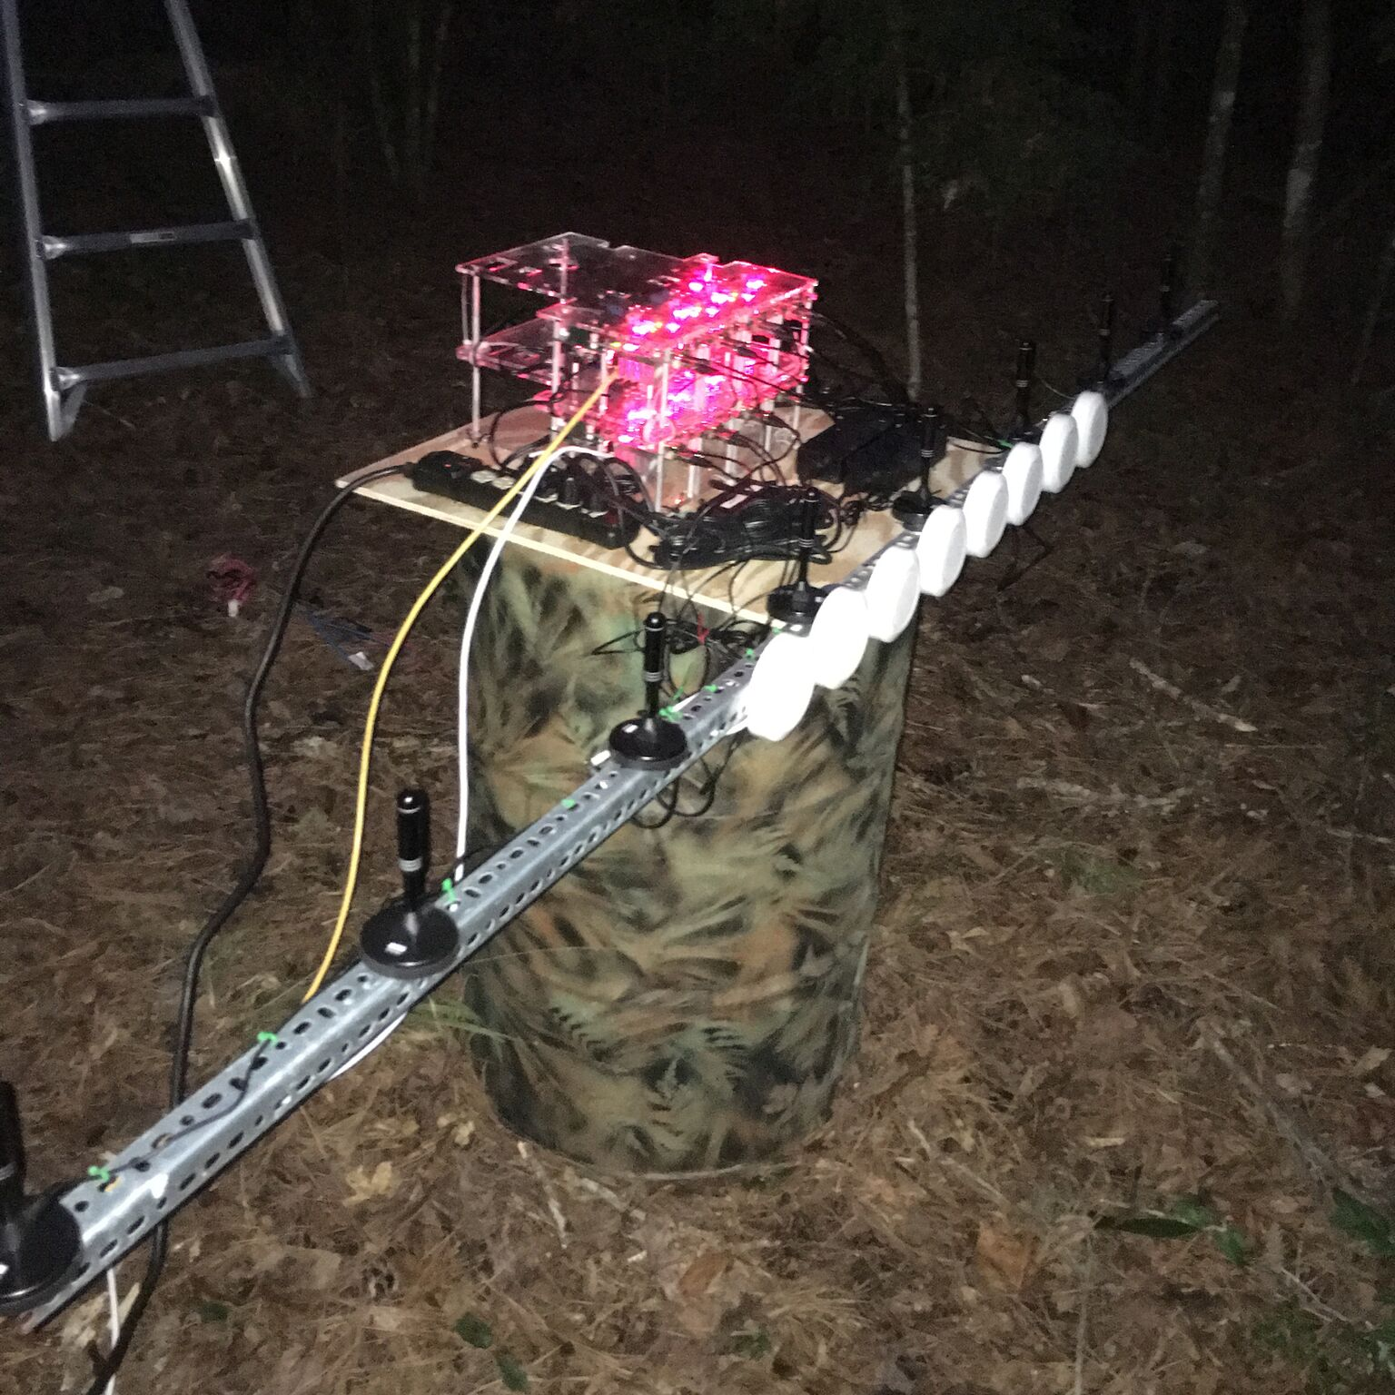
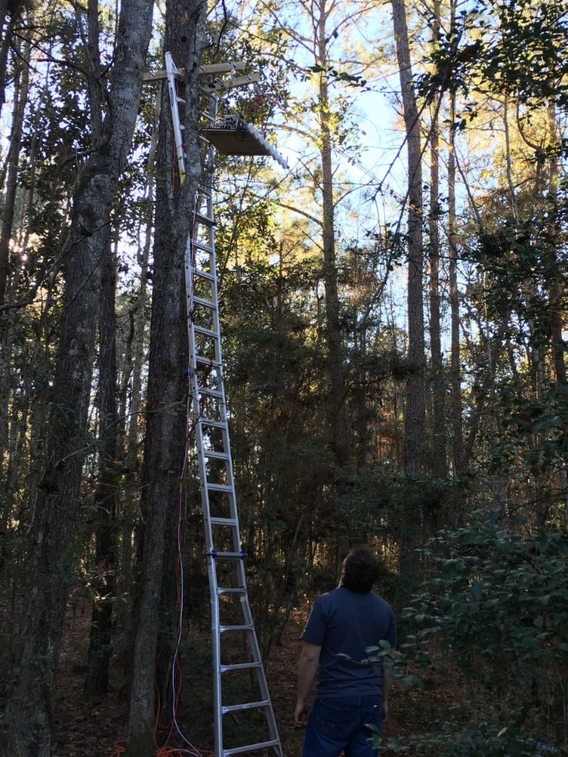
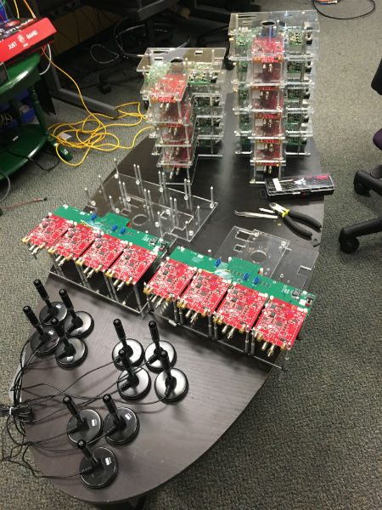
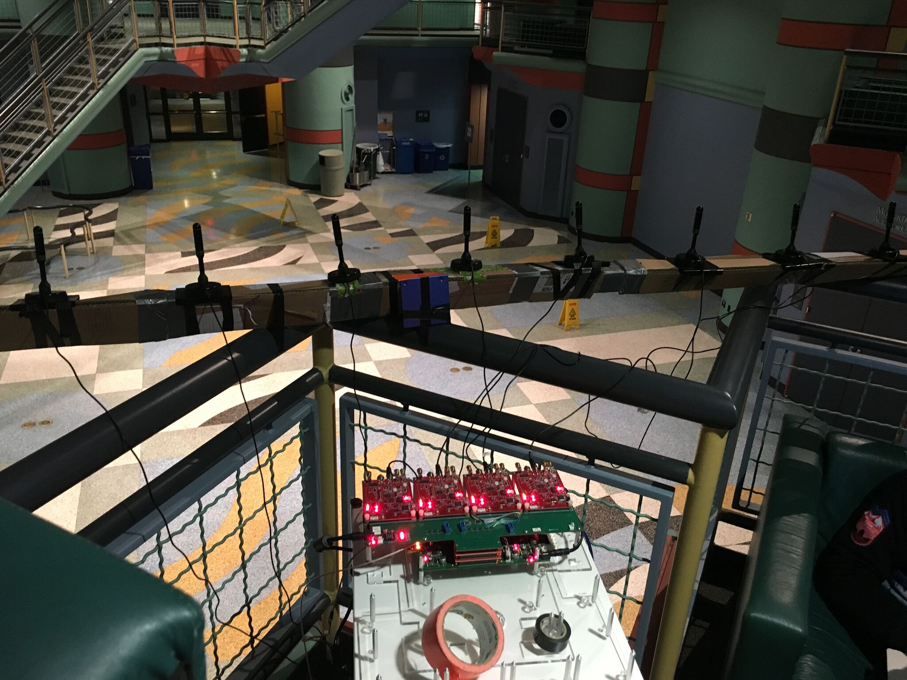
Notes:
UHF Measurements setup, including outdoor wooded area

Slide 15
Results
Many intuitive, but provide baseline for systems
Coherence is not a good metric for systems
Coherence time =/= required channel resounding interval!
Mobility is a significant challenge to many-antenna MU-MIMO
Notes:
Coherence doesn’t rely on beamforming technique, noise, etc. Good for theoretical analysis.
Lots of other insights/confirmations, but would be distracting

Slide 16
Metrics: Correlation, Coherence , Capacity
Correlation:
Coherence:
Capacity:
Notes:
Averaged over every subcarrier!
Capacity of total system is sum of per user.
ZF or MMSE

Slide 17
Stationary Channels are Long-Term Stable
Outdoor 96x8 5 GHz Correlation with 1 point
Notes:
While this should be intuitive, it does differ from some previous results.

Slide 18
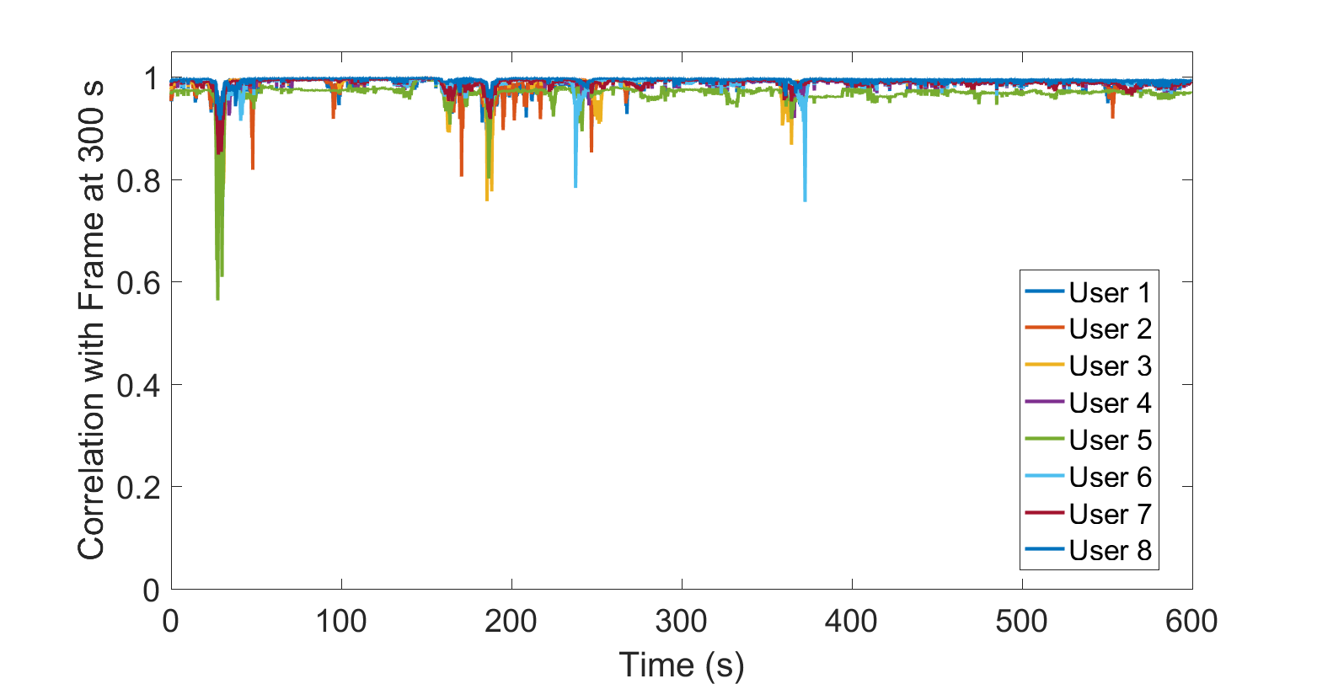
Environmental Movement Has Low Impact
Indoor NLOS 96x8 2. 4 GHz Correlation with 1 point
Frame
10 minutes!
Notes:
Longitudinal results: this is done in an office environment during the day with people moving around.

Slide 19
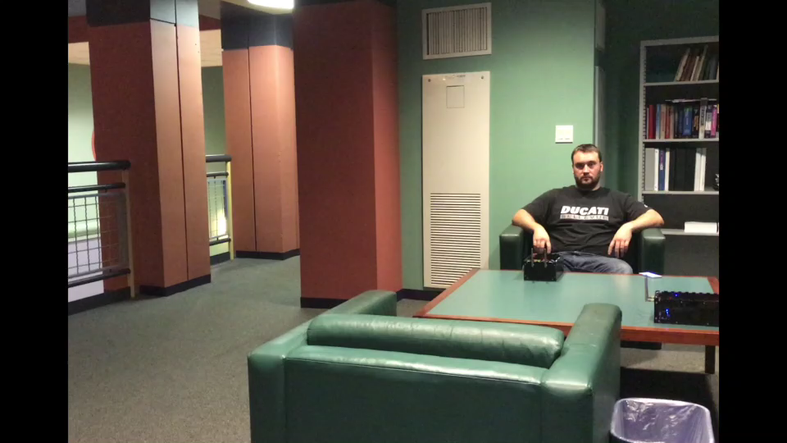
Realtime Capacity of Natural Scenario
Zeroforcing
Conjugate
NLOS 96x8 5 GHz 10 ms Frame
Notes:
MCS has to be set to lowest rate to avoid drop
Mobility is bimodal
Mobility drastically affects channel capacity

Slide 20
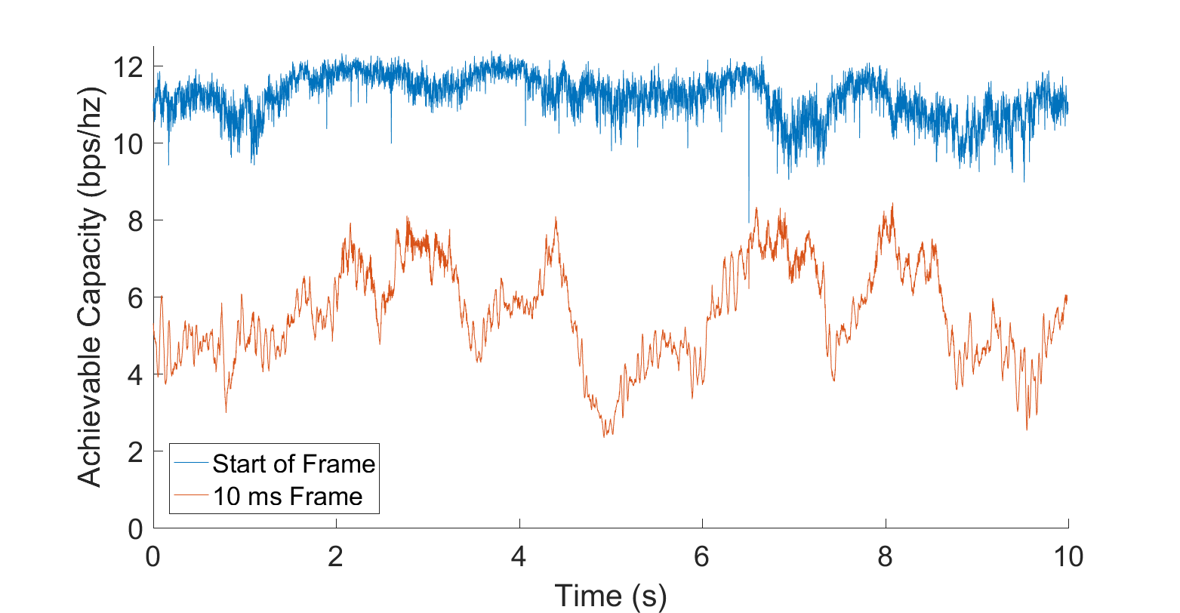
Mobility Significantly Degrades Capacity
NLOS 96x8 2. 4 GHz Capacity of Mobile User
50% Avg. Loss!

Slide 21
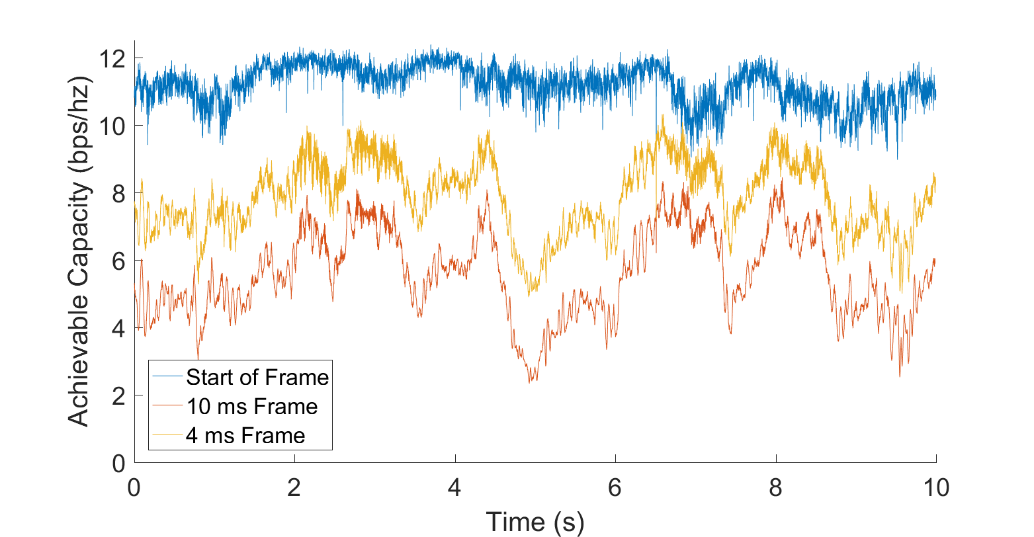
Collecting CSI Faster Helps…
NLOS 96x8 2. 4 GHz Capacity of Mobile User

Slide 22
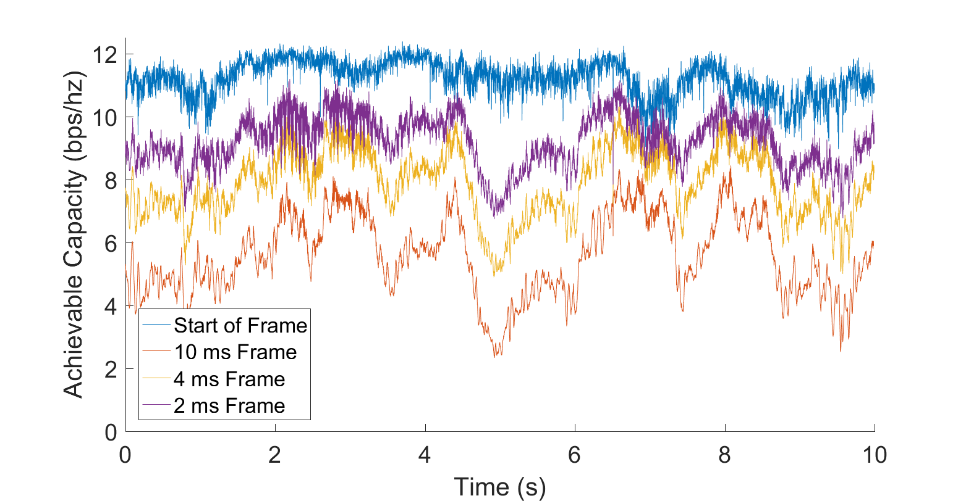
Still Significant Challenge
NLOS 96x8 2. 4 GHz Capacity of Mobile User
45% Loss!
Notes:
Still requires conservative selection of MCS

Slide 23
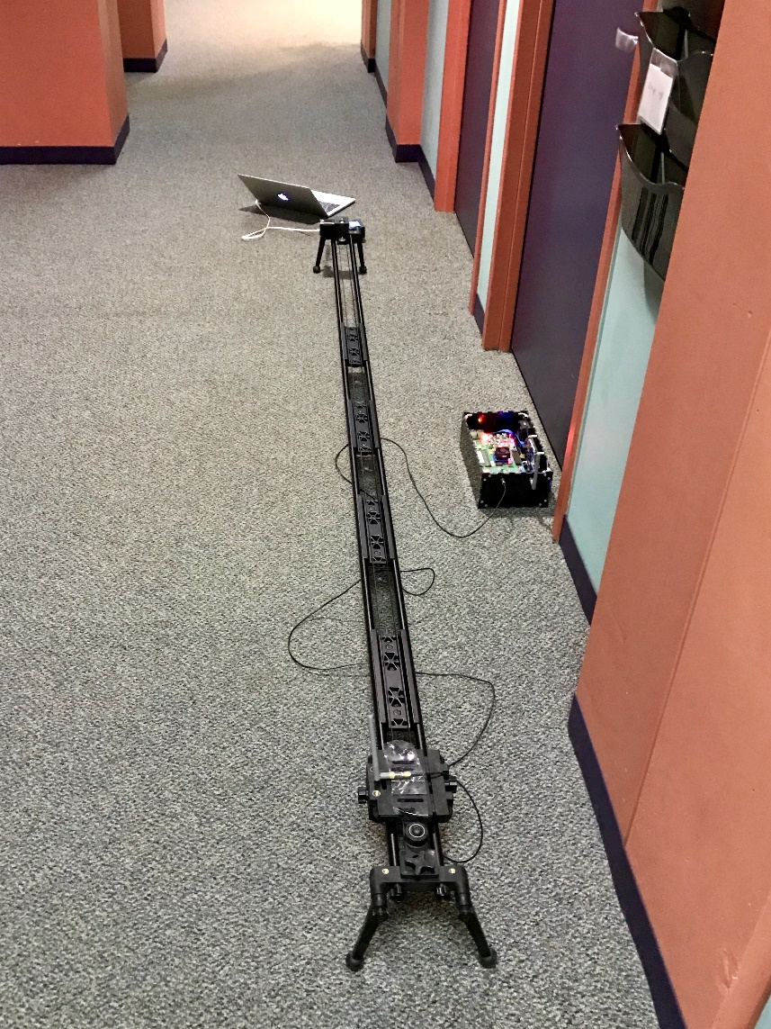
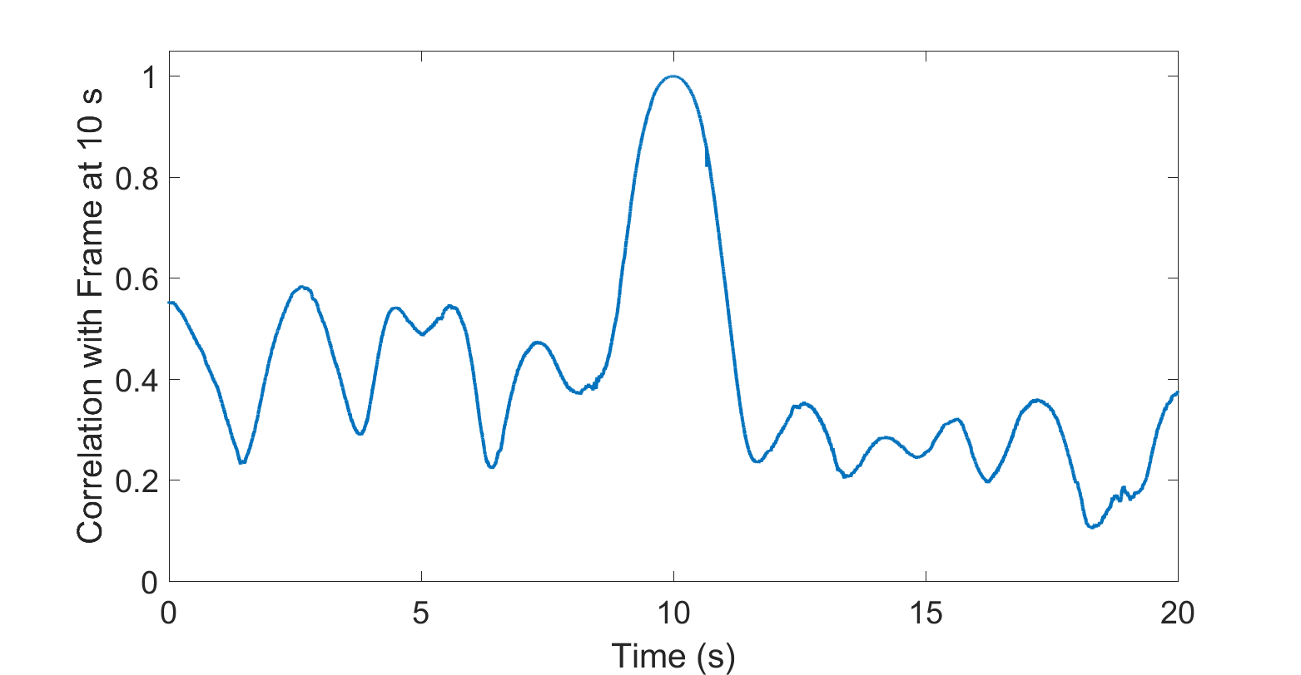
Controlled Track: Correlation
NLOS 96 BS Ant. 2. 4 GHz
~ 4.6 cm/s
0 cm
92 cm
Notes:
Both with and without shared clock.
Analagous to a beam pattern
NLOS creates assymetry

Slide 24
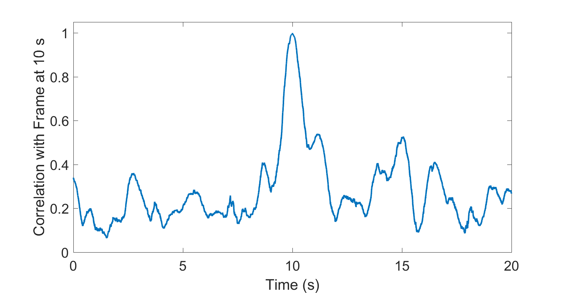
Controlled Track: Correlation
NLOS 96 BS Ant. 5 GHz
~ 4.6 cm/s
0 cm
92 cm
Notes:
Both with and without shared clock.
Analagous to a beam pattern
NLOS creates asymmetry
2.4 GHz was at half-wavelength spacing, 5 GHz is at full wavelength, so we have narrower beam

Slide 25
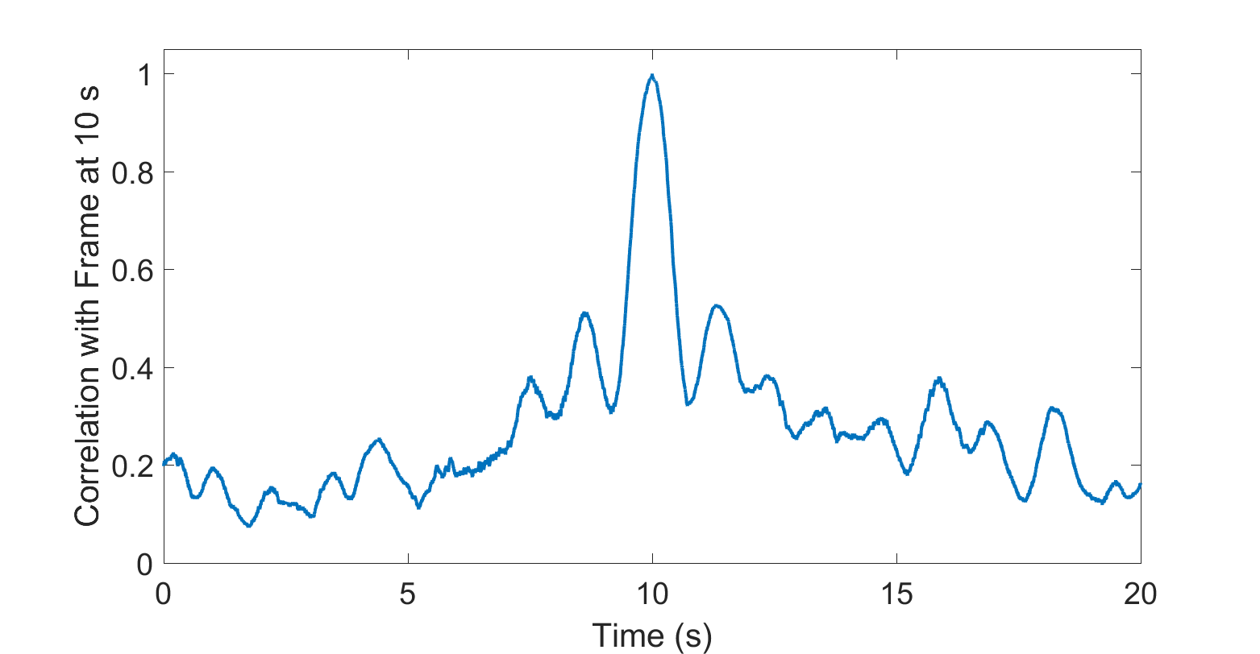
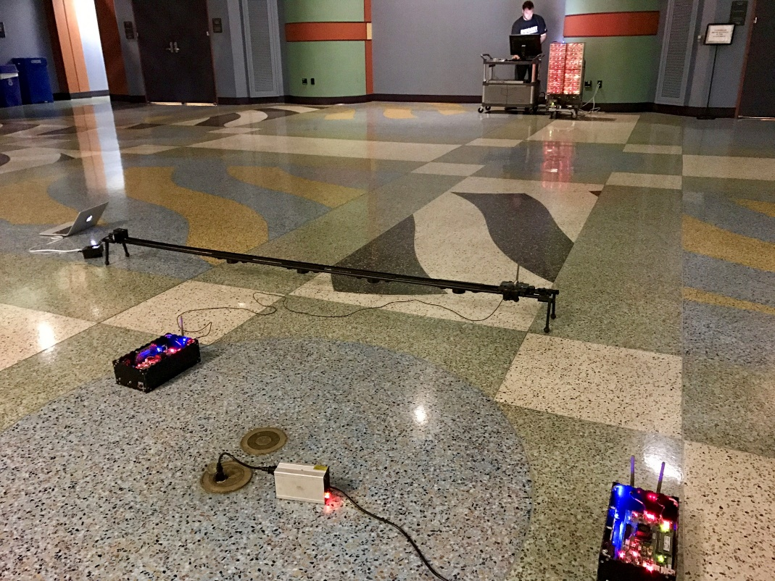
Controlled Track: Correlation
LOS 96 BS Ant. 5 GHz
~ 4.6 cm/s
0 cm
92 cm
Notes:
LOS more symmetric

Slide 26
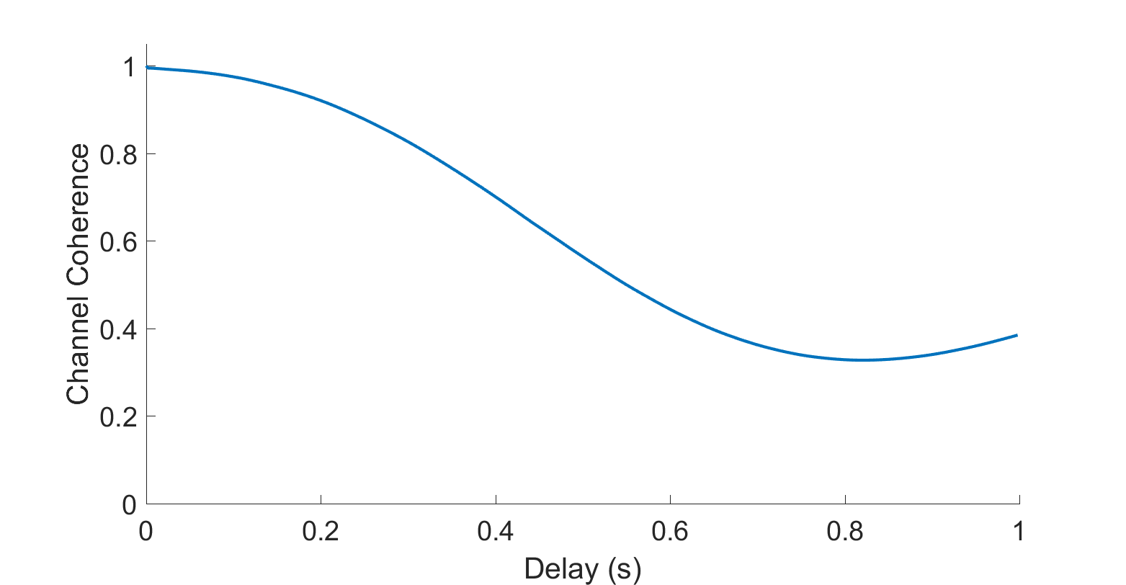
Controlled Track: Coherence
LOS 96 BS Ant. 5 GHz
~ 4.6 cm/s
Notes:
Coherence shows sidelobe

Slide 27
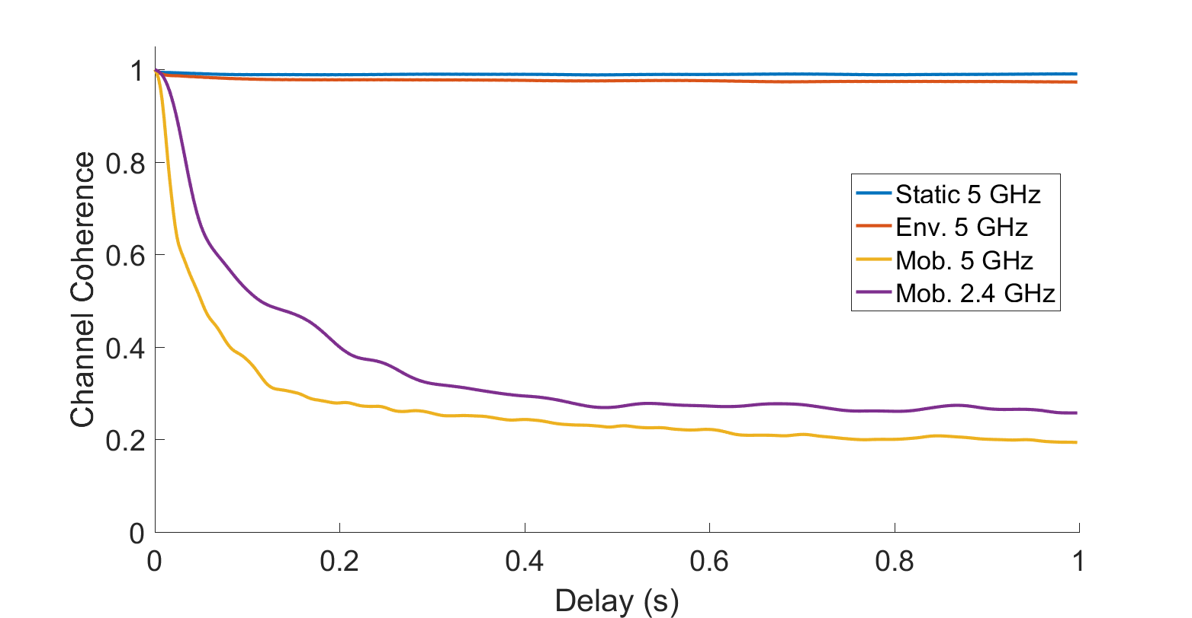
Channel Coherence
96x8 NLOS
Notes:
Static and Env have long-term coherence. Mobile drops immediately.

Slide 28
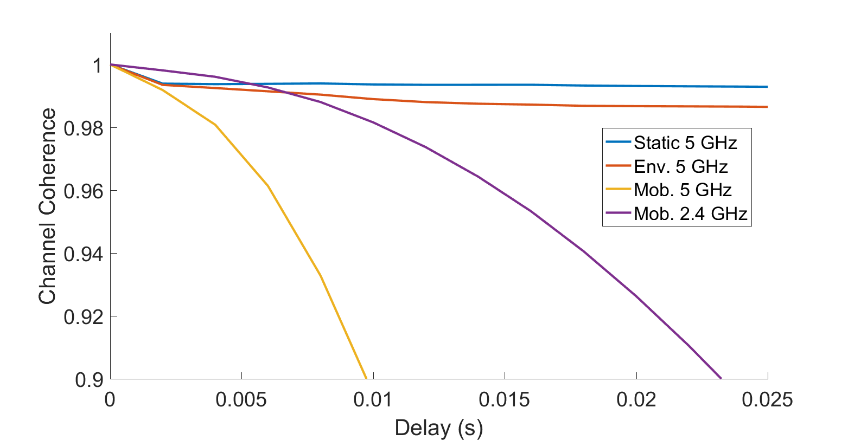
Channel Coherence
96x8 NLOS
~7 ms
~16 ms
~9.5 ms
~23 ms
Notes:
Coherence time, typically a threshold, e.g. .95 or .90, of the channel coherence.
Note these are just with pedestrian mobility!

Slide 29
What about UHF?

Slide 30
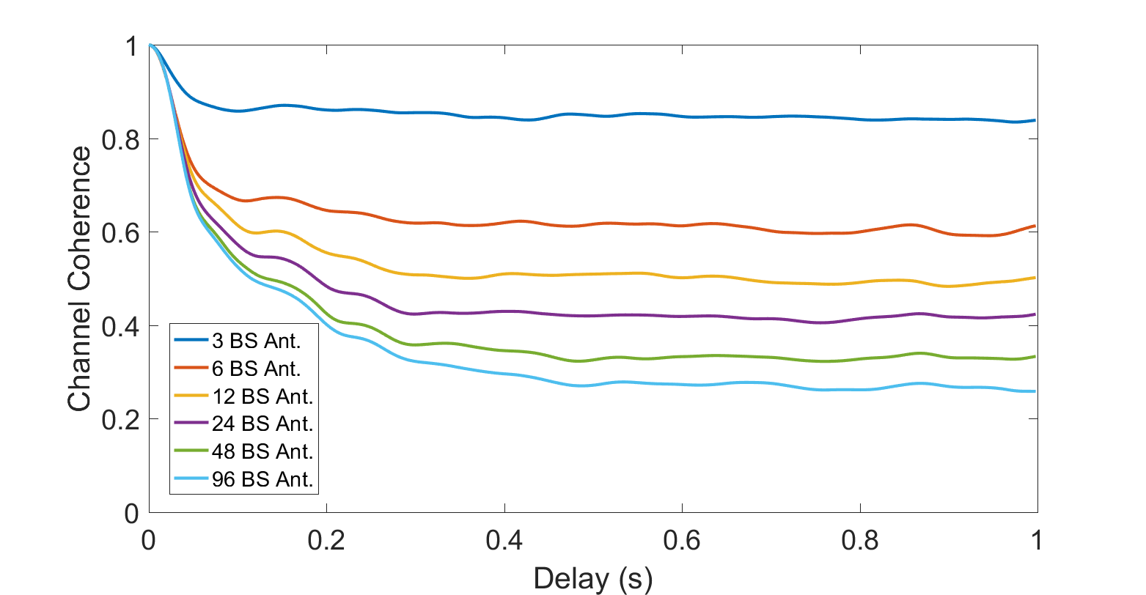
Scaling up Reduces Channel Coherence
96x8 2. 4 GHz NLOS
Notes:
It’s unfair to compare an 8 antenna system with a 96 antenna system because coherence drops with # of BS antennas.

Slide 31
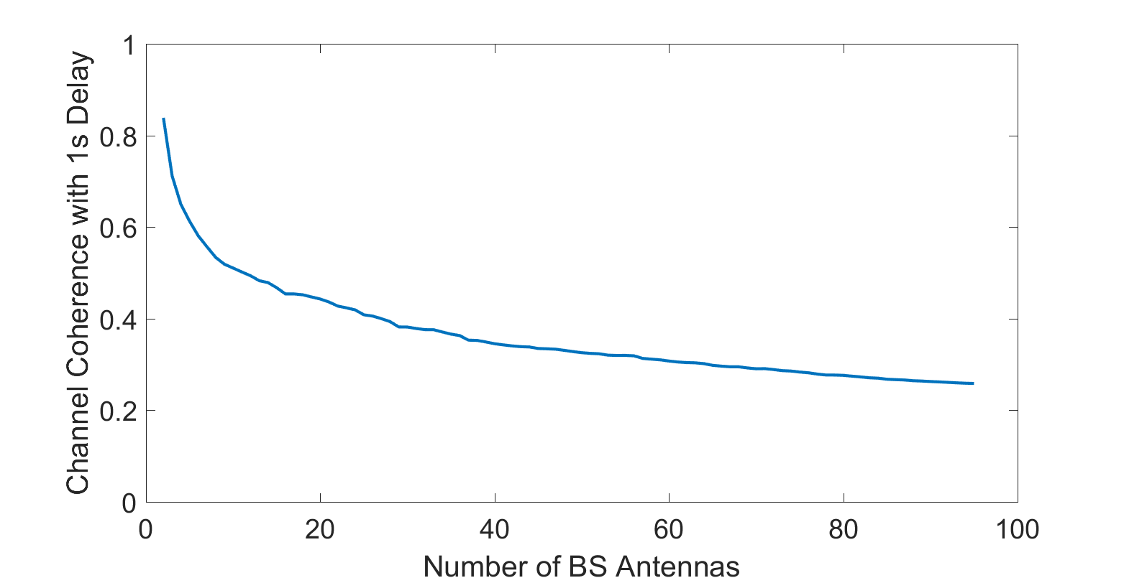
Scaling up Reduces Channel Coherence
96x8 2. 4 GHz NLOS
Notes:
It’s unfair to compare an 8 antenna system with a 96 antenna system because coherence drops with # of BS antennas.
This is mathematically expected.

Slide 32
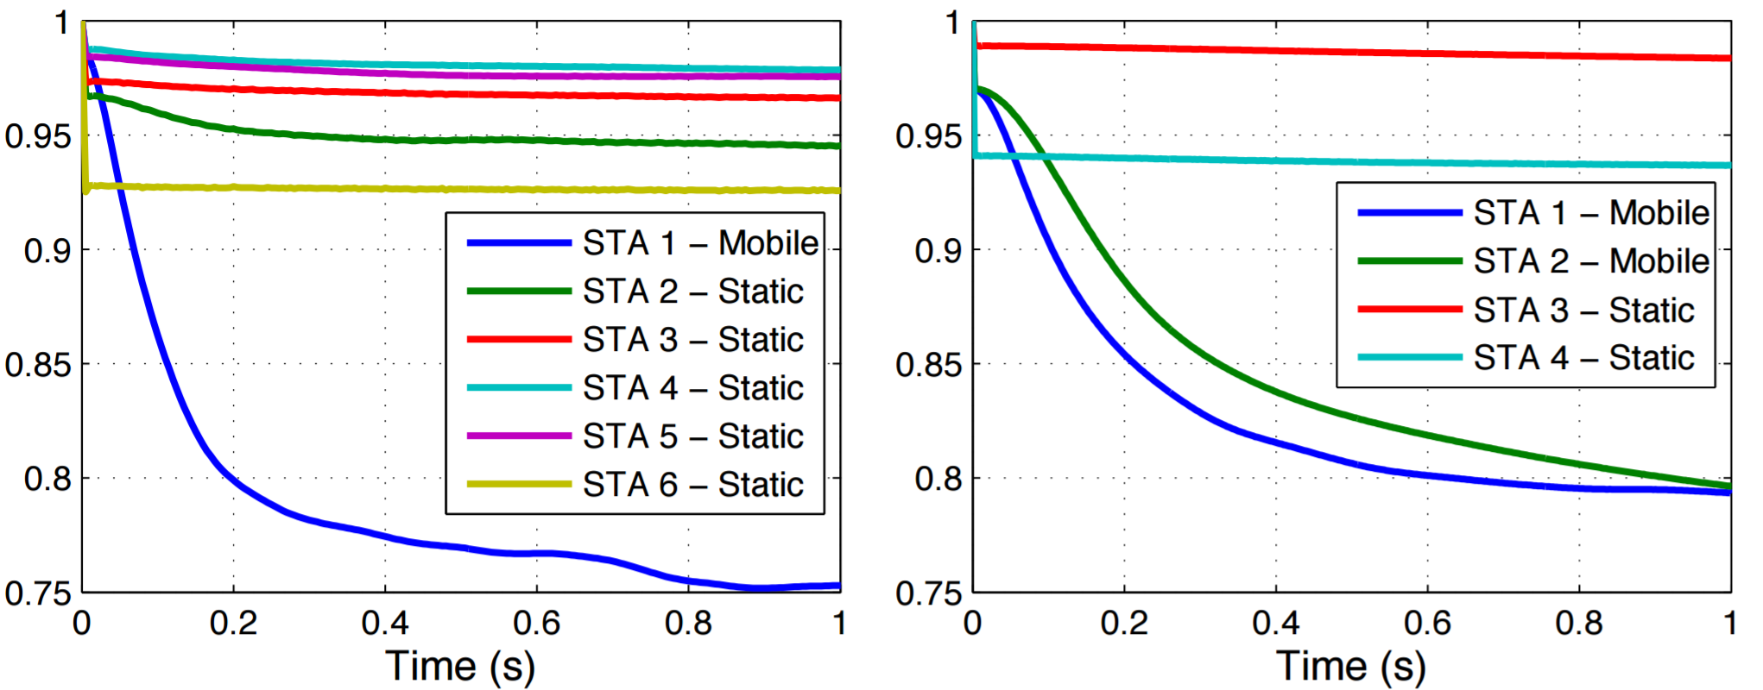
Channel Coherence of UHF
8 BS Antennas, 563 MHz
Noise!
Channel Coherence
Indoor NLOS
Outdoor (Trees)
Notes:
UHF plots look similar to 2.4/5 GHz – nothing unexpected. Still coherence times on the order of 10s of ms.
Note that gaps in correlation/coherence are caused by noise, which isn’t correlated across time. The UHF channels in Houston are very noisy, and UHF was taken at much longer range.

Slide 33
Coherence not a good metric!

Slide 34
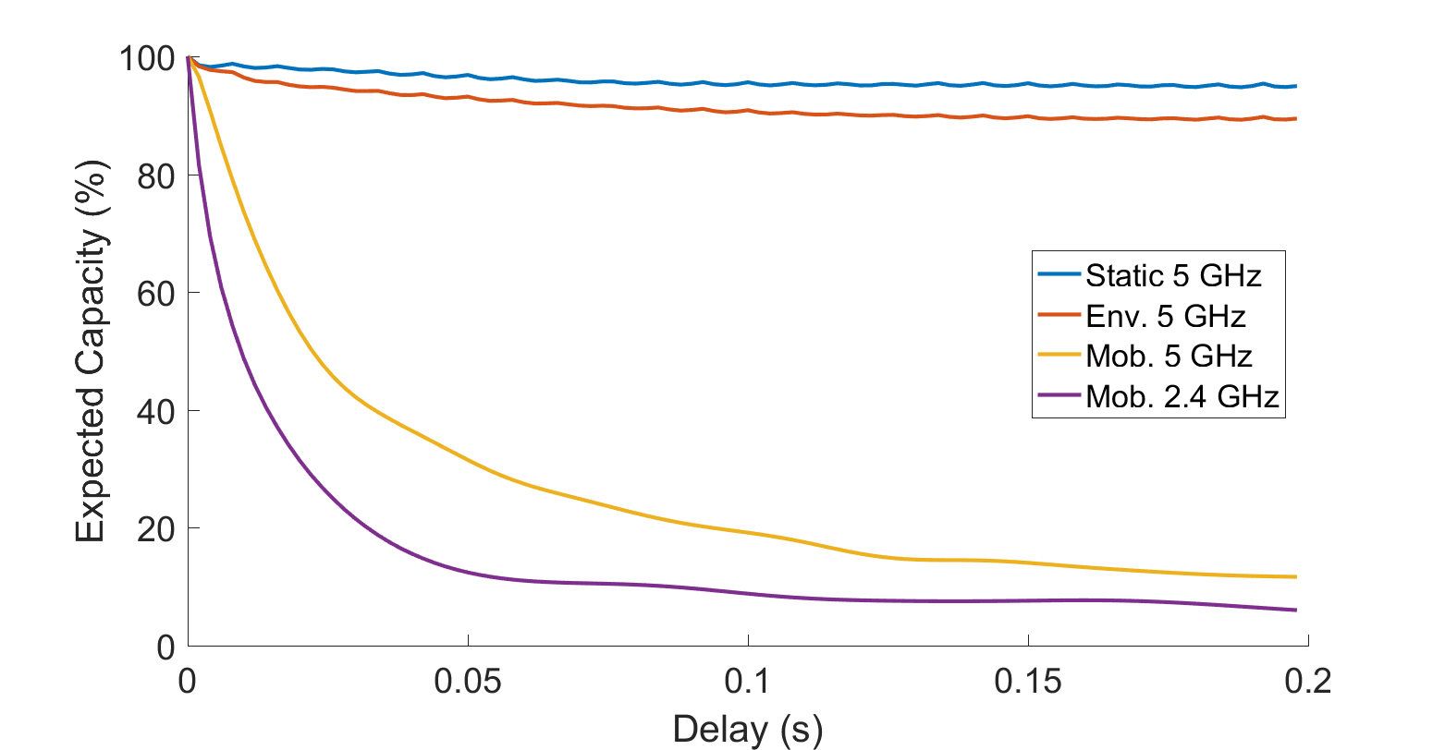
Expected Capacity
Zeroforcing 96x8 for Mobile User
Notes:
Just like we can look at coherence (expected correlation) we can look at expected capacity. It looks very similar to coherence, but drops much quicker (and larger gap between static and env).

Slide 35
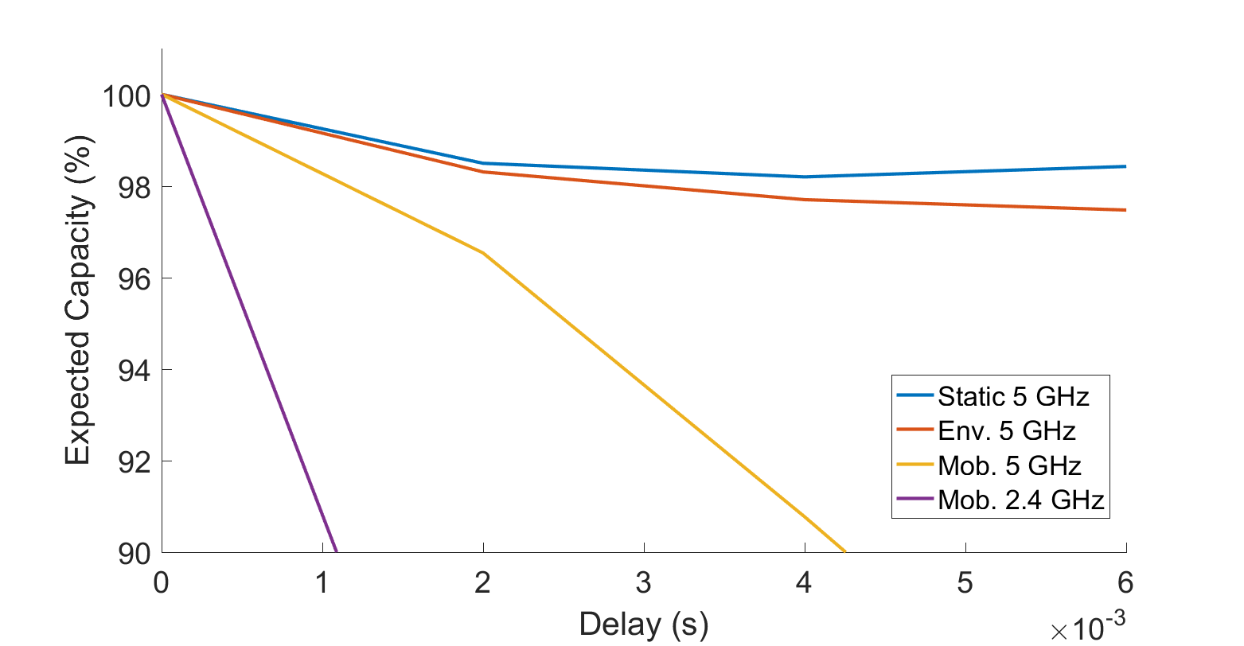
Expected Capacity
Zeroforcing 96x8 for Mobile User
~0.5 ms
~2.6 ms
~4.2 ms
~1.1 ms
2. 4 GHz?
Notes:
We see much shorter required resounding intervals than indicated by coherence time.
Why is 2.4 GHz below 5 GHz? This actually illustrates exactly why expected capacity is not necessarily a good metric -- it heavily relies on scenario: beamformer, noise, interference, user orthogonality, etc. A higher channel capacity also results in more instability, which is what is happening here – the 2.4 GHz scenario actually had a higher channel capacity, and thus dropped faster.

Slide 36
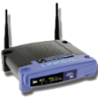
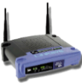
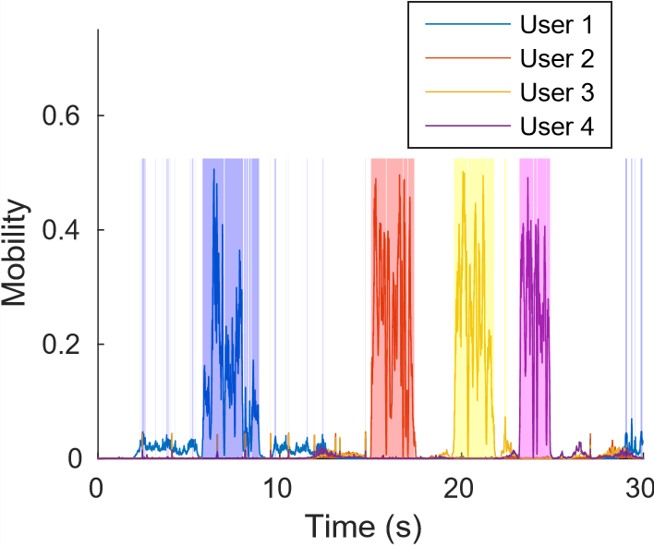

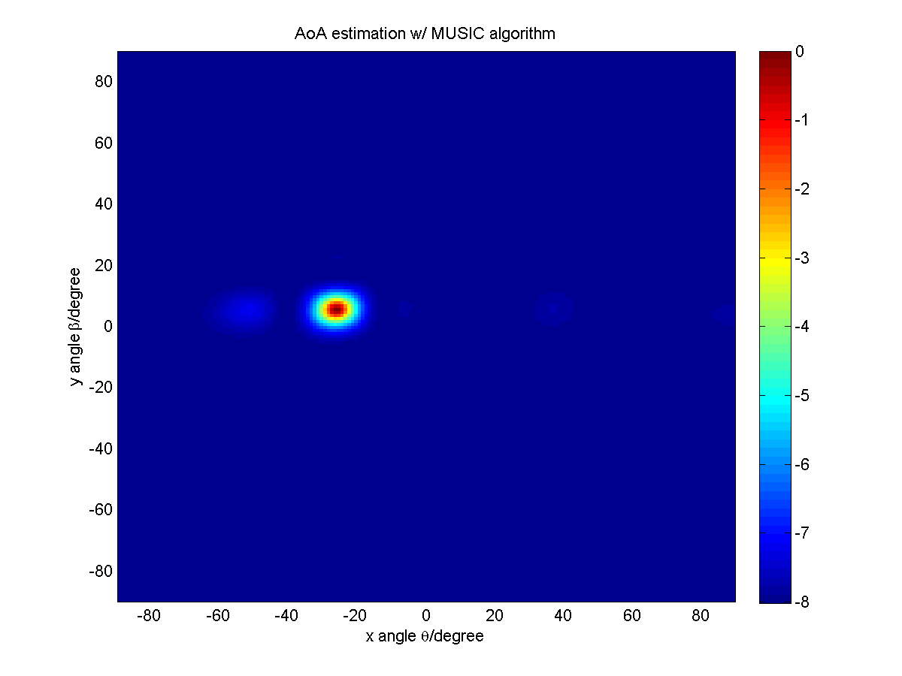
Developing Next-Gen Wireless Systems
Opportunistic CSI Collection
Mobility Detection
Channel Predictability
Angle-of-Arrival
Notes:
Platform for Innovation guiding next generation wireless systems
These are just some of the projects already leveraging these measurements, and we hope that they will be a beneficial resource to the community.

Slide 37
Everything is released online!
http://data.projectargos.org
Notes:
Clean, well documented – maps photos, videos.
Includes measurements, analysis toolbox, and measurement system.

Slide 38




Thank You!
Jian Ding
Abeer Javed
Ryan Guerra
Lin Zhong
Rahman Doost-Mohammady
Josh Blum
Notes:
Thanks to my co-authors, as well as some others who helped with the measurements.

Slide 39
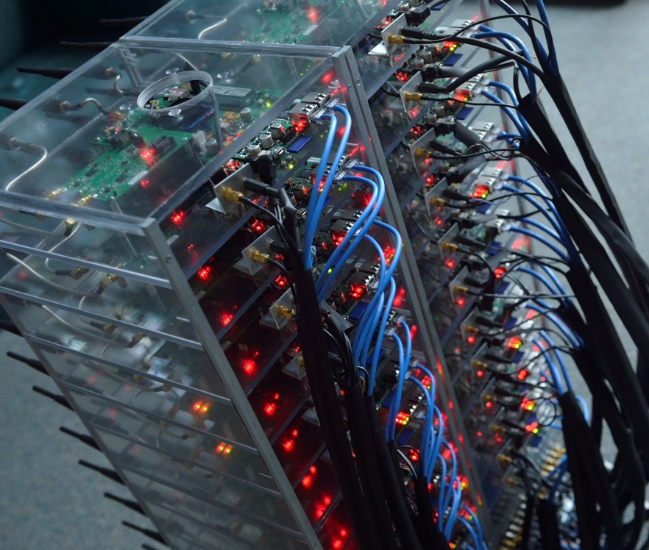
Recap
Realtime wideband channel measurement system
Multiple frequencies
Extensive measurement campaign
Varying mobility and propagation environments
Characterized impact of mobility
Significant design challenge

Slide 40
