Slide 1


ArgosNet A Multi-Cell Many-Antenna MU-MIMO Platform
Clayton Shepard Rahman Doost-Mohammady Jian Ding Ryan Guerra Lin Zhong

Slide 2
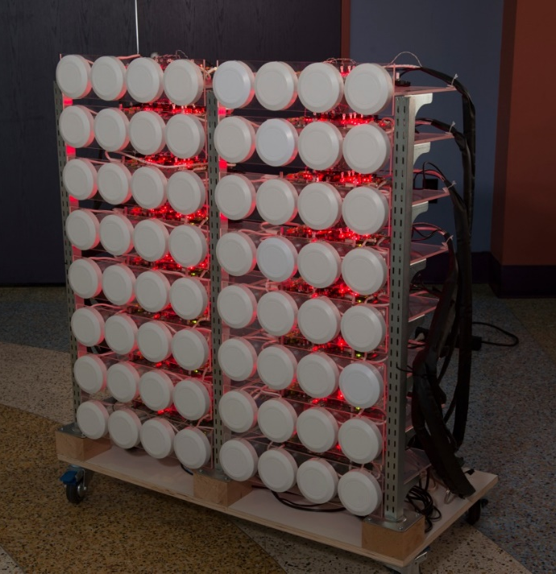
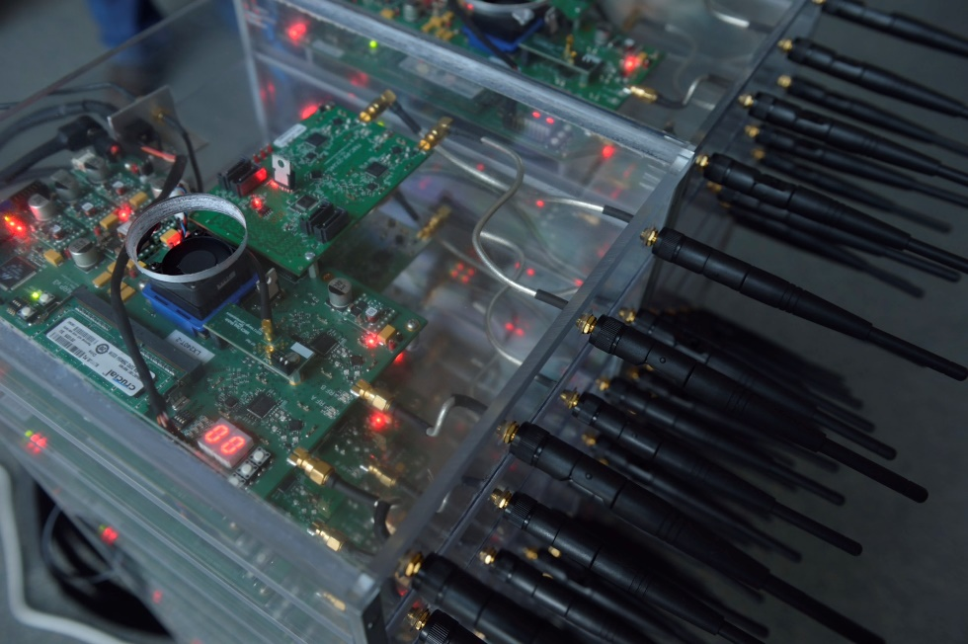
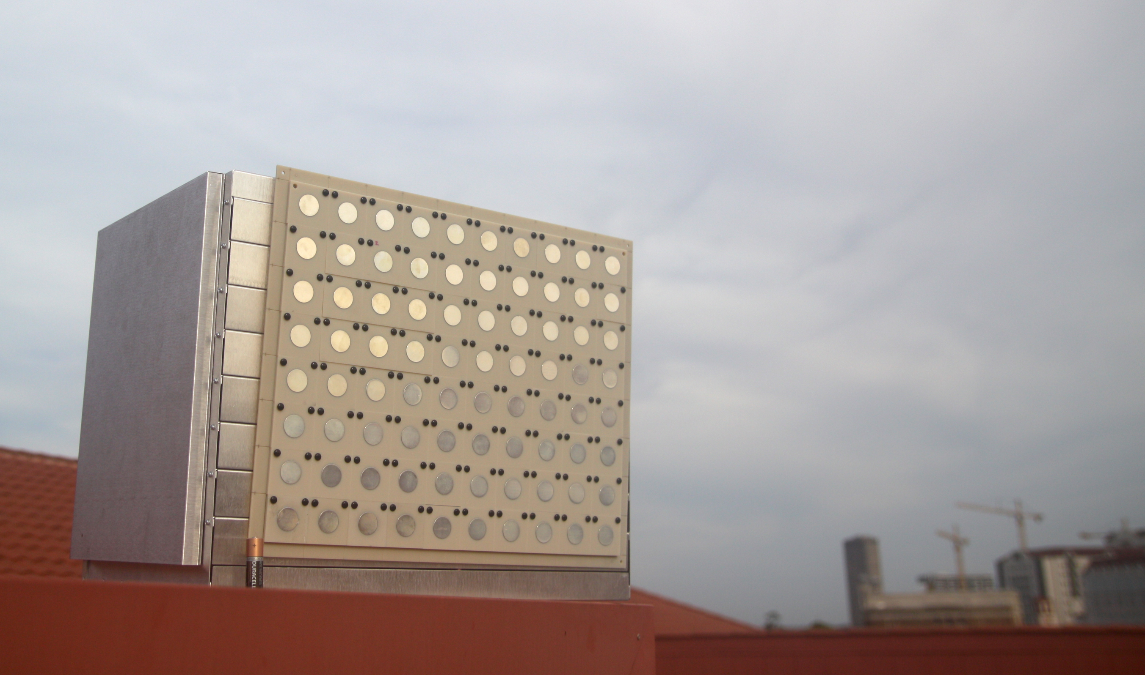

Argos Many-Antenna MU-MIMO Platforms
Notes:
I am a systems engineer – I started building Massive MIMO systems 5 years ago.
Dr. Treichler missed “massive MIMO”. Which is also just now becoming economically viable.
We say many-antenna MIMO because our results apply to everything from relatively small systems to “massive” systems

Slide 3
ArgosV3 An Efficient Many-Antenna Platform
Notes:
And scalable physical design

Slide 4
Argos Base Station Architecture
Central Controller
Data Backhaul
…
Argos Hub
Argos Hub
Argos Hub
…
Module
Module
Module
Module
Module
…
…
Module
Radio
Radio
Radio
Notes:
Modular
Daisy-chainable
1 or more radios
Hierarchal
Increases Reliability
Constrains Latency
Cost-effective
Replace figure w/ paper veresion?
Need a lot more here – present central controller, explain hub, etc.
Scalable in 4 directions:
# of Radios per Module
# of Modules per Chain
# of ports per Hub
# of Hubs (and levels)
Reliable
Branches can fail without affecting other branches
Central hubs can be easily made redundant
Accommodates linear pre-coding
Add samples together at every junction

Slide 5
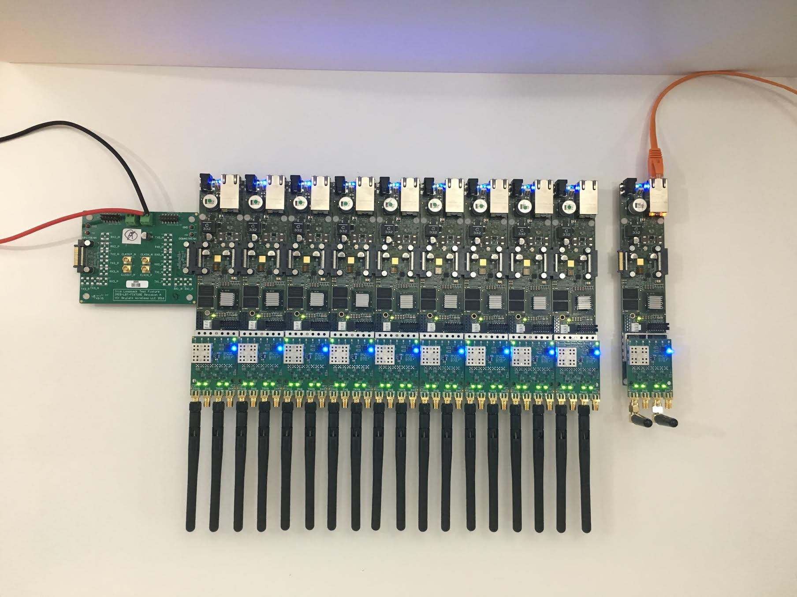

Slide 6
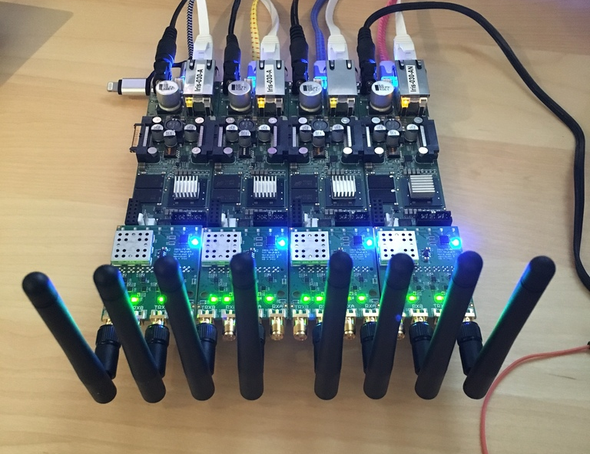
ArgosV3 Iris Radio Modules
Lime LMS7002
  2x 50 MHz to 3.8 GHz
  58 MHz Bandwidth
Modular RF Frontend
Xilinx Zynq 7030
PoE
Large-Array Support

Slide 7
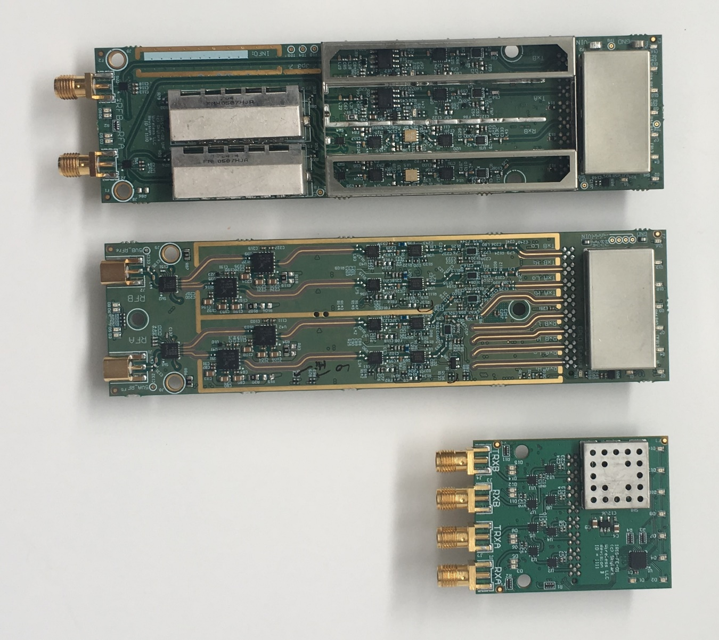
Iris RF Frontends
UHF
  470 to 700 MHz
  30 dBm
BRS/CBRS
  2. 48 to 2.7 and 3.55 to 3.7 GHz
  28 dBm
Development

Slide 8
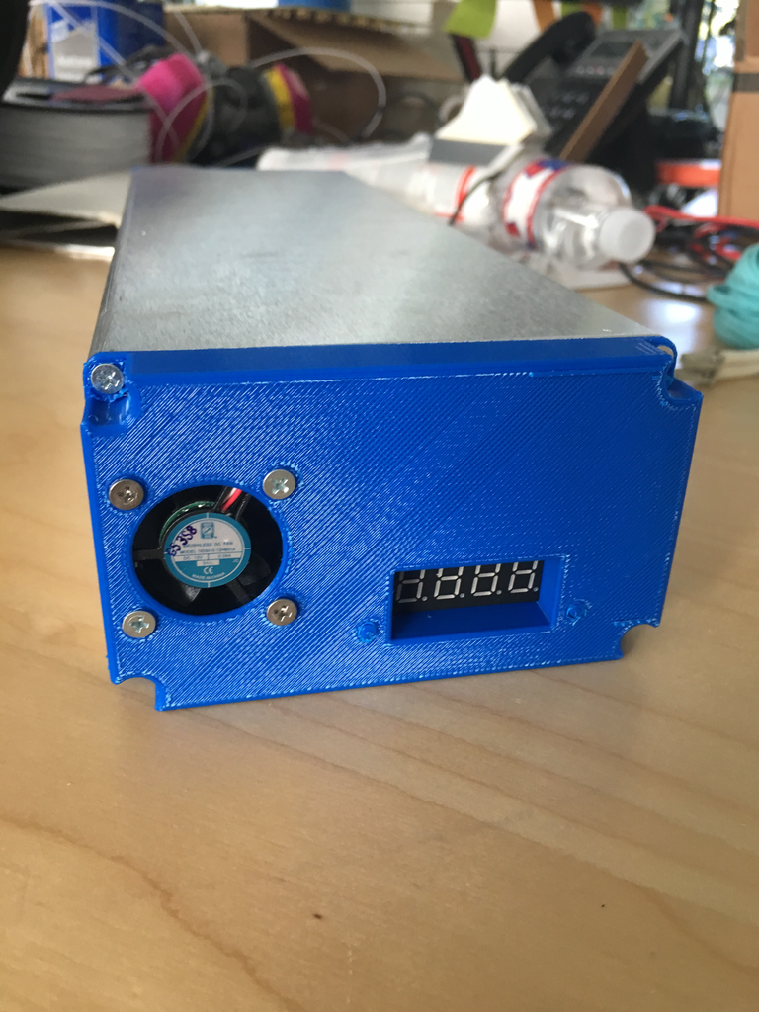
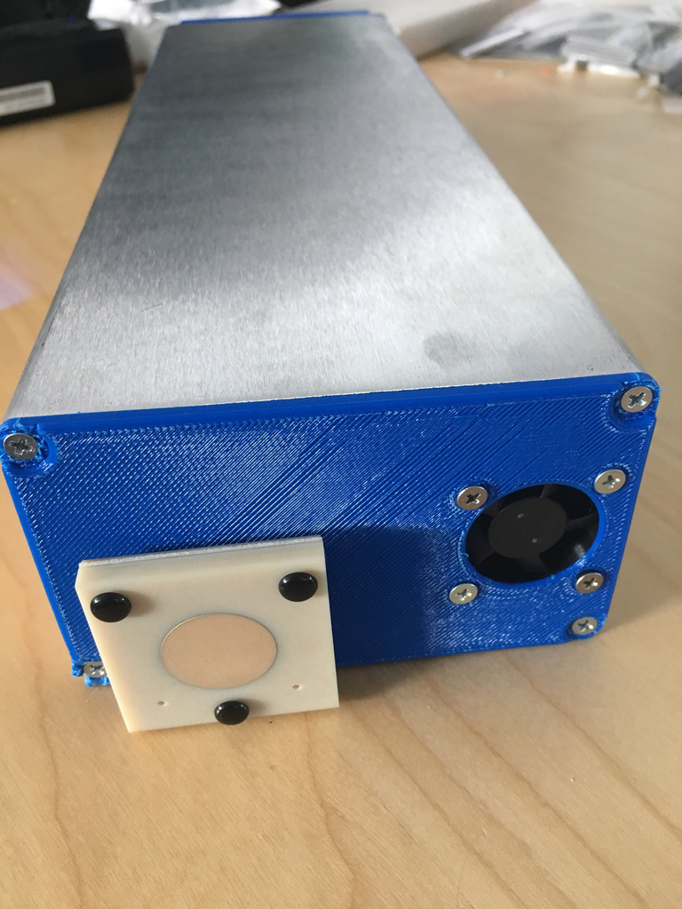
ArgosV3 Mobile
~12 Hour Battery Life
Integrated GPS
Integrated WiFi

Slide 9
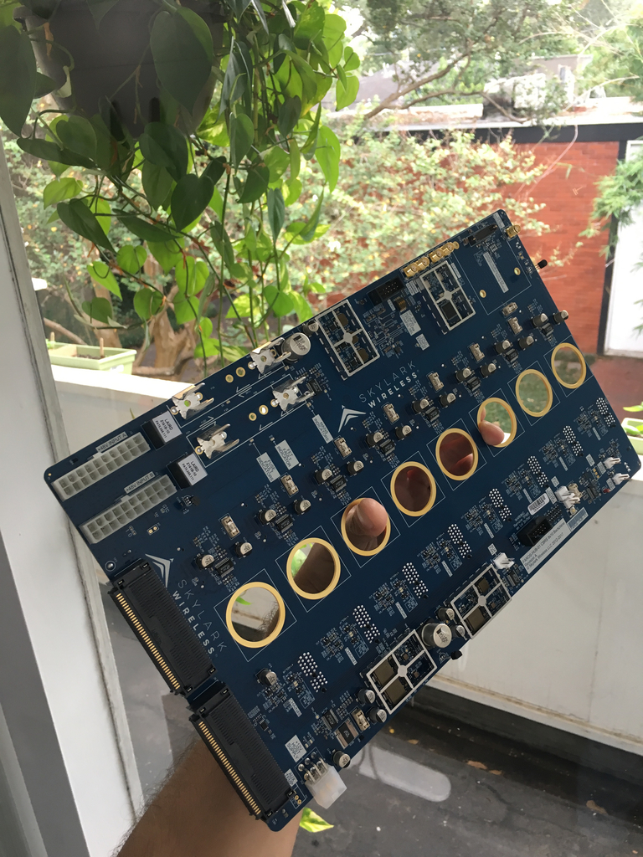
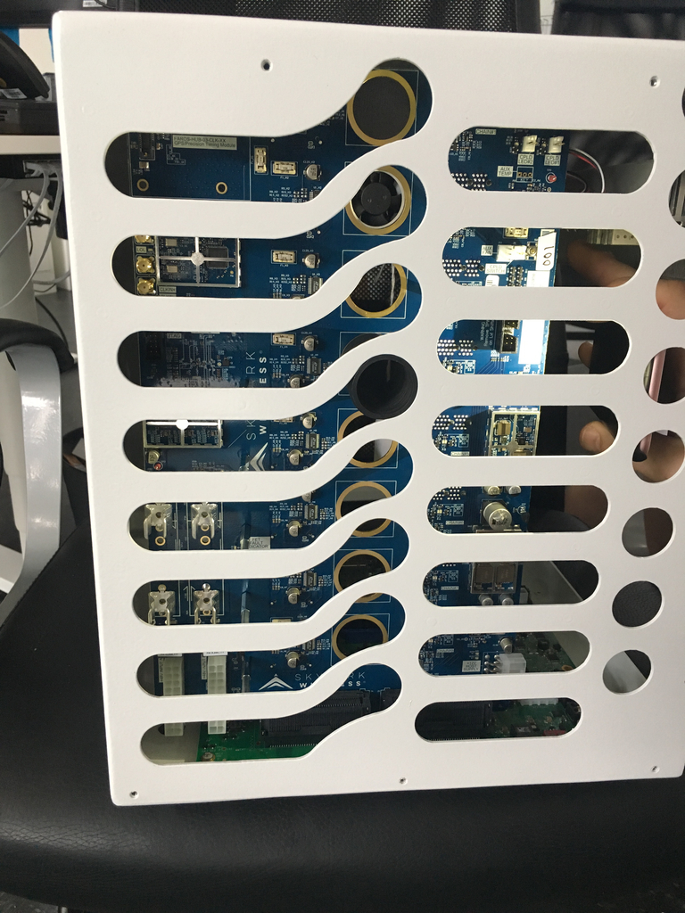
ArgosV3 Hub
8 Chains of Irises
160 Radios
Xilinx ZCU102
Integrated GPS
SyncE/PTP (NGFI)
Scale with Multiple Hubs
Notes:
2,520 DSPs

Slide 10
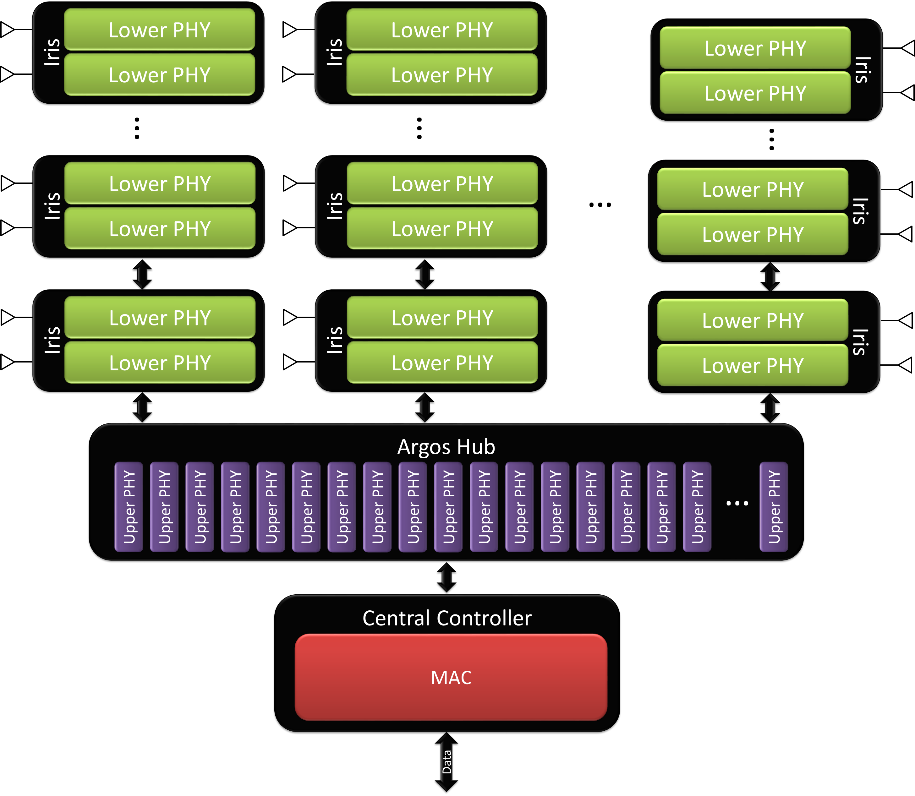
ArgosV3 Base Station Implementation

Slide 11
Notes:
Custom antenna array
~60 Lbs

Slide 12
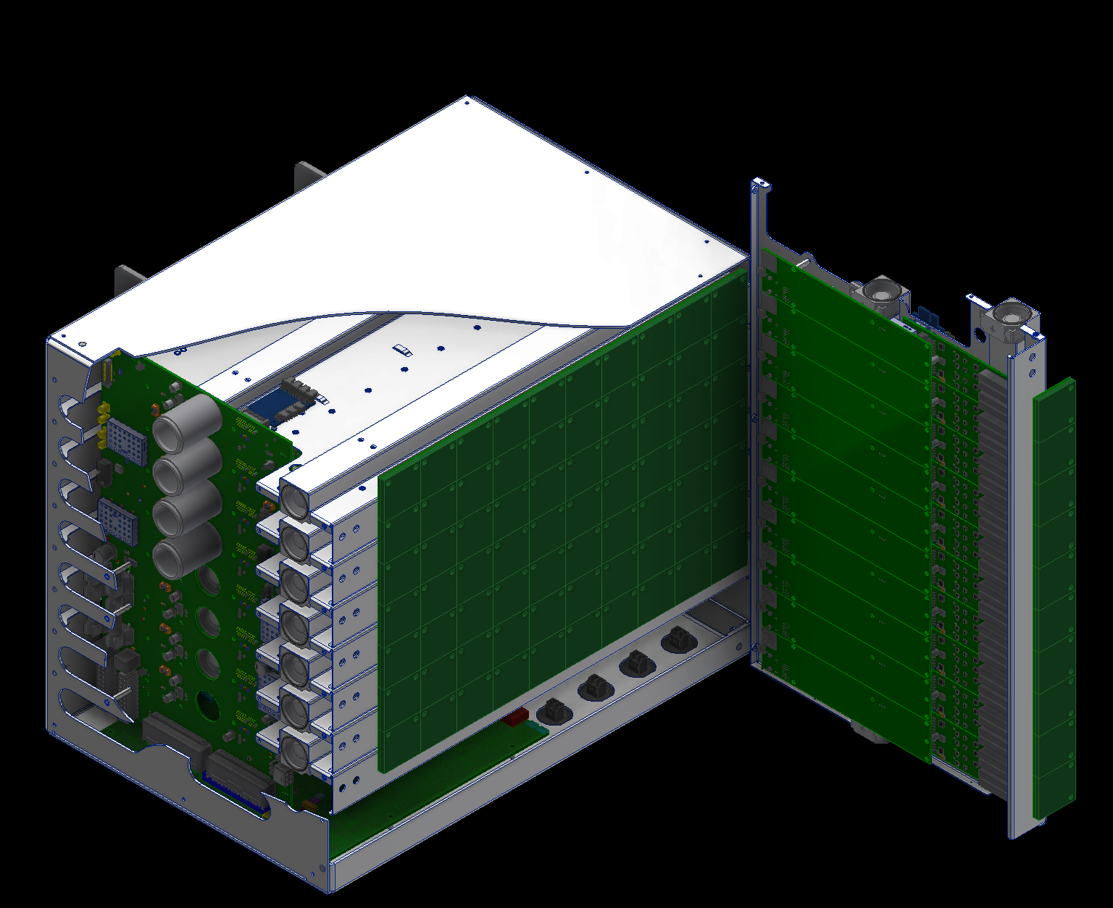

Slide 13
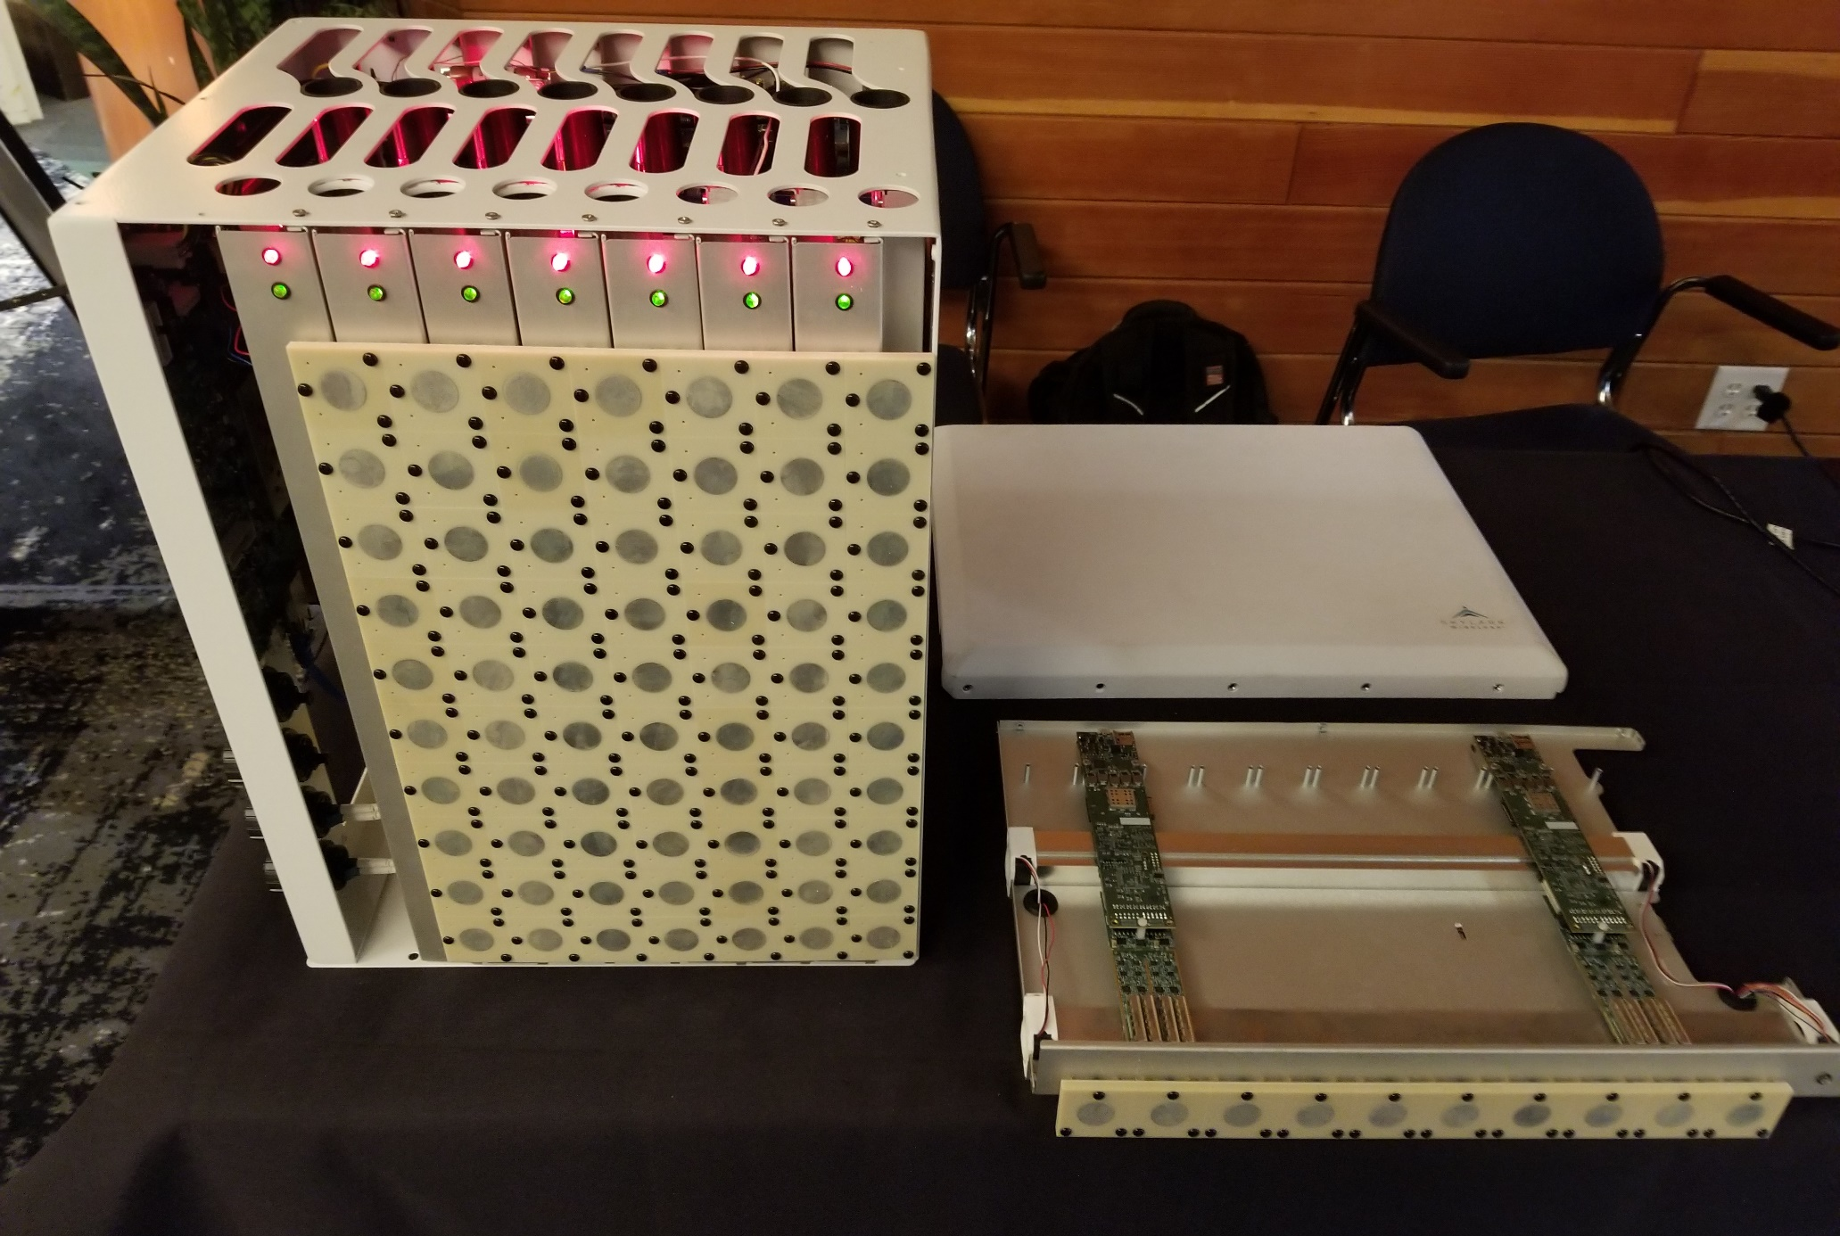

Slide 14
Why Multi-Cell Massive MIMO?
Reduced Inter-Cell Interference
CoMP
Pilot Contamination
Other Research
Notes:
At scale, tomography, localization, architecture, etc.
Drones

Slide 15
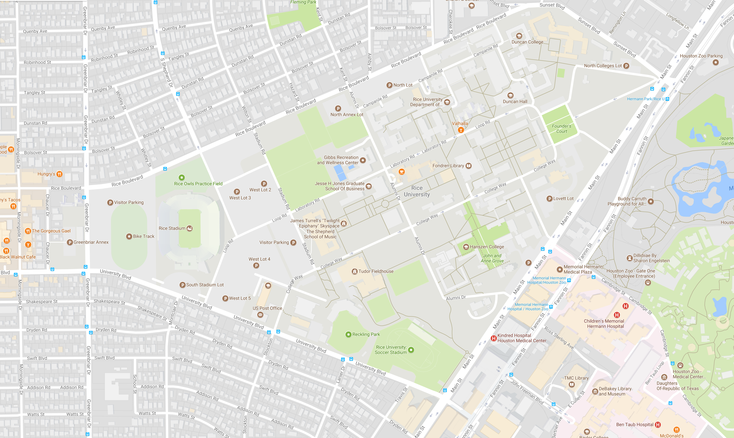


Notes:
5 locations, 2 with 2 sets of fibers/mounts
40 2-antenna UEs

Slide 16
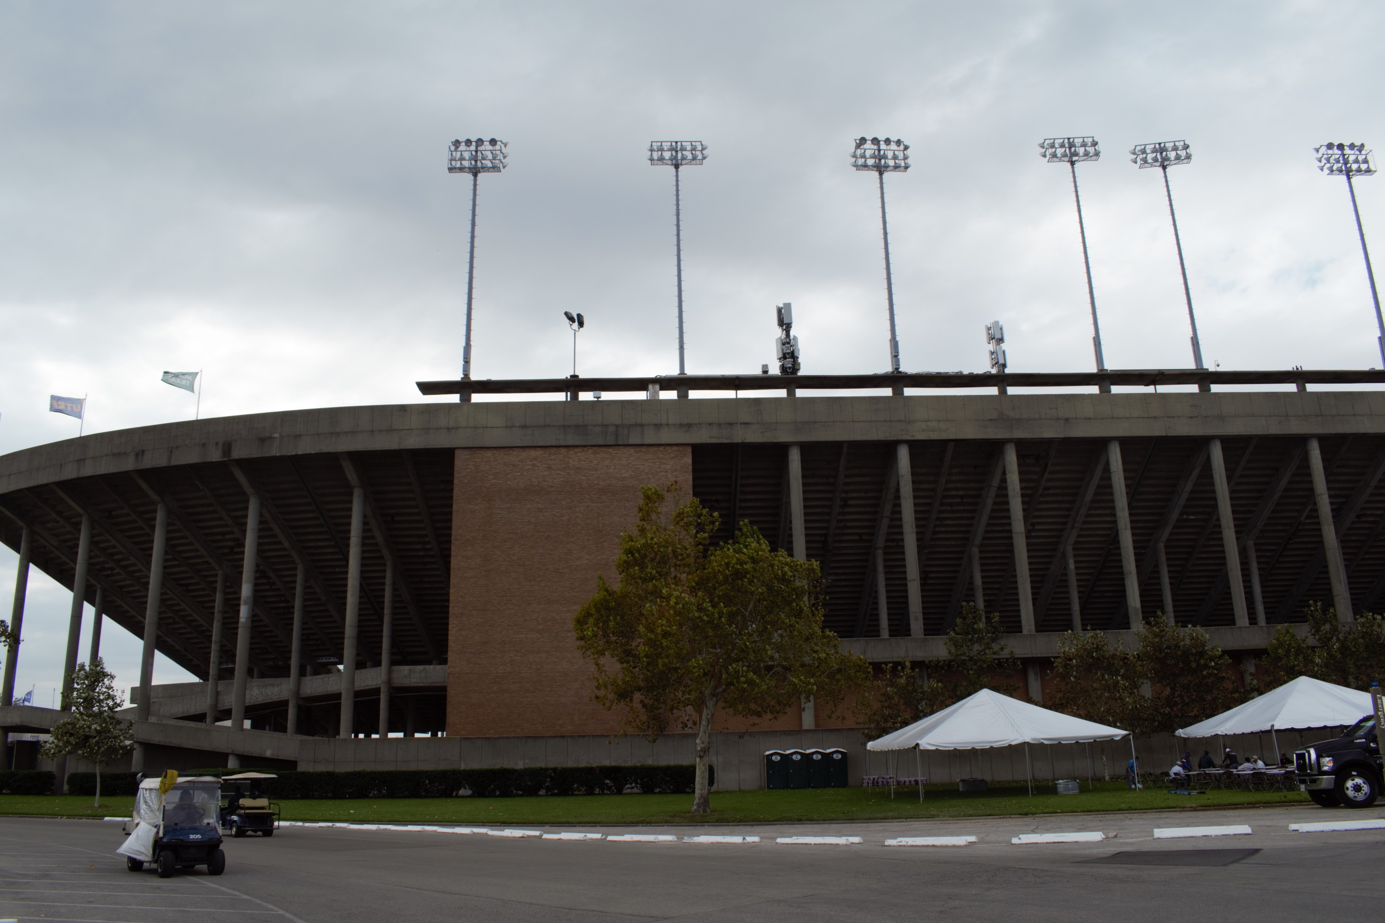

Slide 17
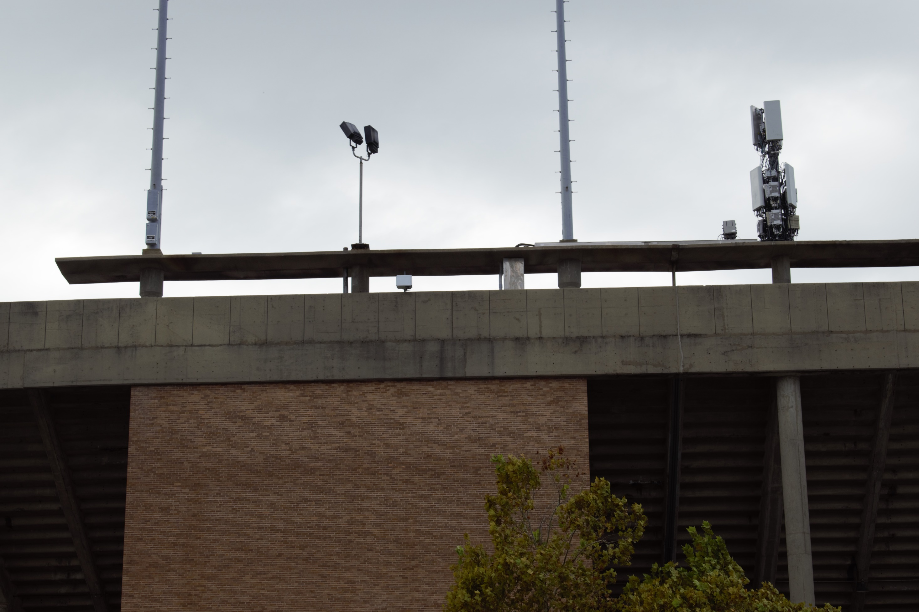

Slide 18
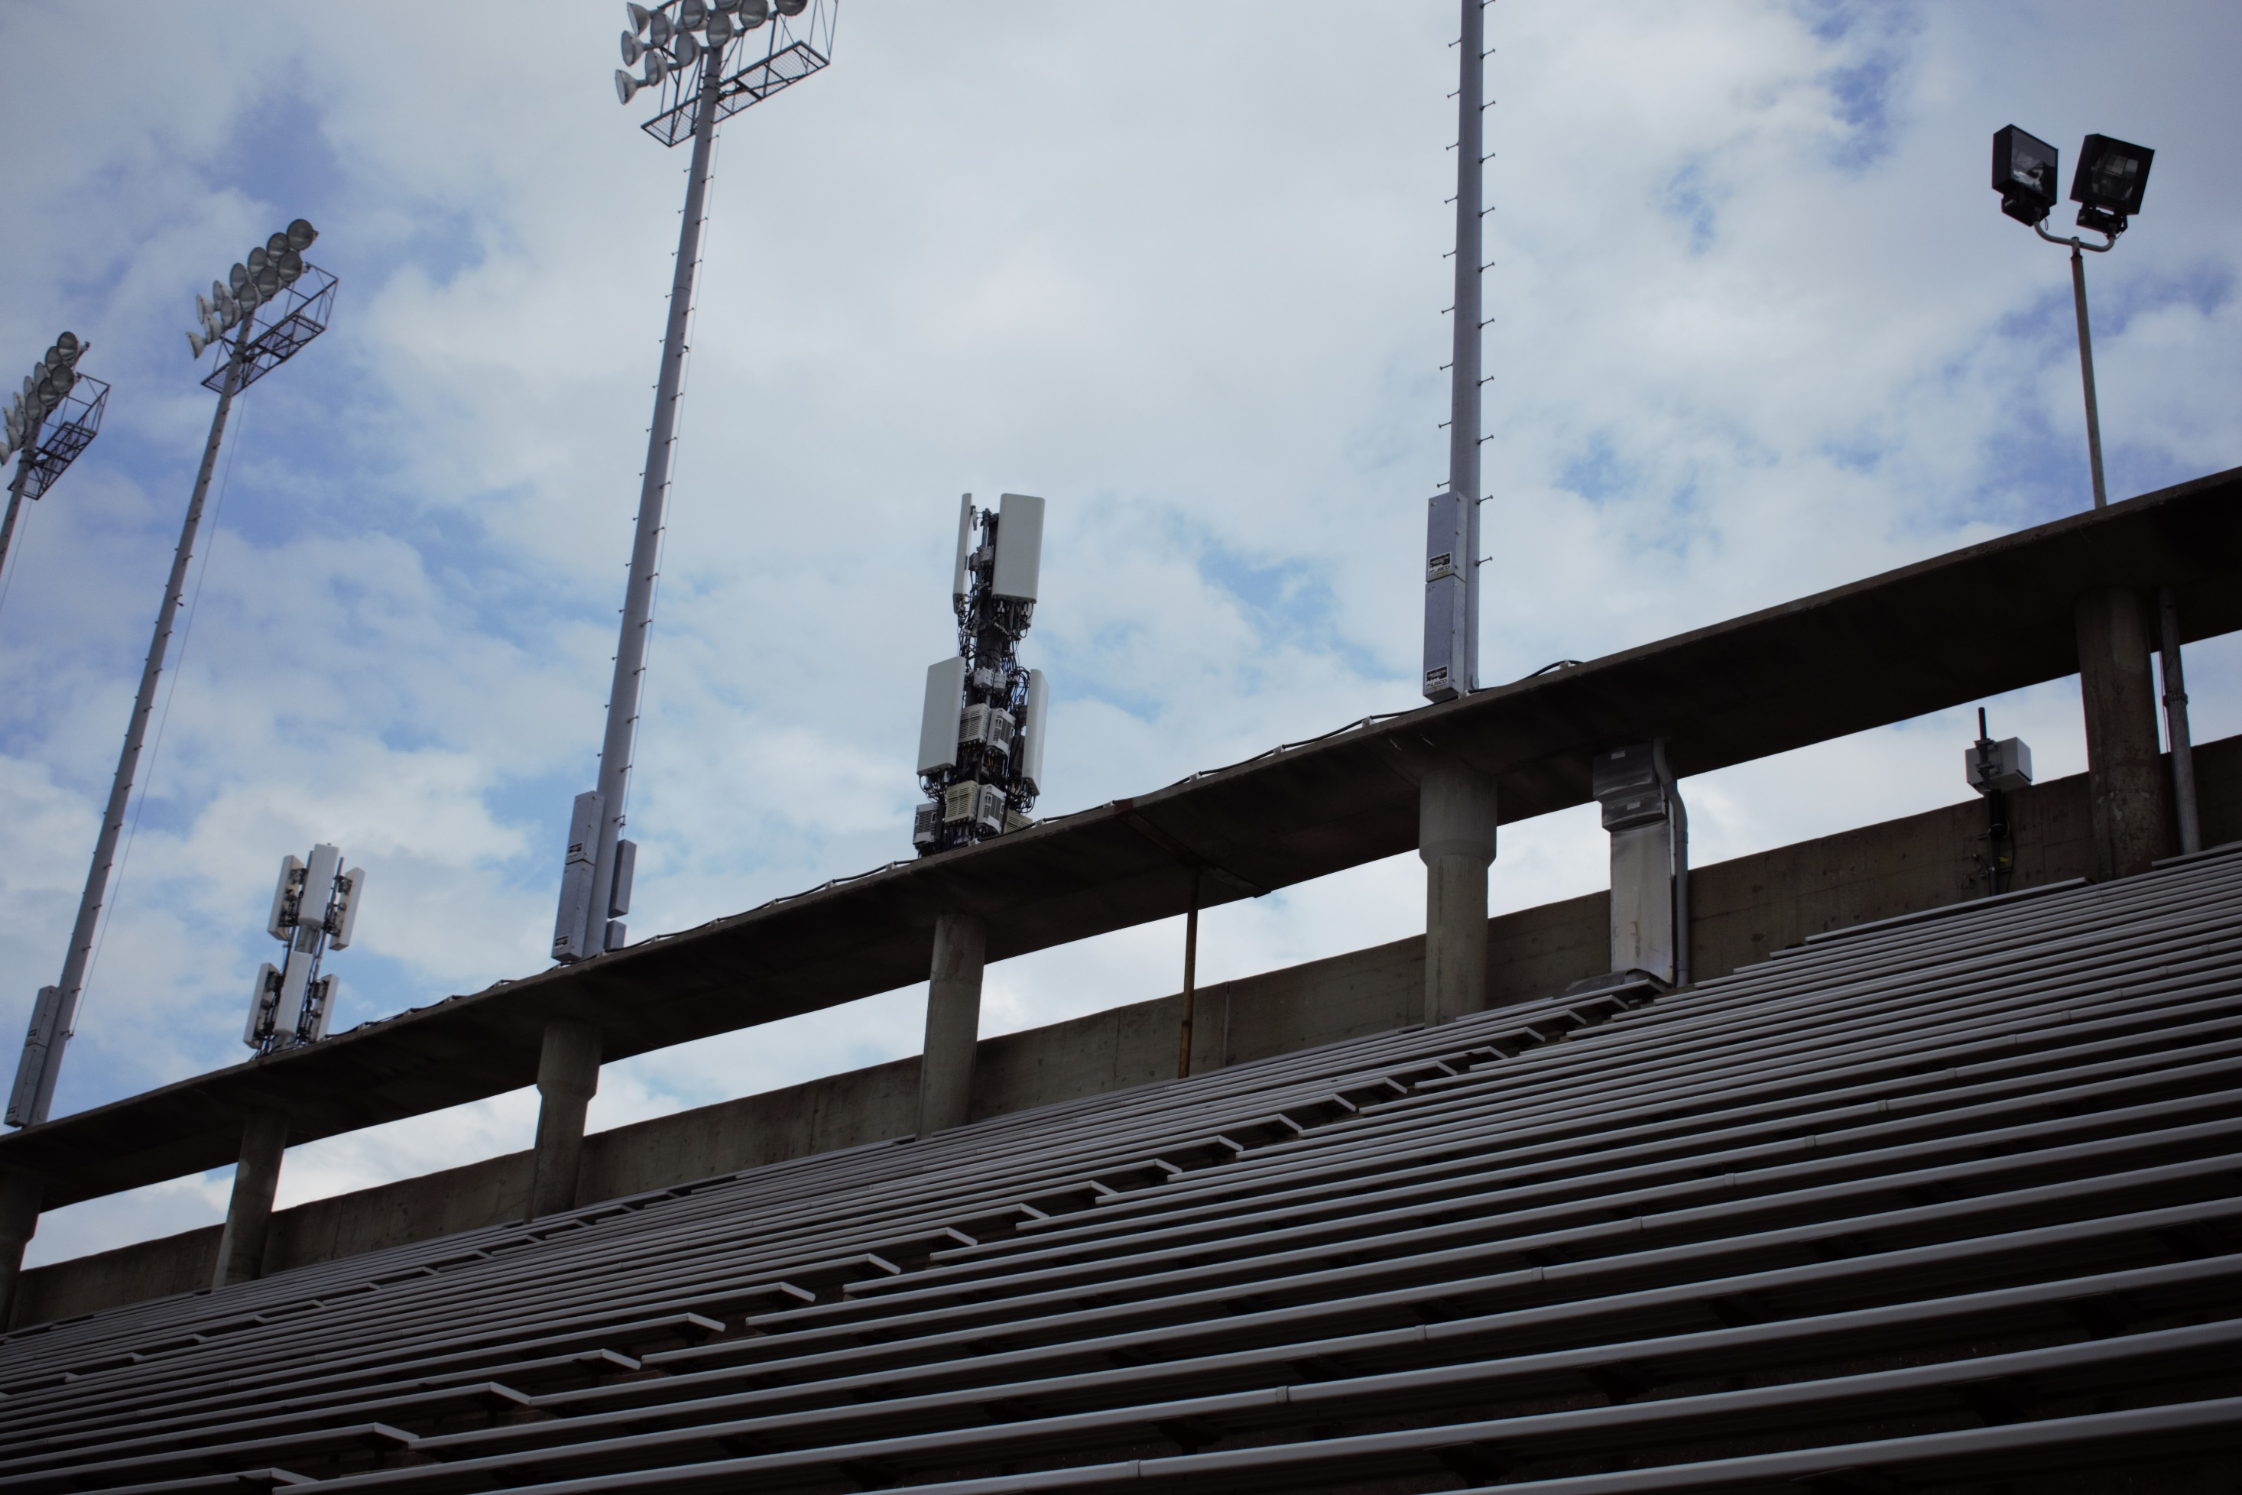

Slide 19
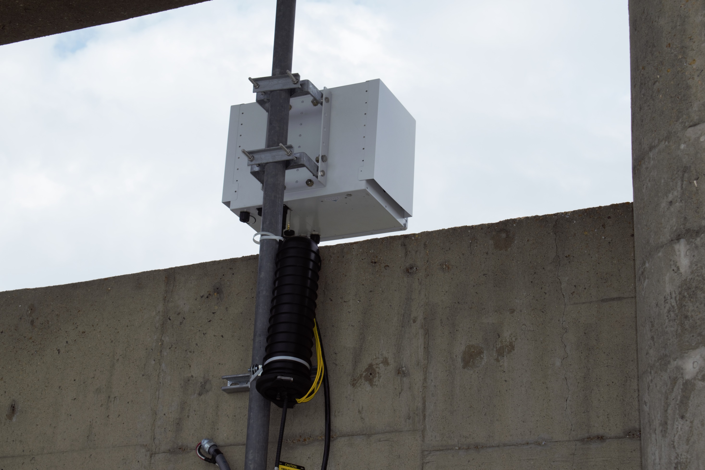

Slide 20
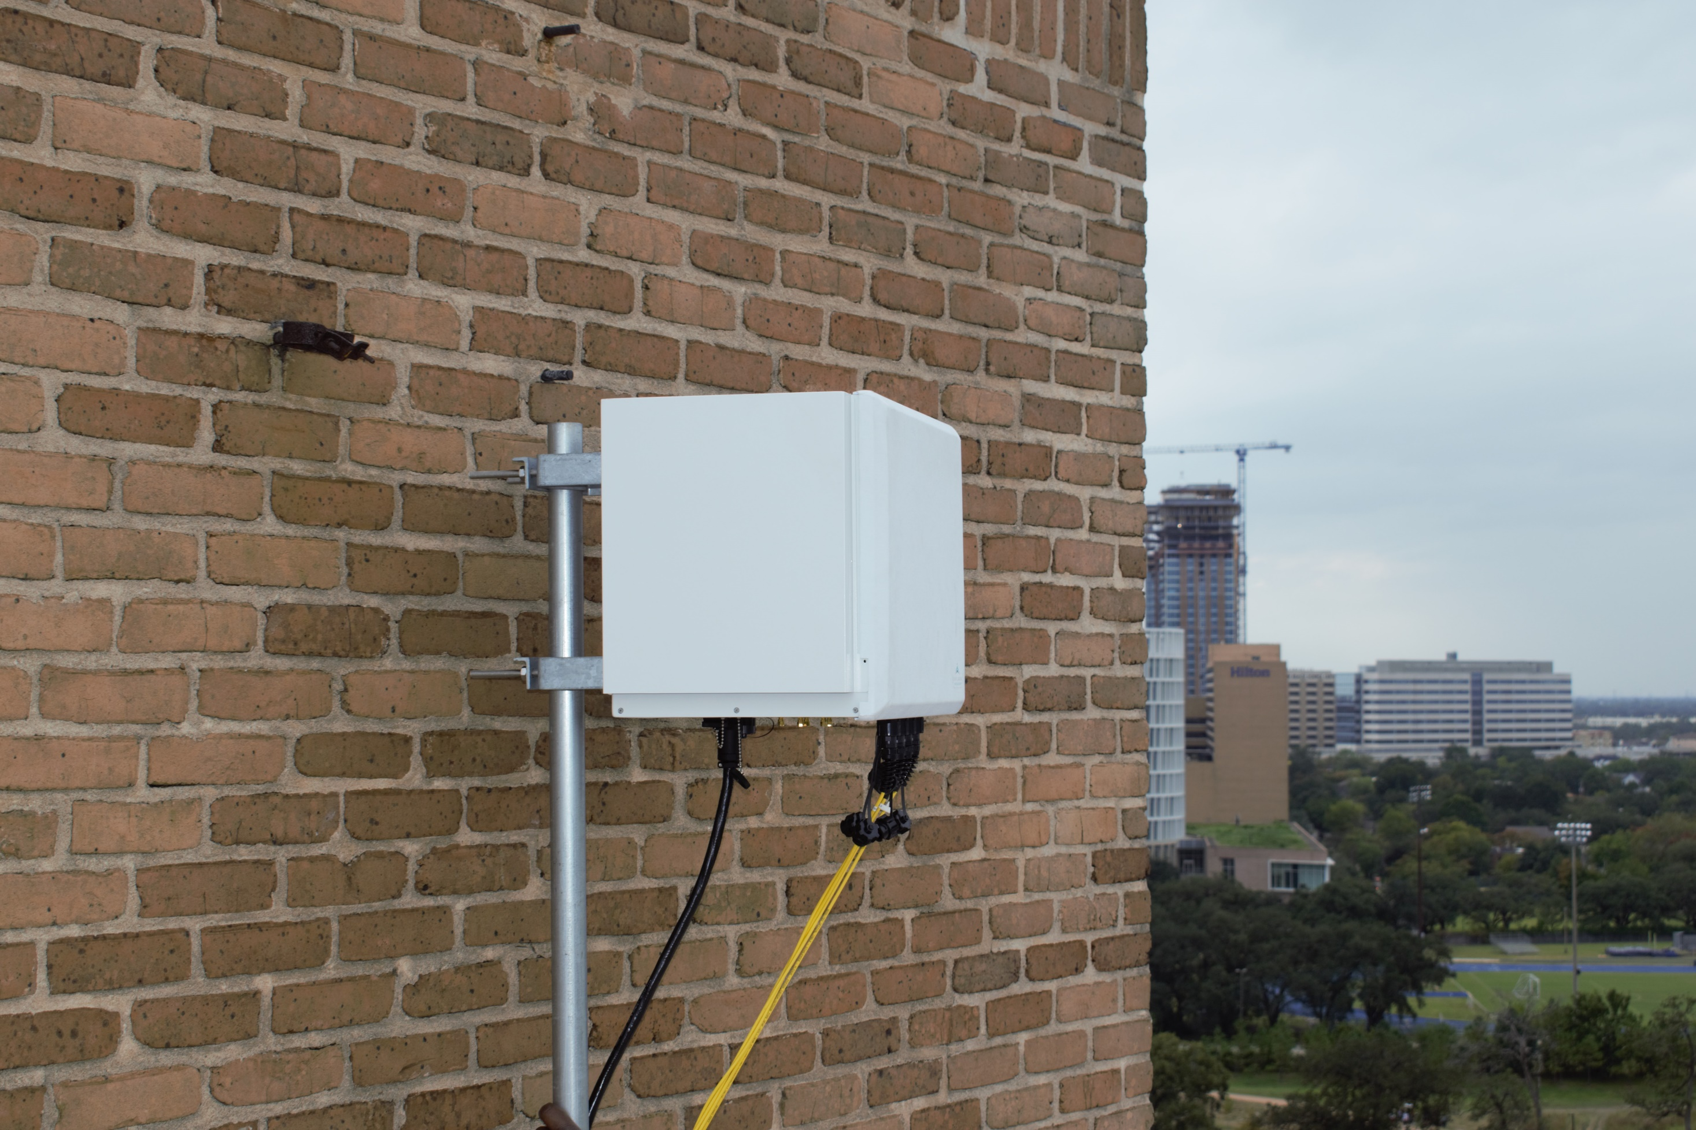

Slide 21
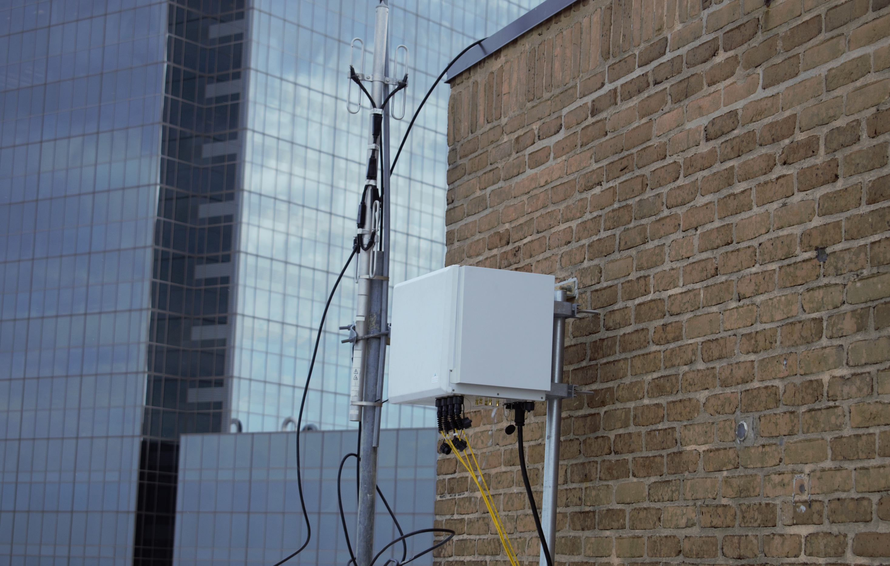

Slide 22
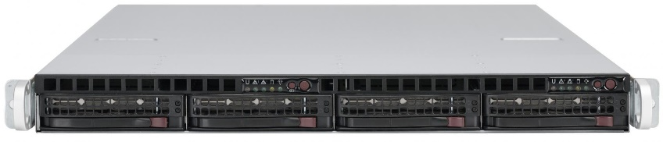
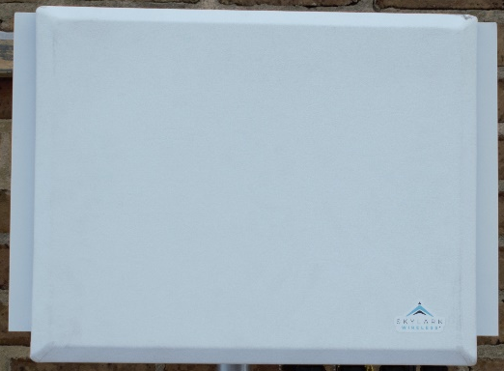
ArgosNet Architecture
4x 10 GbE
NGFI (SyncE/PTP)
CPRI
208-Core Cloud
ZCU102 with 12 SFP+

Slide 23
Framework Support
SoapySDR/Pothos (LimeSDR)
GNU Radio (UHD Driver)
OpenAirInterface
Argos Realtime Flow

Slide 24
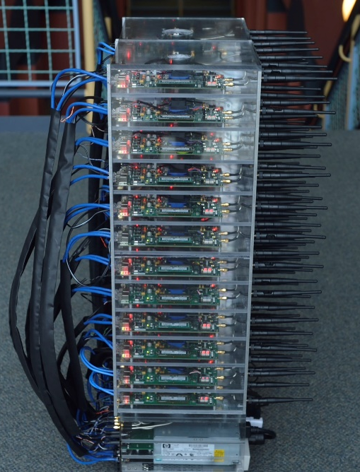

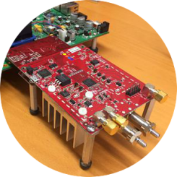
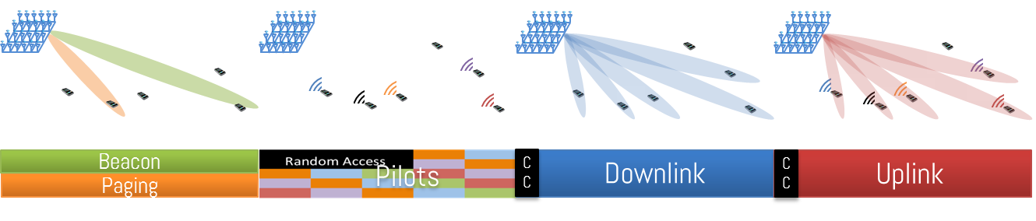
Many-Antenna Measurement System
ArgosV2 --> ArgosV3
Faros
Python
  Accelerated in C
Notes:
So I built a system to measure realtime wideband MU-MIMO channels.

Slide 25

Multi-Cell Measurement System Design
IQ
IQ
User K
User 2
…
ArgosCloud
Noise
User 1
Notes:
The measurement system is based on a scheduled frame, and leverages the Faros mechanisms for time-frequency synchronization with the mobiles.
The base station sends a beacon, which provides the users synchronization, then they send orthogonal pilots; in this case we use TDMA to achieve orthogonality.
After the pilot phase each base station antenna reports the raw IQ samples to the central controller, which saves them.
This happens every frame (thus the frame length is the collection interval).
In multi-cell we can’t do uplink AGC to every cell, so we have users rotate gains to get good dynamic range at every base station (sacrificing some time resolution).

Slide 26
Everything is released online!
http://data.projectargos.org
Notes:
Clean, well documented – maps photos, videos.
Includes measurements, analysis toolbox, and measurement system.

Slide 27
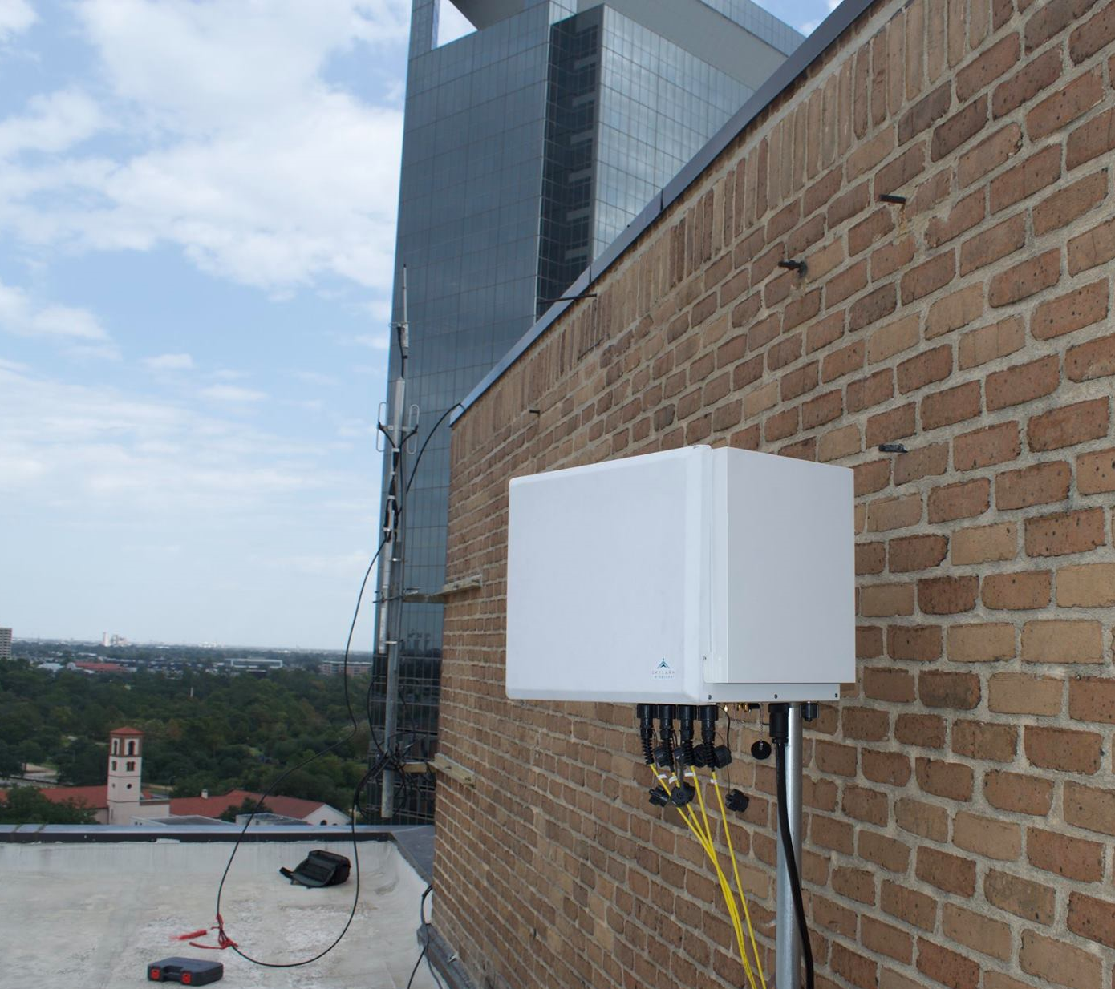
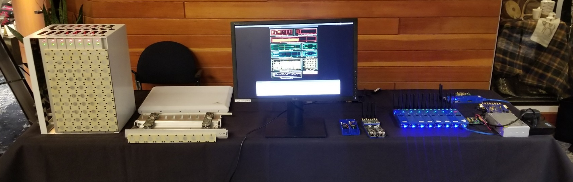
ArgosNet
Fully Programmable Multi-Cell Indoor/Outdoor Long-Range Massive MIMO Platform
Flexible Framework Support
Demonstrate incredible potential for Massive MIMO to reduce inter-cell interference and increase cell-edge performance
Fully Programmable Multi-Cell Indoor/Outdoor Long-Range Massive MIMO Platform
Enables unprecedented at-scale experimental research

Slide 28





Thank You!
Rahman
Doost-Mohammady
Jian Ding
Ryan Guerra
Lin Zhong
Notes:
Thanks to my co-authors, as well as some others who helped with the measurements.

