Slide 1

Practical Performance of MU-MIMO Precoding in Many-Antenna Base Stations
Clayton Shepard Narendra Anand Lin Zhong

Slide 2
Background: Many-Antennas
More antennas = more capacity
Traditional approaches don’t scale
Notes:
There has been a recent push in theory to use more antennas on base-stations, and we’ve only just started to explore the idea in practical systems.
More antennas on base stations should result in monotonically increasing performance (if nothing else, then because you can always not use the additional antennas).
However, it’s not quite that simple in practice. The existing approaches don’t scale up well; to see why, let’s first take a look at how MU-MIMO works.

Slide 3

Background: Beamforming
Destructive Interference
=
Constructive Interference
?
=
3
Notes:
To see why traditional MU-MIMO techniques won’t scale, let’s take a look at how they work. There are various techniques for MU-MIMO, however the most performant practical approach is called beamforming (or linear precoding). To demonstrate how beamforming works, let’s look at an aerial view of two antennas, the black dots, spaced a half-wavelength apart. If we put the same sine wave through them, we will see that they perfectly align in one direction, which results in constructive interference, and thus a very strong signal to the right and left.
However, in the other direction these waves will be misaligned, and create perfect destructive interference both, resulting in no-signal, or a null up and down. Also note that with more antennas this beam becomes stronger and narrower.
Now we can see that by changing the phase of one of the antennas, we can rotate this beam in space.
In order to point this beam towards a user, we need to know where that user is. We determine this by collecting channel state information.
Beamforming
Power Gain
Adjust phase (“beamweights”)
Leverages Interference
Open-loop
Pre-compute weights to specify direction
Closed-loop (adaptive)
Use channel state information (CSI) to target receivers

Slide 4
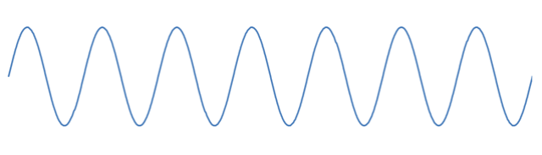
Background: Channel Estimation
Due to environment and terminal
mobility estimation has to occur
quickly and periodically
Path Effects (Walls)
Align the phases at the receiver to
ensure constructive interference
BS
+
=
+
Notes:
In order to determine where the user is, we have it transmit a pilot.
Each base station antenna looks at the phase and amplitude of the received signal, represented by a complex value, which is the channel state information (CSI) for that antenna pair.
The base station can then remove the phase offset for its transmission (using the conjugate of the CSI), which ensures constructive interference at the user.
However, the user and environment are mobile, so this has to be done very quickly and regularly.

Slide 5

Background: Channel Estimation
BS
Multiple users have to
send pilots orthogonally
Notes:
To send to multiple users simultaneously, we must collect the CSI for every base station antenna – receiver pair by sending orthogonal pilots (in time, frequency, and/or code) from every user.

Slide 6
Frame Structure
Time Division Duplex (TDD)
Uplink and Downlink use the same channel estimates
(Still Retrospective)
Coherence Time
Retrospectively Apply
Channel Estimation
CE
Uplink
…
Comp
Downlink
Uplink
CE
…
Pipeline Uplink
Computational Overhead
Notes:
These past few slides have assumed a TDD system leveraging channel reciprocity, with uplink pilots.
It is important to note existing systems do not leverage TDD reciprocity, particularly cell systems since they use FDD.
Instead they use explicit feedback which has polynomial time overhead, and does not scale well beyond a few antennas (<10).
Thus many-antenna base stations have to leverage TDD reciprocity with uplink pilots in order to be feasible.
This leads to a fairly straightforward frame structure, where first the channel is estimated, then beamforming weights are computed, then data is transmitted.
Each frame has to have a duration which is less than the coherence time, otherwise the channel estimates become stale, and the MU-MIMO is no longer effective. (signals combine over the air)
However, we can send uplink outside of the coherence period, since we can retrospectively apply the channel information. (Signals are combined in the baseband).
For this same reason, we can actually pipeline the uplink to mask the computational overhead.
Thus we see that uplink throughput can always meet or exceed downlink throughput. Thus we see that downlink is the limiting factor.

Slide 7
Downlink is Limiting Factor!
Notes:
(this is somewhat unfortunate since typical wireless networks have an assymetric throughput requirement favoring downlink.)
Because of this, our work focuses on optimizing the dowlink throughput.
Now let’s take a look at how multi-user beamforming works.

Slide 8

Background: Multi-User Beamforming
Data 1
Notes:
Unfortunately, even though we are steering the beam towards one user, it still creates interference for the other users due to side lobes.

Slide 9
Background: Multi-User Beamforming
Data 2
Notes:
This will be stronger for some users than others, but will make it sub-optimal to serve many users simultaneously.

Slide 10
Background: Zero-forcing
Null
Null
Data 1
Null
Null
Null
Notes:
To combat this there are many techniques, but the most feasible approach is zeroforcing. Essentially zeroforcing not only ensures that a beam is pointed towards the intended users, but ensures that the interference sums to 0 at all of the un-intended receivers, in other words it steers nulls towards the unintended receivers.
There is a slightly altered form of zero-forcing, called MMSE, which performs slightly better, particularly at low SNRs.

Slide 11
Background: Zero-forcing
Data 2
Null
Null
Null
Null
Null
Notes:
The main lobe and nulls have to be calculated for every user, making it clearly a polynomial time algorithm. O(MK^2)

Slide 12
Background: Zero-forcing
Data 2
Data 3
Data 1
Data 4
Data 6
Data 5
Notes:
This enables high SNR channels to be established to all of the users simultaneously.
However, this is a very complex thing to do in real time, since it has to be recomputed within the channel coherency. It works well for a small number of users, but since it takes O(M*K^2) time, and is largely non-parallelizable, it does not work as the number of antennas scales up.

Slide 13
Background: Scaling Up Conjugate
Data 1
Notes:
So how do we solve this problem of interference to the other users?

Slide 14
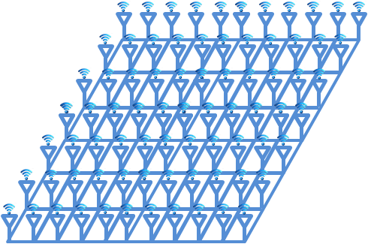
Background: Scaling Up Conjugate
Data 1
Notes:
As I mentioned earlier, more antennas allow you to create a more narrow focused beam. This reduces the amount of unintended radiation.

Slide 15
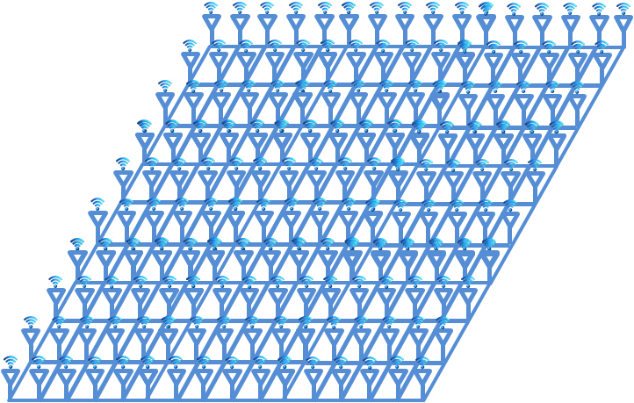
Background: Scaling Up Conjugate
Data 1
Notes:
And, eventually, with enough antennas this interference drops below the noise floor, enabling a much simpler beamforming algorithm to be used. In fact, this is essentially just single user beamforming to multiple users, and thus the complexity scales linearly, rather than polynomially.

Slide 16
Background: Scaling Up Conjugate
Data 2
Data 3
Data 1
Data 4
Data 5
Data 6
Notes:
And, eventually, with enough antennas this interference drops below the noise floor, enabling a much simpler beamforming algorithm to be used. In fact, this is essentially just single user beamforming to multiple users, and thus the complexity scales linearly, rather than polynomialy.
Approaches optimal as M -> infinity.

Slide 17
Conjugate vs. Zero-forcing
Negligible Processing
Completely Distributed
No Latency Overhead
Poor Spectral Efficiency
O(M•K²)
Centralized
Substantial Overhead
Good Spectral Efficiency
Notes:
This leads us to the critical question in the many-antenna community now:

Slide 18
Under what scenarios, if any, does conjugate precoding outperform zero-forcing?
Notes:
To do this, we analyze the factors which affect the performance of each precoding technique discrepantly.

Slide 19
Performance Factors
Environmental
Complex, and constantly changing
Design
Straightforward and Static
Notes:
We are going to focus on the factors that discrepantly affect the precoding techniques.
The factors can be separate in to two high-level categories”

Slide 20
Performance Factors
Environmental
Channel Coherence
Precoder Spectral Efficiency
Design
Number of Antennas
Hardware Capability
Notes:
Within the environmental category we see two primary factors which discrepantly affect performance:
Similarly, in the design category we also see two factors which discrepantly affect performance:
Now let’s take a closer look at each of these factors.

Slide 21
Environmental Factor: Channel Coherence
Coherence Time
Increases frequency of channel estimation
Coherence Bandwidth
Increases coherence bandwidth
Notes:
There are two components of channel coherence.
100s of µs to 100s of ms
100s of kHz to MHz
Note that coherence bandwidth is independent of FFT size (though related to cyclic prefix).

Slide 22
Env. Factor: Precoder Spectral Efficiency
Real-world performance, neglecting overhead
Performance Depends on:
User Orthogonality
Propagation Effects
Noise
Interference
Can be modeled, but impossible to capture everything
Notes:
Instead, we advocate taking real-world performance measurements in the intended environment. To do this we use our Argos platform.

Slide 23
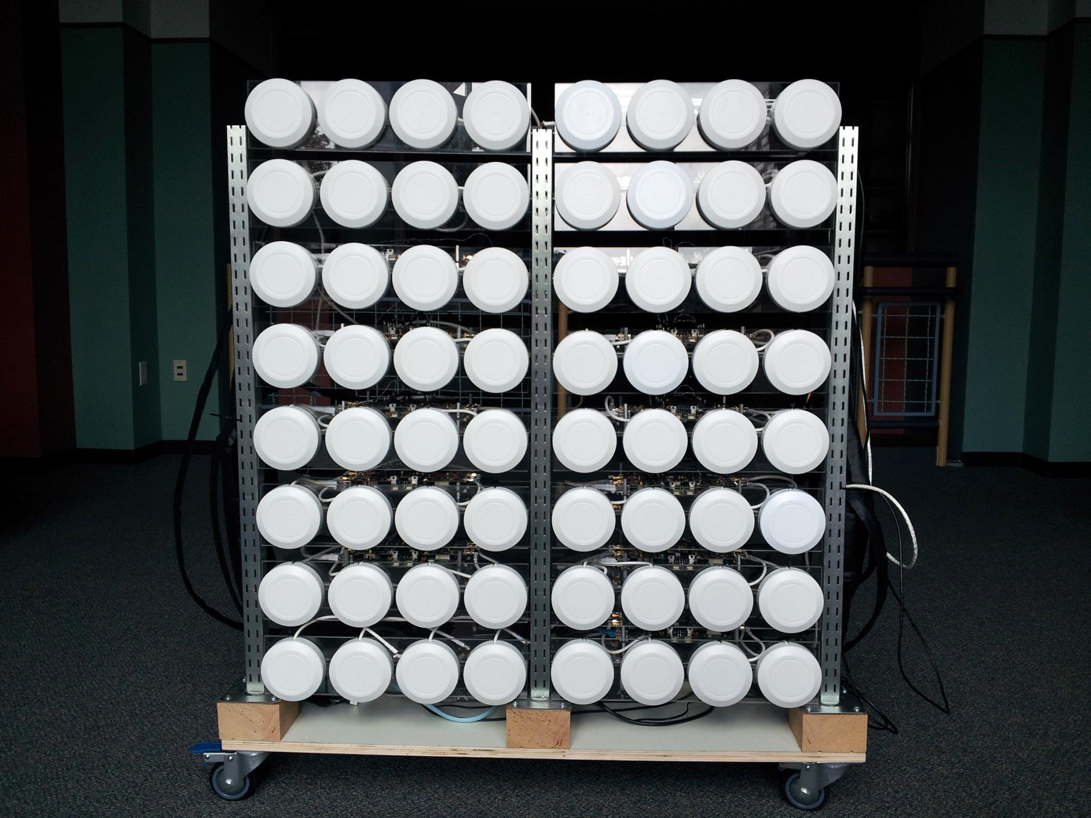
Notes:
Mention greek creature here.

Slide 24
Design Factor: Number of Antennas
Number of Base Station Antennas (M)
Increases amount of computation
Number of User Antennas (K)
Increases channel estimation and computation

Slide 25
Design Factor: Hardware Capability
Conjugate has negligible computational cost
Zero-forcing requires:
Bi-Directional Data Transport
Large Matrix Inversions
Notes:
Both have common set of baseband requirements, such as the FFTs, cyclic prefix, modulation, coding, linear precoder, etc., which have the same overhead. Since these are the same for both precoders, we ignore them (though any processing overhead has an affect that is similar to lowering the coherence time).
Speed of light in fiber is 5 us/km (but doubled)

Slide 26
Zero-forcing Hardware Factors
Channel Bandwidth
Quantization
Inversion Latency
Data Transport
Switching Latency
Throughput
Notes:
There are many, many, factors which affect hardware performance. For more detail, please refer to the paper.

Slide 27
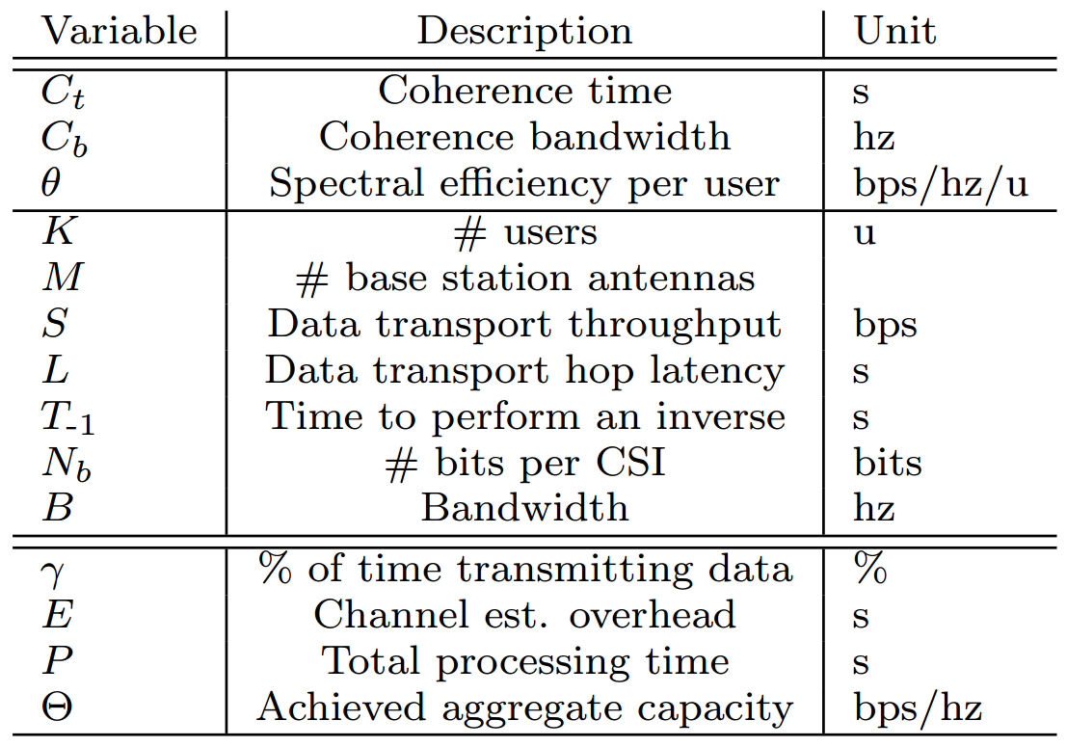
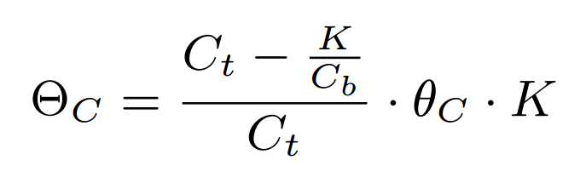
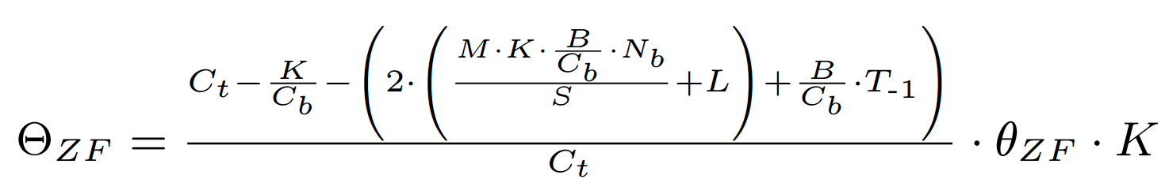
Performance Model
Notes:
Please see paper for more details

Slide 28
Conjugate vs. Zero-forcing

Slide 29

Without Considering Computation
CE
Comp
Transmit

Slide 30
Spectral Efficiency vs. # of BS antennas
K = 15
Spectral Efficiency (bps/Hz)
# of Base Station Antennas (M)
Notes:
Power is 1/# base station antennas, which allows us to demonstrate the benefit of more antennas – not more power, or even the beamforming gain (which is well known/well understood).

Slide 31
Spectral Efficiency vs. # of Users
M = 64
Spectral Efficiency (bps/Hz)
# of Users (K)

Slide 32
Considering Computation
CE
Comp
Transmit
Notes:
40 MHz band
16-bit quantization
Local processing (no transport delay, other than throughput and switching)

Slide 33
M = 64 K = 15
Achieved Capacity (bps/Hz)
Coherence Time (s)
Zeroforcing with various hardware configurations
Notes:
Note that we neglect common overheads, such as FFT, baseband, cyclic prefix, etc., and the channel estimation is the minimum theoretically possible, so this is actually an optimistic view for zeroforcing – all these effects have essentially the same effect as reducing the coherence time.
Even still, we see that conjugate outperforms zeroforcing at coherence times below 1ms

Slide 34
Performance vs. # of Users
M = 64 C_{t} = 30 ms
Achieved Capacity (bps/Hz)
# of Users (K)
Notes:
There are situations where serving more users is actually detrimental.

Slide 35
Max Multiplexing Gain vs. # of Users
M = 200 C_{t} = 30 ms
Multiplexing Gain (γ · K)
# of Users (K)
Notes:
Since we don’t have spectral efficiency results for k>15, let’s take a look at how gamma*k performs as the number of users increases. This measurement is equivalent to the number of (spatially multiplexed) resource blocks used to actually send data every frame. (note it is not scaled w/ regard to spectral efficiency, which would boost significantly zeroforcing’s performance).
As # of users goes up, spectral efficiency / user goes down. (power loss, more interference, and degrees of freedom loss)
Note that the optimal users for ZF-low went down even further, due to the overhead of the additional BS antennas. 200 antennas would drastically increases the performance for those 4 users, but it may be better to use fewer antennas to serve more users; that would have to be optimized using the spectral efficiency data.

Slide 36
Applicability
Guide Base Station Design
Refine model for your implementation
Enables adaptive precoding
Notes:
Architects can use this model to guide their development. If they are serving a lot of users at a high frequency, or in a highly mobile environment, then there is no reason to invest in ZF.
However, if they are only serving a few stationary users simultaneously, then there is no reason to invest in a large number of antennas.
Our model can also be used to enable adaptive precoding! There are many factors that change in real-time, including two of the most important: # of users and coherence time. Using our model the BS can choose in realtime which precoding method will result in more throughput.

Slide 37
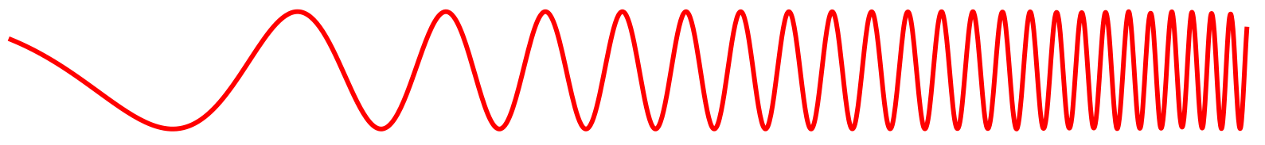
Ramifications
More Antennas or Higher Mobility
Faster Processing
Adaptive
Precoding
Zero-forcing
Conjugate
1 GHz
10 GHz
Notes:
This indicates that there are regimes in the spectrum. In low frequency bands zero-forcing will likely be more useful, since antennas must be huge, it is typically impractical to make large arrays, however the propagation is much better, and coherence time is much larger, which makes the computational overhead of ZF negligible.
In the high frequency bands, the coherence time is much lower and propagation loss is high, but large arrays (with huge beamforming gains) can fit in very small areas, which make them more suited to conjugate.
In the transition regime, adaptive precoding becomes useful, as the optimal precoding method will fluctuate based on the # of users, coherence time, etc.
As computation becomes cheaper, this transition regime may move up in frequency, however as mobility, bandwidth, or # of antennas increases, this transition range is pushed back towards the lower frequencies.

Slide 38
Conclusions
Accurate model of real-world precoding performance
Separates unpredictable environmental factors from deterministic design
Conjugate can outperform zerforcing
Useful for guiding design and enabling adaptive precoding
http://argos.rice.edu

Slide 39
Questions?
http://argos.rice.edu

Slide 40

Frame Pipelining Schemes
Coherence Time
All
Downlink
CE
Comp
Downlink
CE
Comp
Downlink
CE
…
…
Coherence Time
Coherence Time
All
Uplink
CE
Uplink
CE
…
(Not to Scale)
Coherence Time
Optimal
CE
Uplink
…
Comp
Downlink
Uplink
CE
…
Notes:
Two reasons All Up and all Down are bad:
1) Impractical to say that there are no acks (you always need some feedback to optimize channel capacity).
2) On downlink you waste valuable coherence time prematurely re-estimating the channel. (Also note the TX/RX switching latency overhead, not shown.)
Note that if computational overhead is small enough relative to CE, it is better to just use whole coherence for downlink rather than premature estimation in the all down-link scenario.

