Slide 1


Argos Practical Many-Antenna MU-MIMO Systems
Clayton Shepard
Notes:
Many-antenna wireless systems have shown the potential to drastically increase spectral efficiency, and are one of the key candidate technologies for 5G cellular connectivity. By designing and prototyping two generations of many-antenna base stations we have discovered, characterized, and solved critical challenges which impede their implementation and eventual adoption.

Slide 2
Understanding and optimizing system performance
Notes:
Understanding and optimizing *system* performance as MU-MIMO scales up
Overcoming unique challenges

Slide 3
Challenges and opportunities unique to scaling up
Notes:
Understanding and optimizing *system* performance as MU-MIMO scales up
Overcoming unique challenges

Slide 4


MU-MIMO Potential
Data 2
Data 3
Data 1
Data 4
Data 6
Data 5
Notes:
Driving vision behind my thesis is enabling scalable many-antenna MU-MIMO in the real world.
Theoretically, many-antenna MU-MIMO can provide enormous gains in spectral efficiency, but up until my work these gains were never tested in practice.
My research is devoted to building these many-antenna MU-MIMO systems in the real world, seeing where they break, then fixing these problems and optimizing the system.

Slide 5
Order of magnitude gains!
Spectral Efficiency
Base Station and User Power Reduction
Interference
Network
Shared Spectrum
Notes:
Spectral Efficiency and base station / user power reduction has been well investigated. Our focus moving forward will be the system implementation/more diverse characterization, as well as demonstrating reduced network interference and potential applications for shared spectrum.

Slide 6
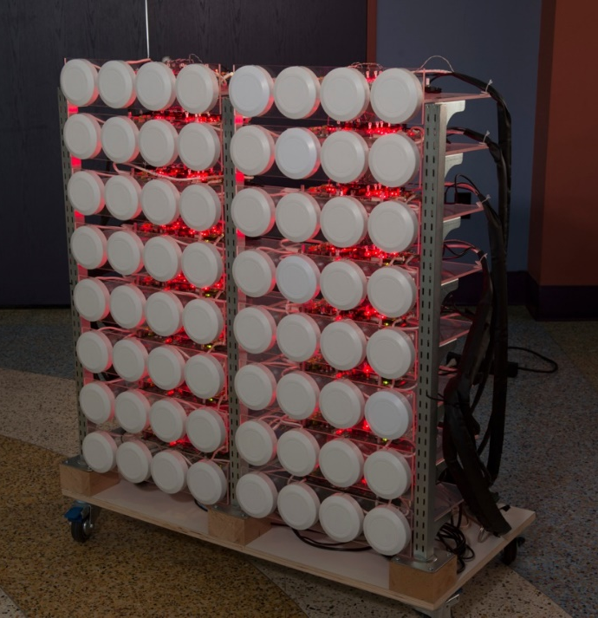
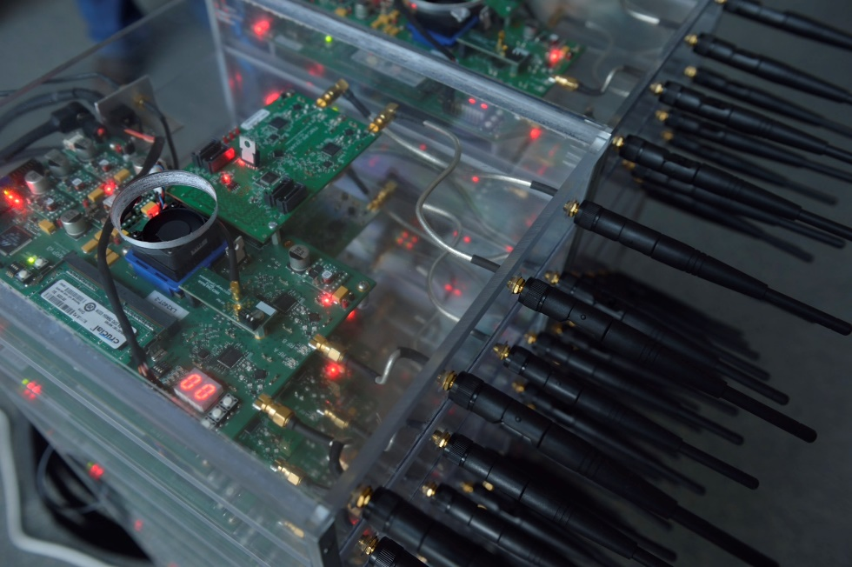
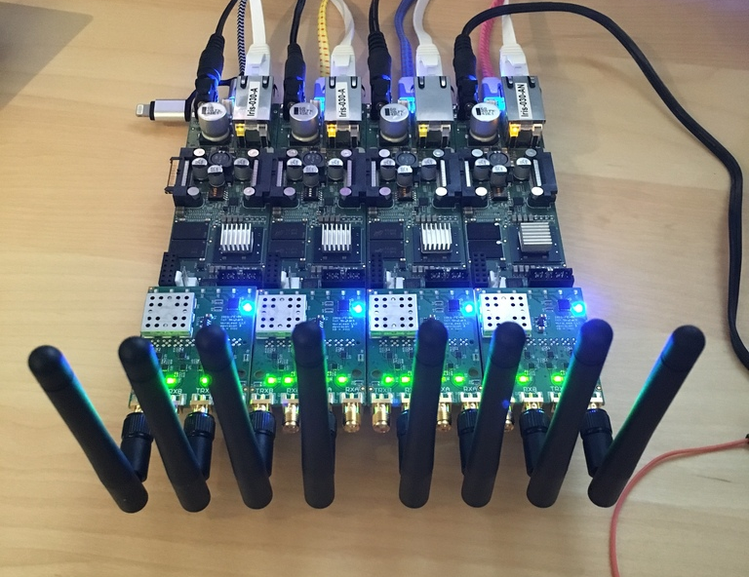

Argos Many-Antenna MU-MIMO Platforms
MobiCom ‘12
MobiCom ‘13
MobiCom ‘17
Notes:
I am a systems engineer – I started building Massive MIMO systems 6 years ago.
We say many-antenna MIMO because our results apply to everything from relatively small systems to “massive” systems.
Custom hardware built by Rice startup companies.
ArgosV1 2011-2012
ArgosV2 2012-2013, used to 2017
ArgosV3 2015-2017, will be used to 2020 and beyond

Slide 7
ArgosV1 A Prototype Many-Antenna System

Slide 8
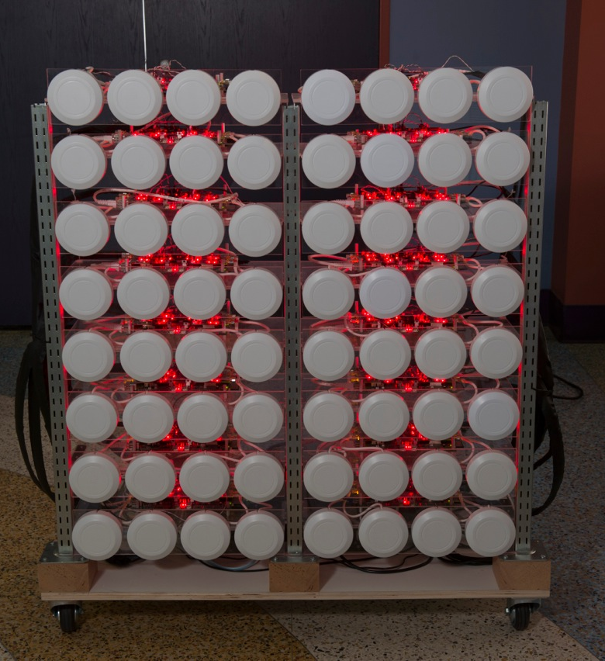
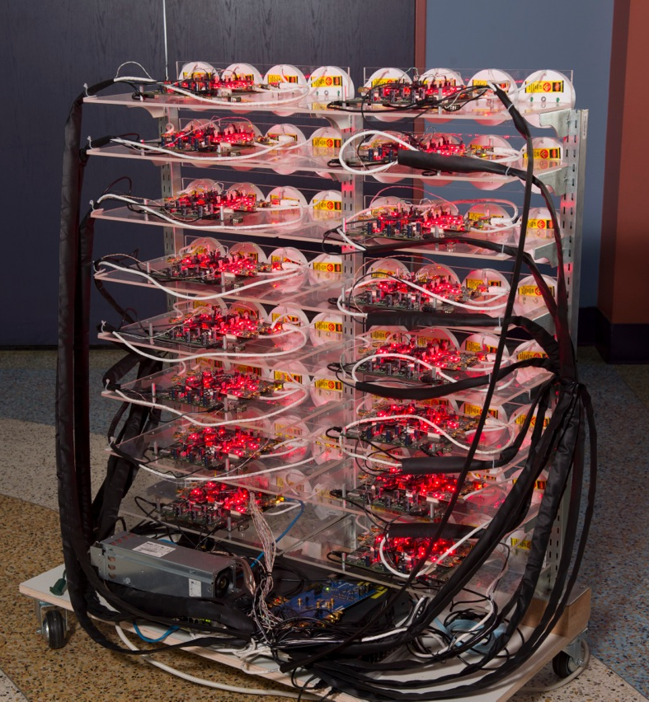
Notes:
Non realtime, first demonstration of large-scale beamforming OTA
Informed abstract design, identified and solved critical scaling issues (channel reciprocity, distributed beamforming)

Slide 9
ArgosV2 A Scalable Realtime Platform
Notes:
And scalable physical design

Slide 10
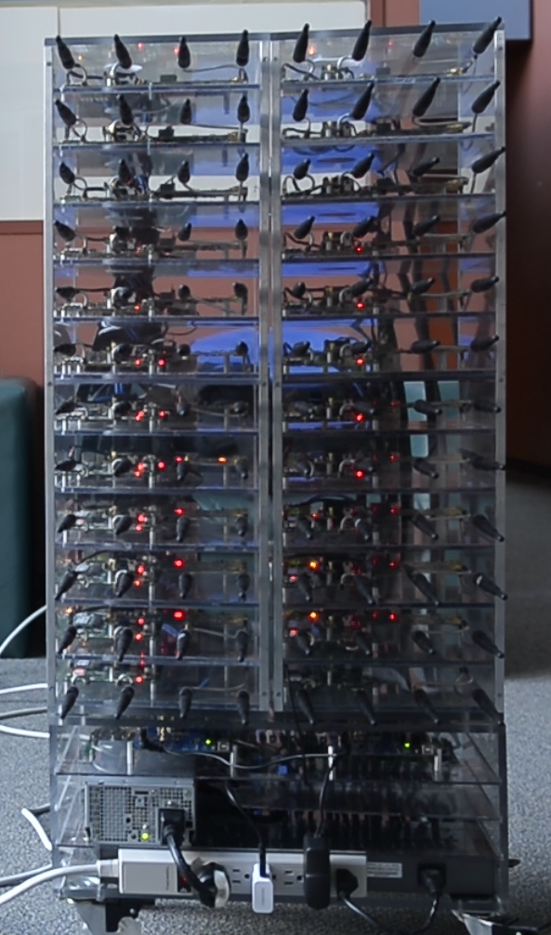
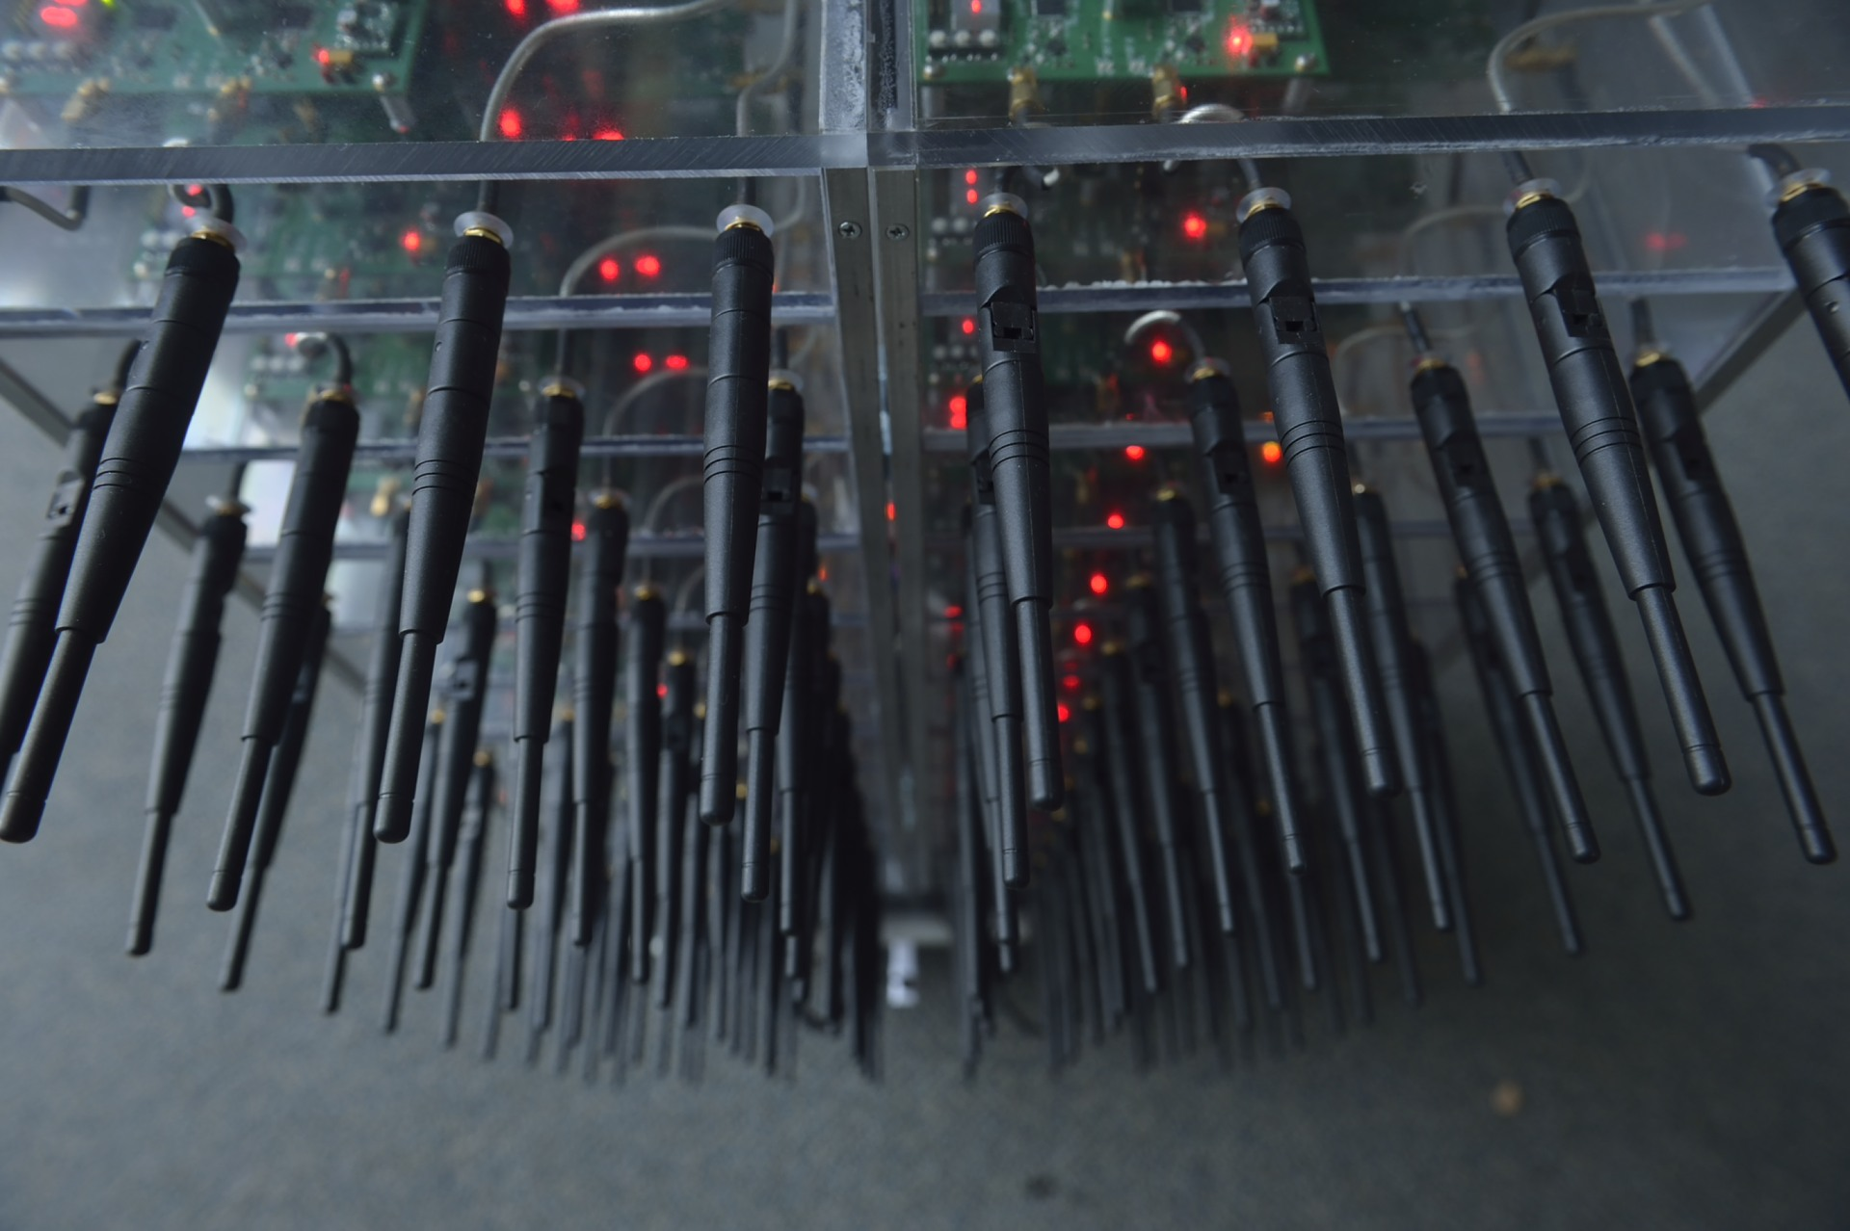

Slide 11
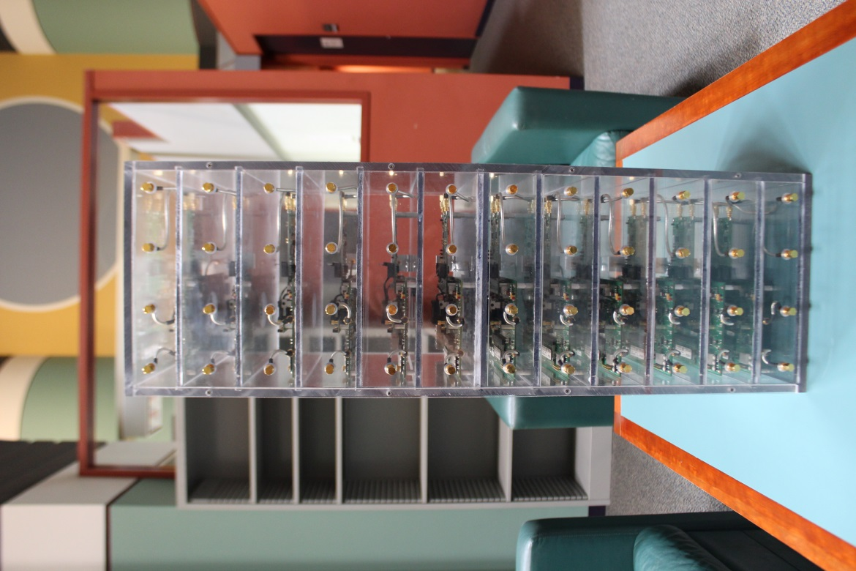
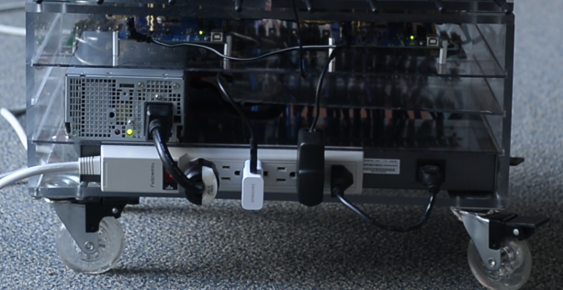
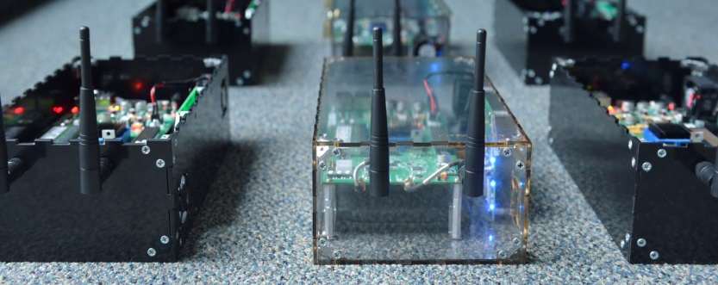
New or Improved
ArgosV2 Rack
ArgosHub
ArgosMobile
Notes:
Realtime
Fully Mobile experiments
We tested up to 120 antennas, supported 144.

Slide 12
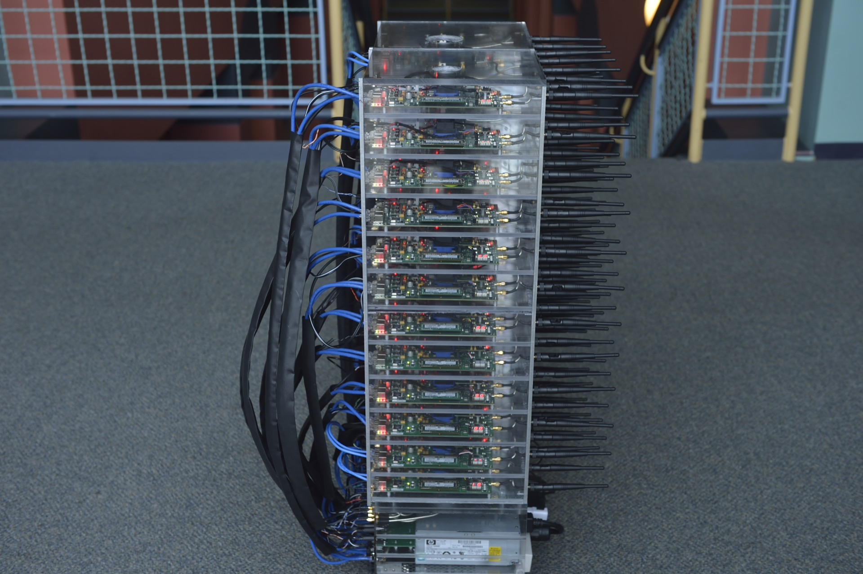

Slide 13

Notes:
Outdoor Environment for channel measurements

Slide 14
ArgosV3 An Efficient Many-Antenna Platform
Notes:
Efficient it cost, power, space, etc. Built for commercial applications.

Slide 15
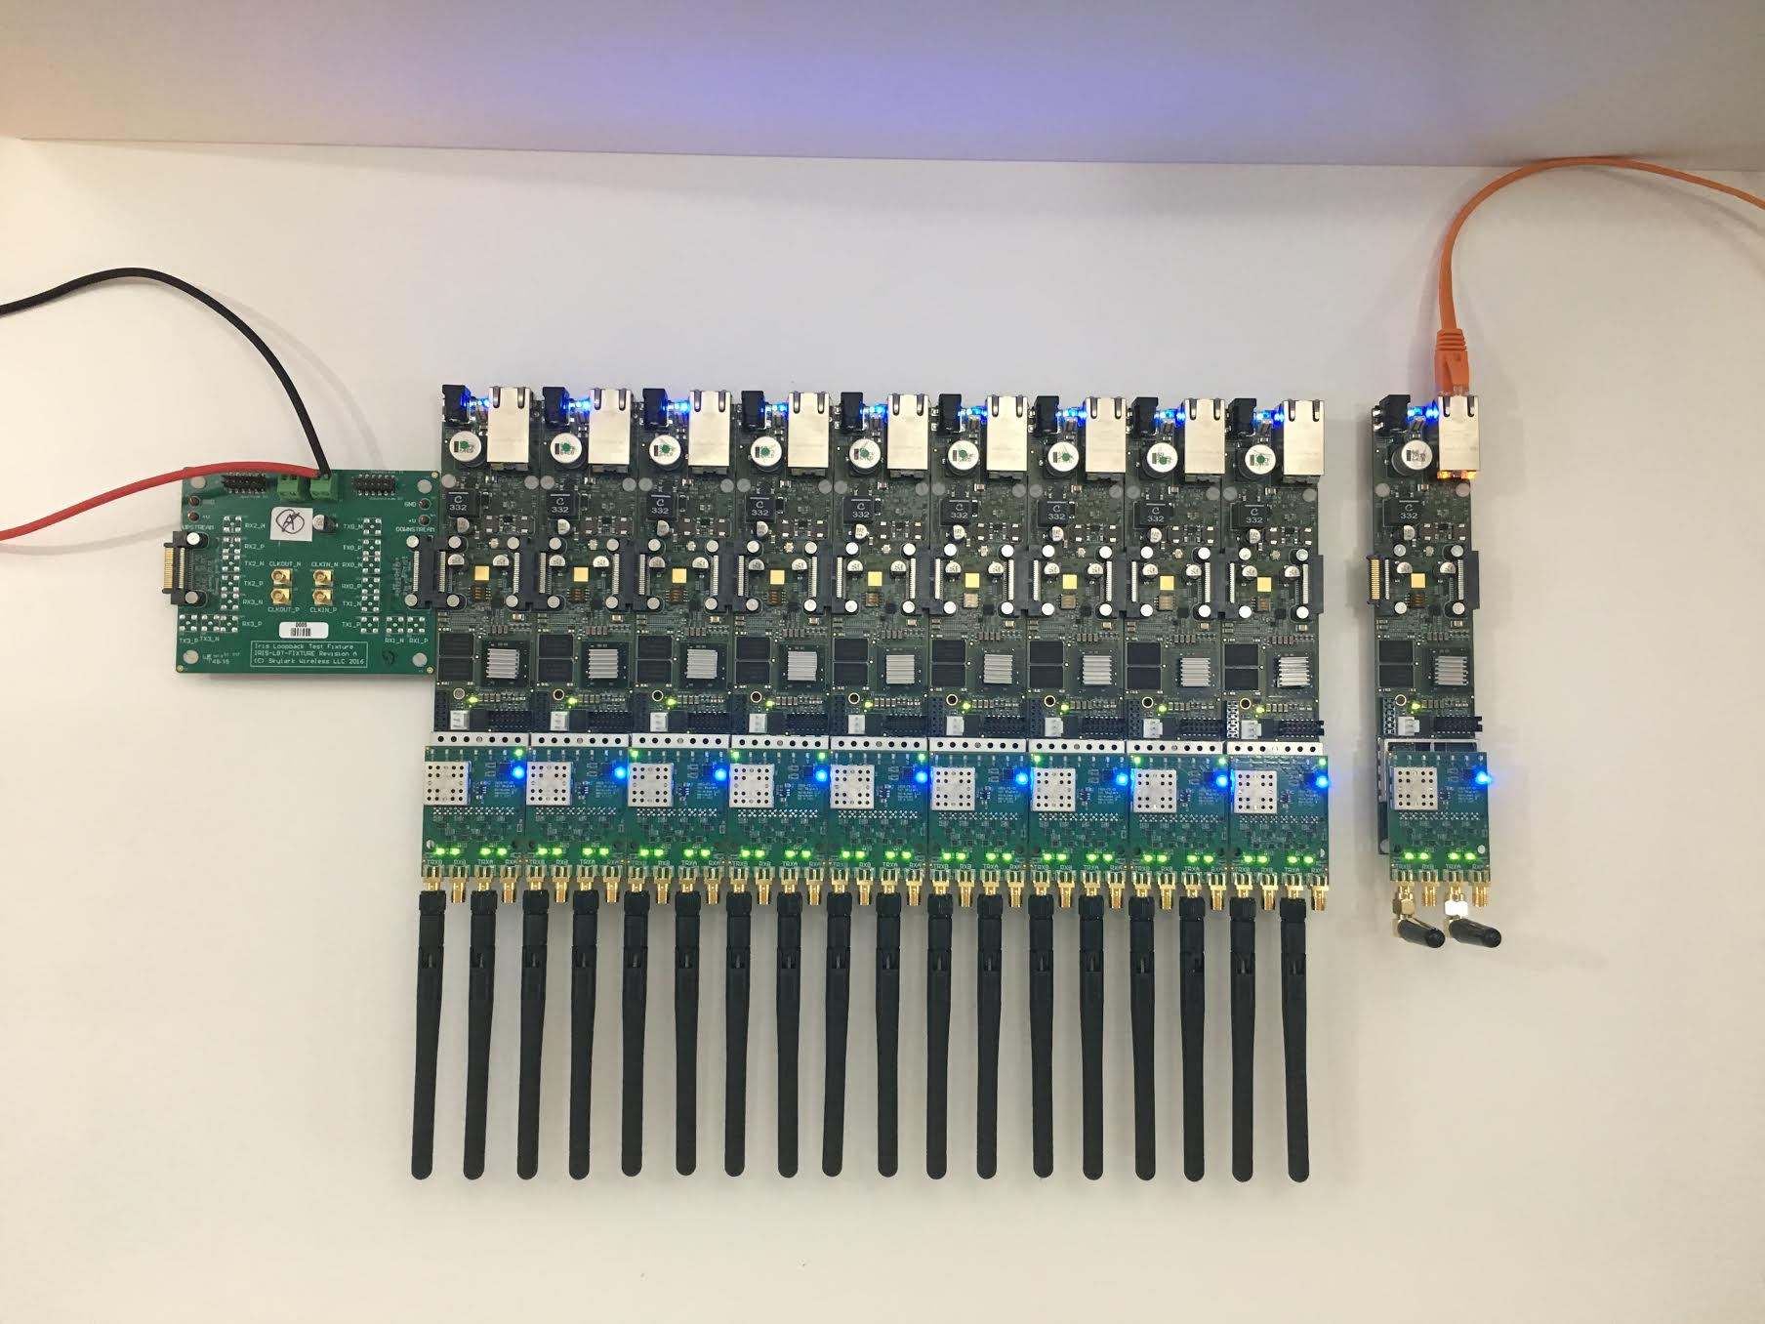
Notes:
Bus provides 13.2 Gbps, clocking, GPIO, and power (left)
PoE support (right)

Slide 16
ArgosV3 Iris Radio Modules
Lime LMS7002
2x 50 MHz to 3.8 GHz
58 MHz Bandwidth
Modular RF Frontend
Xilinx Zynq 7030
PoE
Large-Array Support

Slide 17
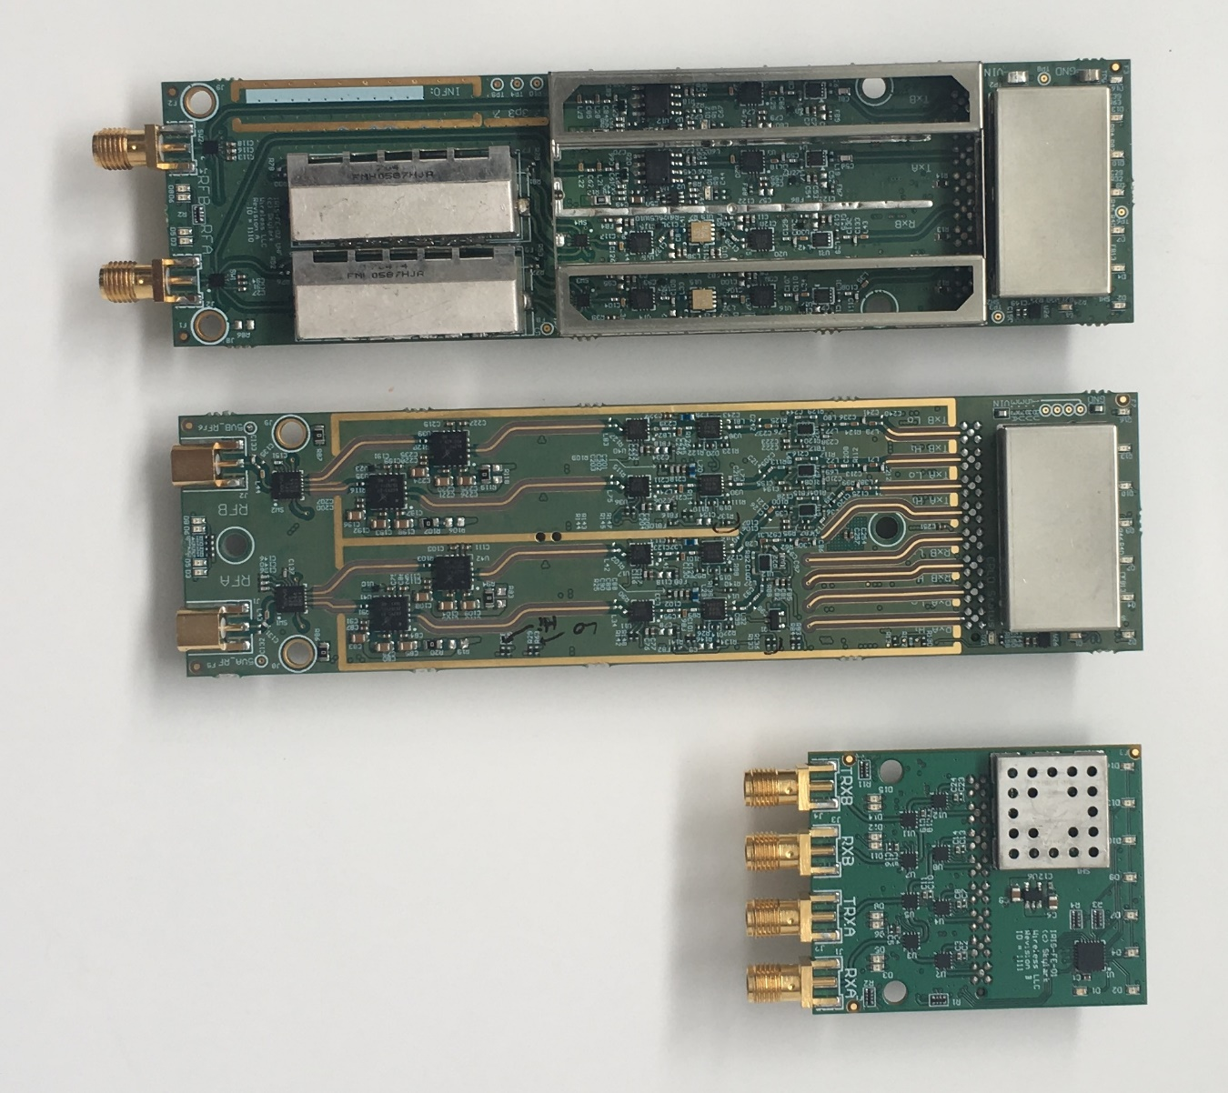
Iris RF Frontends
UHF
470 to 700 MHz
30 dBm
BRS/CBRS
2.48 to 2.7 and 3.55 to 3.7 GHz
28 dBm
Development
Notes:
Custom antennas for each band as well (6 dBi, dual-polarized, half-wavelength dimensions)

Slide 18
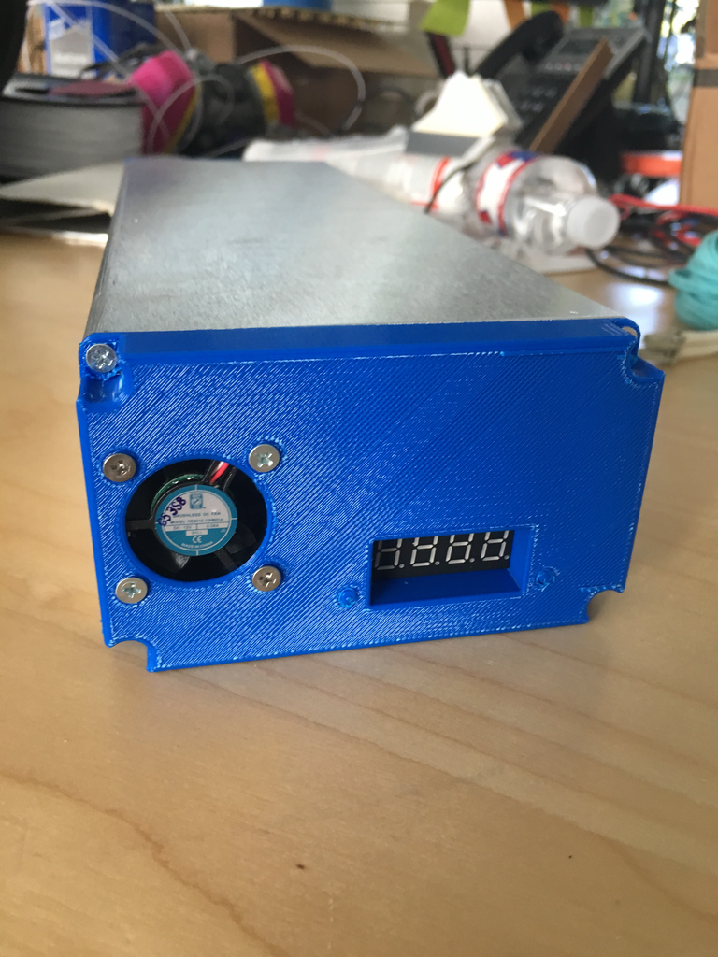
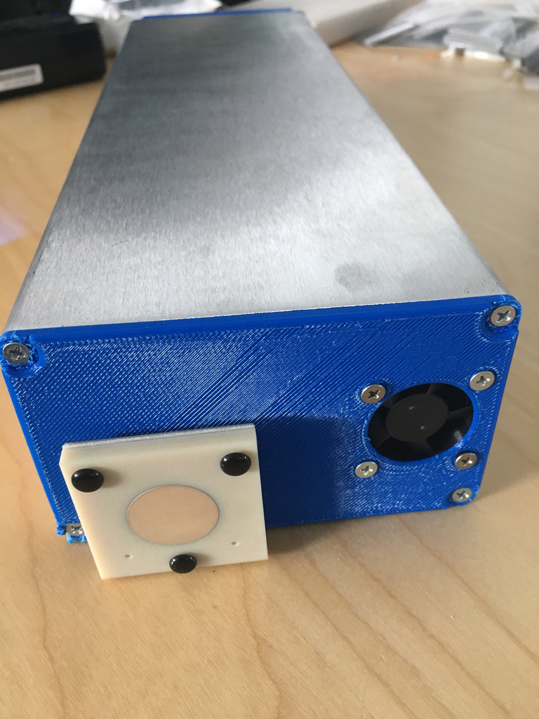
ArgosV3 Mobile
~12 Hour Battery Life
Integrated GPS
Integrated WiFi
Notes:
Mention Antennas

Slide 19
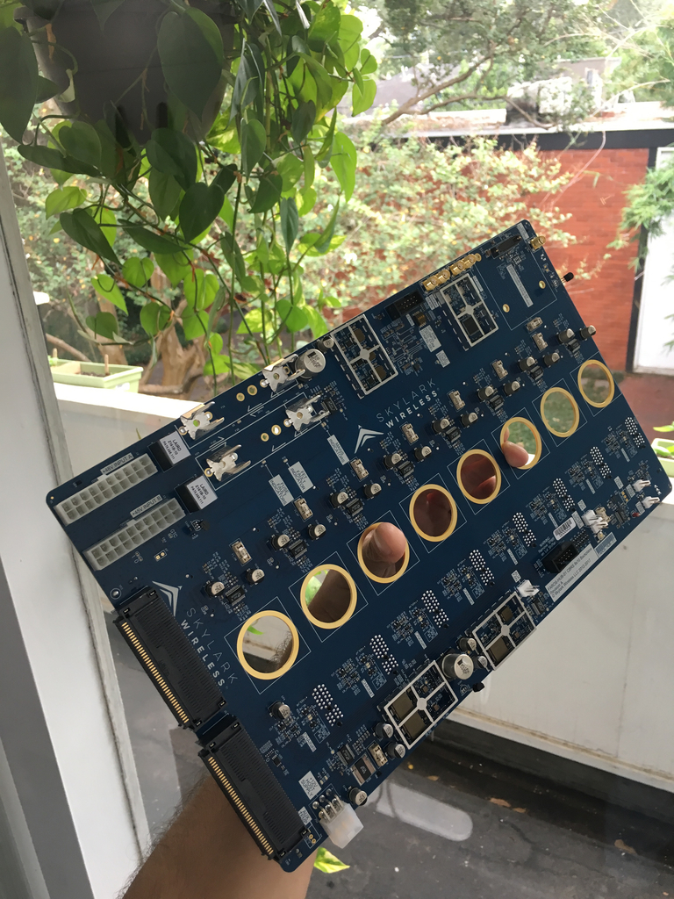
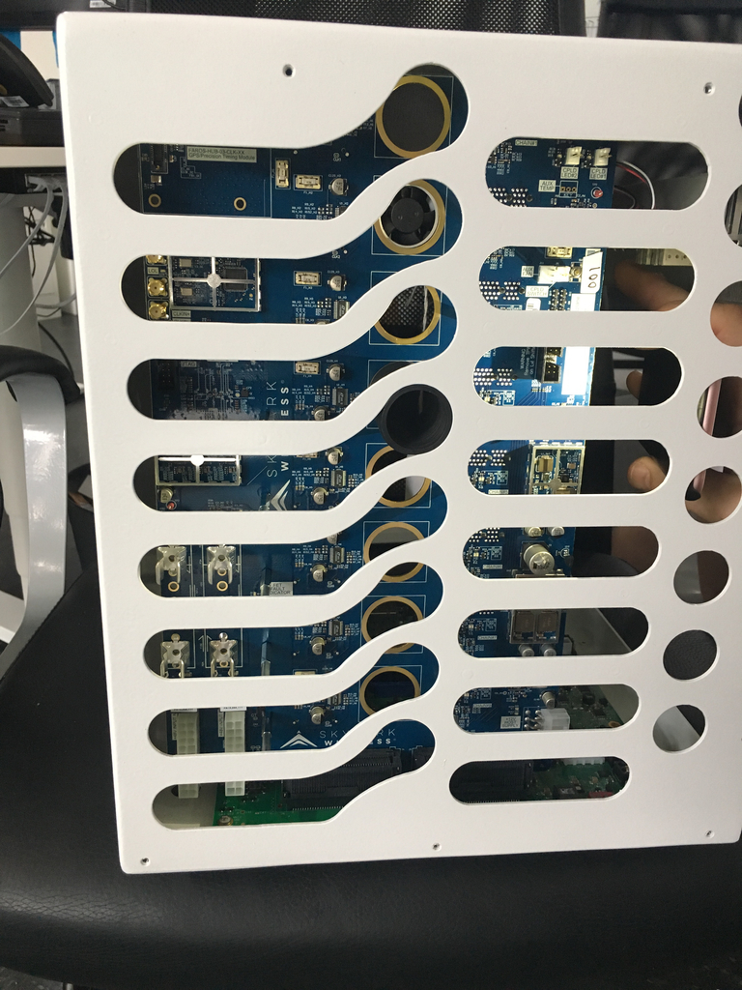
ArgosV3 Hub
8 Chains of Irises
160 Radios
Xilinx ZCU102
Integrated GPS
SyncE/PTP (NGFI)
Scale with Multiple Hubs

Slide 20
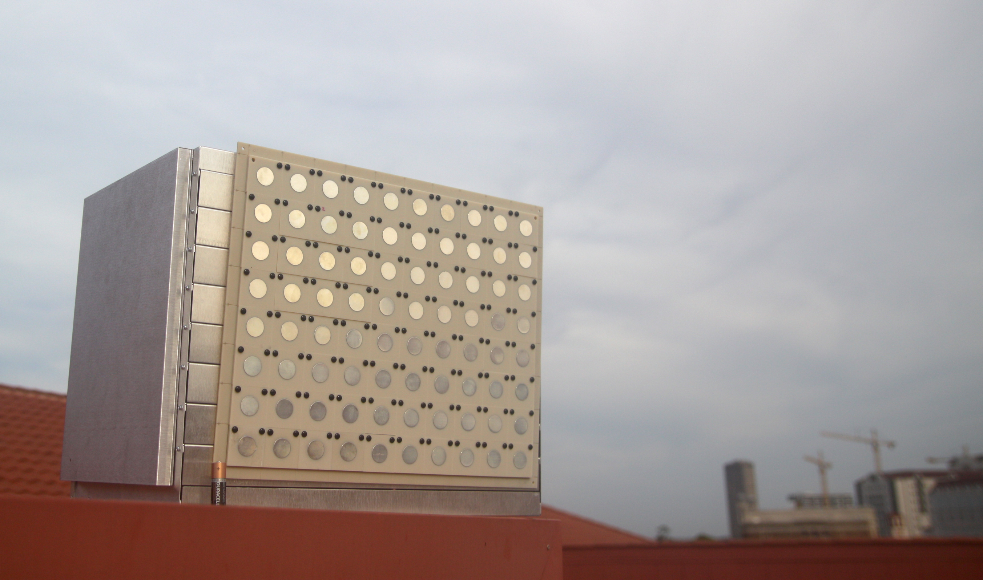
Notes:
Weatherproof enclosure
Antennas

Slide 21
Critical System Design Challenges
CSI Collection
System Architecture
Control Channel
Mobility
Multi-Cell

Slide 22
Critical System Design Challenges
CSI Collection
System Architecture
Control Channel
Mobility
Multi-Cell

Slide 23
Impact of Mobility

Slide 24
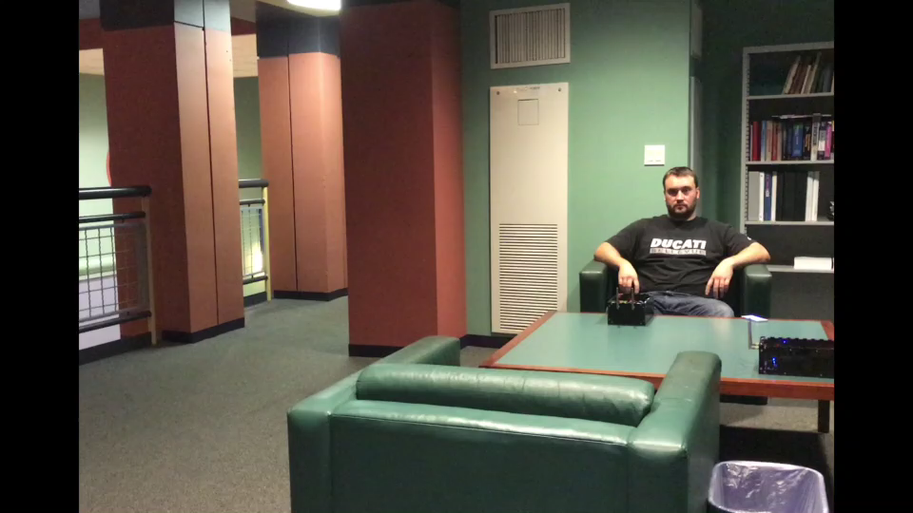
Realtime Achievable Rate of Natural Scenario
Zeroforcing
Conjugate
NLOS 96x8 5 GHz 10 ms Frame
Notes:
MCS has to be set to lowest rate to avoid drop
Mobility is bimodal
Mobility drastically affects channel capacity

Slide 25
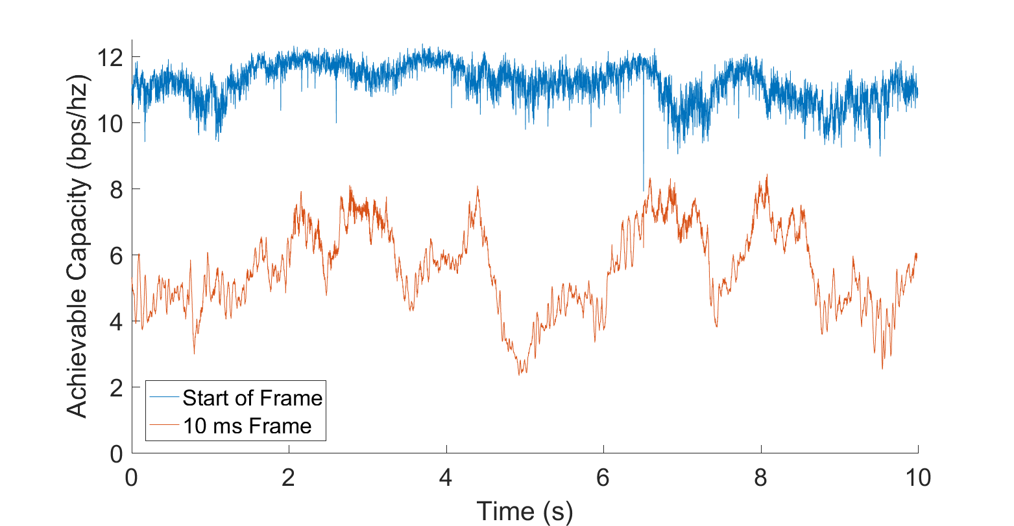
1) Mobility Significantly Degrades Capacity
NLOS 96x8 2. 4 GHz Capacity of Mobile User
Achieved Rate (bps/Hz)
50% Avg. Loss!

Slide 26
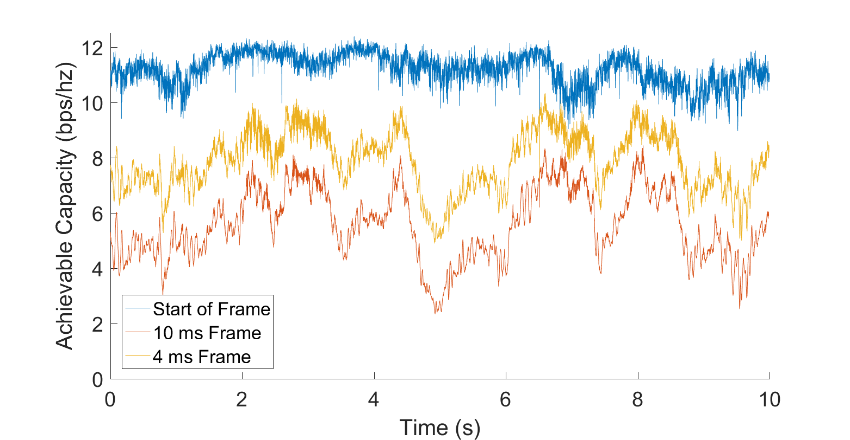
Collecting CSI Faster Helps…
NLOS 96x8 2. 4 GHz Capacity of Mobile User
Achieved Rate (bps/Hz)

Slide 27
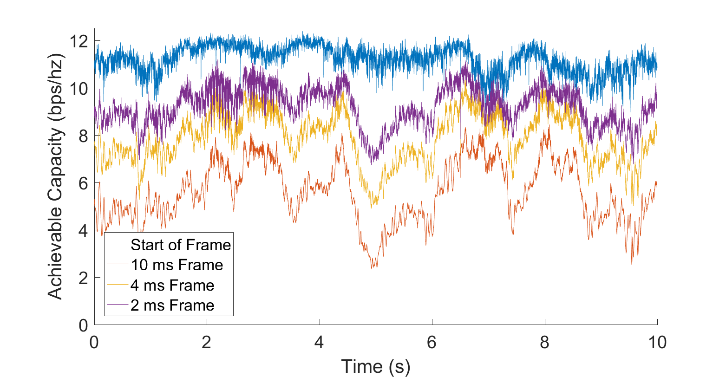
Still Significant Challenge
NLOS 96x8 2. 4 GHz Capacity of Mobile User
Achieved Rate (bps/Hz)
45% Loss!
Notes:
Still requires conservative selection of MCS

Slide 28
Mobility Fundamentally Limits Capacity
Beamformed channel achievable rate drops
System overhead
Notes:
Impacts user selection/grouping and MCS selection

Slide 29
Users Move Away from Intended Signal
Data 2
Data 3
Data 1
Data 4
Data 6
Data 5
Notes:
This enables high SNR channels to be established to all of the users simultaneously.
However, this is a very complex thing to do in real time, since it has to be recomputed within the channel coherency. It works well for a small number of users, but since it takes at least O(M*K^2) time, and is largely non-parallelizable, it does not work as the number of antennas scales up.
Examples of centralized beamforming are Zeroforcing and MMSE

Slide 30
Users Move in to Interference
Data 2
Null
Null
Null
Null
Null
Notes:
This will be stronger for some users than others, but will make it sub-optimal to serve many users simultaneously

Slide 31
Channel Degradation with Mobility
Zeroforcing 96x8 Mobile NLOS 2. 4 GHz (35 dB SNR)
Achievable Rate (bps/Hz)

Slide 32
Channel and Computational Overhead
Zeroforcing / MMSE
Collect User Locations (CSI)
Update Beampattern
Achieved Rate (bps/Hz)
Sounding Interval (s)

Slide 33
System Performance Considering Overhead
Zeroforcing 96x8 NLOS 2. 4 GHz
6 ms
Achievable Rate (bps/Hz)
6 ms

Slide 34
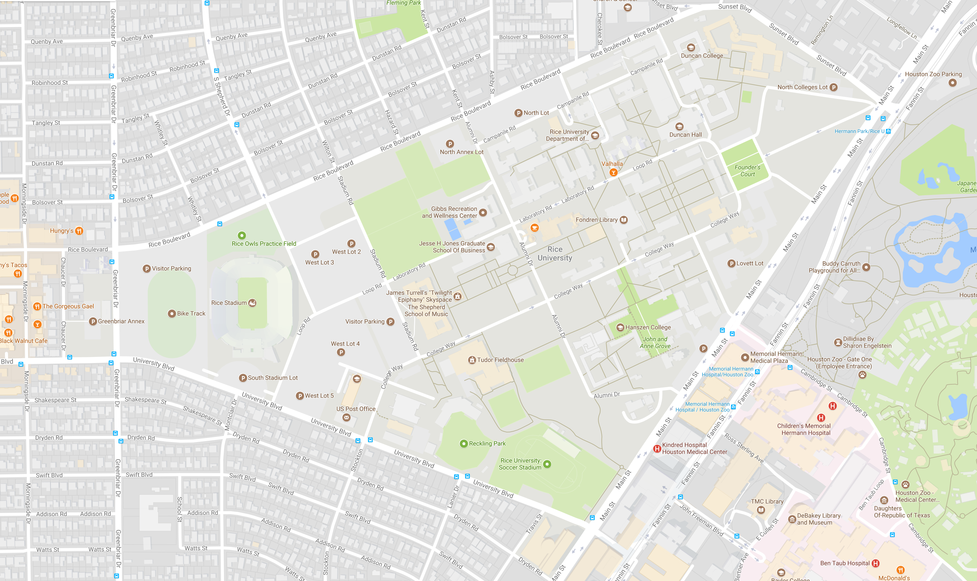



Slide 35
Argos Practical Many-Antenna Systems
Understanding & Optimizing Massive MIMO in the Real World
http://argos.rice.edu
Notes:
Demo tomorrow and Friday
Abs value
1 user
Fix kinitos explanation
Bar plot grouping – maybe change visualization
Fix conj static.
Cut faros to 3 slides.
Colorize explanation of equations
Informal statements:
Very flexible

Slide 36


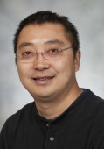



Thank You!
Rahman
Doost-Mohammady
Ryan Guerra
Lin Zhong
Jian Ding Abeer Javed Narendra Anand Eugenio Magistretti Evan Everett Hang Yu
http://argos.rice.edu
Notes:
Thanks to my advisor, colleagues, and financial sponsors.

