Slide 1


Control Channel Design for Many-Antenna MU-MIMO
Clayton Shepard Abeer Javed Lin Zhong

Slide 2
What is the control channel?

Slide 3
Anything that isn’t data

Slide 4
Control Channel Functions
Time-frequency synchronization
Association, paging, and random access
Channel state information (CSI) collection
Gain control
Scheduling, acks, handovers, etc.

Slide 5
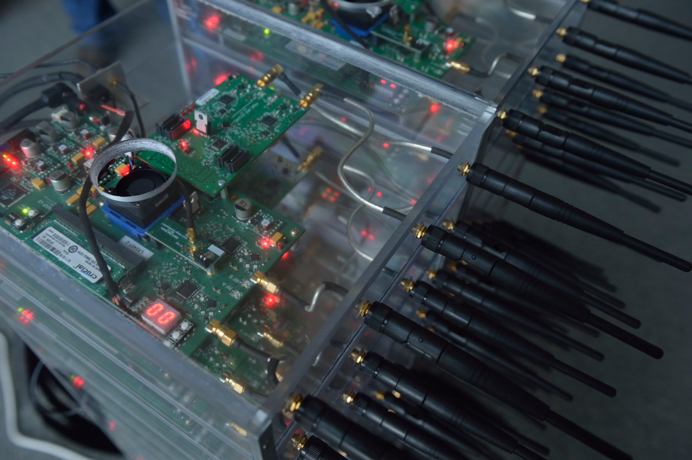
Notes:
When we were building our realtime reference design we realized traditional control channel techniques weren’t practical for many-antenna MU-MIMO systems.

Slide 6
Traditional control channels aren’t practical for many-antenna MU-MIMO

Slide 7


MU-MIMO Gain Gap
Single Antenna
MU-MIMO

Slide 8
Antennas are peak-power constrained!
Notes:
For simplicity, we use the term antenna to include both the radio and antenna.
When engineering a radio, it only has so much transmission power; that transmission power cannot be shared with other radios, unlike what theory often assumes.
Of course, there may also be a total power constraint imposed by the FCC or other regulations.

Slide 9
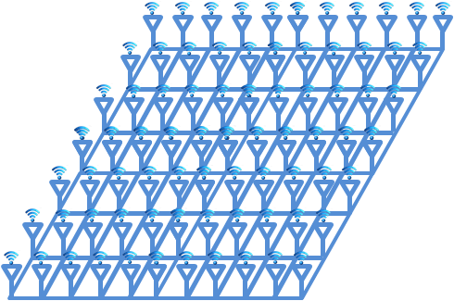
Gap grows with M²!
M Base Station Antennas
K Users
M
M²/K
Traditional Sync
MU-MIMO
Notes:
An individual WARP radio has a transmit power of ~20 dBm, thus a 100 antenna array has a total transmit power of 40 dBm, and an additional beamforming gain of up to 20 dB. This means that it has a potential EIRP of up to 60 dBm!
Base station can only focus energy towards users once channel estimates have been collected.
This gain is bidirectional, but the uplink only grows with M since users’ transmit power does not increase.

Slide 10
M-Antenna Gain?
M²/K
M
All Antennas?
Single Antenna
MU-MIMO
Notes:
It is important to ask, why can’t we just transmit from all of the antennas simultaneously to get an M-fold power gain over a single antenna?
There are techniques, such as CDD that can do this.

Slide 11
Multi-antenna techniques don’t work for synchronization or CSI collection!
Notes:
However, all multi-antenna techniques cause either temporal or spatial distortion.

Slide 12
Existing Solutions Don’t Work!
Widely adopted/efficient technique is correlation
802.11 uses Cyclic Delay Diversity for MIMO systems
Distortion causes performance to degrade with M!
SINR (dB)
Number of Antennas (M)
Notes:
This figure shows the SNR (power of the peak to the average power) for an autocorrelation of a standard 802.11 long training symbol (LTS) with a version of itself transmitted with CDD using multiple antennas.
It is actually even worse than this, since it ends up obscuring the peak, which means there could be false positives, leading to even more timing inaccuracy.
The reason for CDD is that they are trying to equalize power, but this causes arbitrary beamforming per subcarrier.

Slide 13
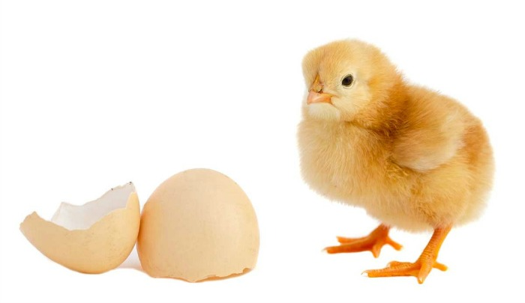
Notes:
We are left with a classic chicken and egg problem.
This photo is found on hundreds of sites online, so we aren’t sure who to cite. If you own the copyright to this photo, please let us know so we can credit you accordingly, or remove it, if necessary.
http://www.shellypalmer.com/2015/02/which-came-first-the-chicken-or-the-egg-data-science-can-help/

Slide 14
From-scratch control channel design for many-antenna MU-MIMO

Slide 15
Faros
Notes:
This lighthouse photo is found on hundreds of sites online, so we aren’t sure who to cite. If you own the copyright to this photo, please let us know so we can credit you accordingly, or remove it, if necessary.
http://wallpaperswide.com/lighthouse_4-wallpapers.html
https://plus.google.com/105129939098222809957/videos?pid=5971544456979296082&oid=105129939098222809957 LightHouseVisionGroup

Slide 16

Notes:
Given the venue, perhaps we should have called it Eiffel.
This photo is found on hundreds of sites online, so we aren’t sure who to cite. If you own the copyright to this photo, please let us know so we can credit you accordingly, or remove it, if necessary.
http://www.easyoffer.net/p/eiffel-tower-at-night-wallpaper-desktop-background-upo7.jpg

Slide 17
Key Insight I:
Send as much as possible over MU-MIMO

Slide 18
Critical Control Channel Operations
Synchronization
Association
CSI collection
Paging
Random access
Notes:
Only these operations have to be done outside of the MU-MIMO mode.

Slide 19
Key Insight II:
Synchronization and association are not time critical
Notes:
This allows us to make critical performance tradeoffs which drastically reduce overhead while only slightly delaying association

Slide 20
Solving the Gain Gap

Slide 21
Faros Gain Matching: Beamforming
Sweep open-loop beams!
No time-distortion
Power scales with M²
Needs many beams (more time)
Still doesn’t provide full range
Coverage Gap
Traditional Sync
MU-MIMO
Open-loop Beam
Notes:
Other multi-antenna techniques, such as CDD, create time-distortion.
Beams should actually not be next to each other in order to improve coverage.
Omnidirectional visualization, but same issue for directional antennas.
Really the beams are a bit larger since they are not split between multiple users, but the coverage cap can still be there, especially in the presence of multipath nulls.

Slide 22
Gain Gap: Solution
Use coding gain!
Increase coverage area
Flexible range control
Takes more time
Full Coverage
Traditional Sync
MU-MIMO
Open-loop Beam
Faros
Notes:
All coding gain comes from sending for longer period of time (thus increasing total receive power integrated over time).

Slide 23
Faros Gain Matching Flexibility
Traditional Sync
MU-MIMO
Faros
Notes:
To increase range more beams and more coding can be used. Of course, this is a tradeoff with the achievable modulation rate in the downlink and uplink.
To reduce latency, beams should not be swept contiguously, but this is difficult anyway without calibration (both within the RF chains as well as to the environment).
Applies to LOS and NLOS (obviously harder to predict propagation in NLOS) as well as directional antennas
Other benefits / architectural considerations:
Fine grained control over coverage area
Reduced/stable inter-cell network interference
Reuse MU-MIMO hardware
Cheaper clients (higher tolerable receive sensitivity)
Tailor overhead
Accommodates Synchronization (no time-distortion)
Potential coverage area grows with M² (or reduce power per antenna by M²)
Spread power dissipation across wider space, less total TX power required (makes passive cooling easier)
Beamforming actually helps reduce multipath, increasing detectability

Slide 24
Faros Control Channel Design

Slide 25

MU-MIMO Frame Structure
CC
CC
Downlink
Downlink
Uplink
Uplink
CC
Beacon
CC
Beacon
CC
Beacon
Uplink
Downlink
CC
Uplink
Pilots
CC
Pilots
Pilots
Paging
Paging
Paging
Notes:
All MU-MIMO has some form of beacon/preamble to advertise the base station and establish synchronization.
Next they have to collect CSI for the users.
And finally send/receive data to some subset of the users.
Since users are not continuously transmitting, there also need to be mechanisms for paging and random access so that the base station can contact inactive users and inactive users can contact the base station, respectively.
They do not necessarily need to occur in this order (though the pilots are only ephemerally valid)

Slide 26
Synchronization
Beacon
Paging
Wait for beacon to establish synchronization
Notes:
Beacons will almost never be directly pointed at a user, but that’s okay because the coding gain allows them to detect even low RSSI beacons.

Slide 27
Association
Pilots
Send association request in dedicated slot
Notes:
This also enables the base station to collect CSI!

Slide 28
Association
Pilots
Use MU-MIMO channel to transmit remaining control
Notes:
(including paging replies and association requests)

Slide 29
Random Access
Pilots
Dedicated slots for random access
Notes:
(including paging replies and association requests)

Slide 30
Collecting CSI
Pilots
OFDMA for extra gain
Coded for even more gain
Notes:
By sending in OFDMA, users send for at least K times longer, which provides a gain of K.
Users at cell edges send even longer codes to ensure good CSI collection.
It is important to realize that when compared to existing systems, there is no need for additional transmit power or coding at the mobile. The extra coding gain simply further extends the potential range of the network.

Slide 31
Paging
Beacon
Paging
Use last known user location to reduce latency!
Notes:
Users also periodically send random access requests to update their location and check for missed pages.

Slide 32
Negligible Overhead
Parameter
Overhead
Code Length | Bandwidth | Frame Length | Number of Beams |  | Channel Utilization | Association Delay | Random Access
128 | 20 MHz | 15 ms | 100 |  | 0.04% | 750 ms | 7.5 ms
128 | 40 MHz | 1 ms | 100 |  | 0.32% | 50 ms | 0.5 ms
256 | 20 MHz | 10 ms | 100 |  | 0.13% | 500 ms | 5 ms
256 | 20 MHz | 5 ms | 500 |  | 0.26% | 1250 ms | 2.5 ms
512 | 40 MHz | 2 ms | 1000 |  | 0.64% | 1000 ms | 1 ms
1024 | 80 MHz | 1 ms | 4000 |  | 1.28% | 2000 ms | 0.5 ms
Not necessary to receive every beacon!
Notes:
Faros can be flexibly tuned for the specific implementation by trading off channel overhead with association and random access delay.
For example, in environments with very high coherence times (e.g. stationary or low carrier frequency) beacons can be sent much less often.
Note that while in this simplistic example beacons are sent at the beginning of every frame, this doesn’t have to be the case. Beacons can be sent more or less often than CSI is collected, they don’t have to be coupled.
Faros flexibly enables channel overhead to be traded off with association and random access delay.
It is important to note that these numbers are very pessimistic, as only someone at the cell edge (probably outside the range of communication) would only be able to detect a single beam in the sweep. Also, the delay can be further reduced by increasing the coding gain (and thus likelihood of detecting a beam).
Since synchronization is maintained over the MU-MIMO mode, it isn’t necessary to receive beacons frequently enough to maintain sync.

Slide 33
Faros Real World Performance

Slide 34
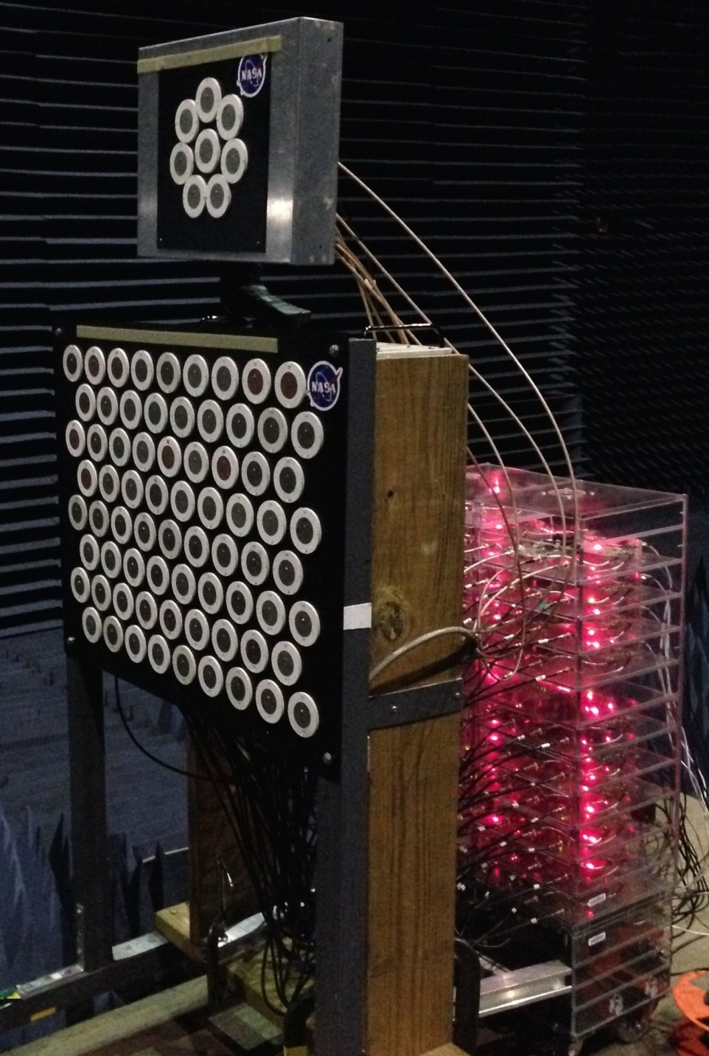

Slide 35
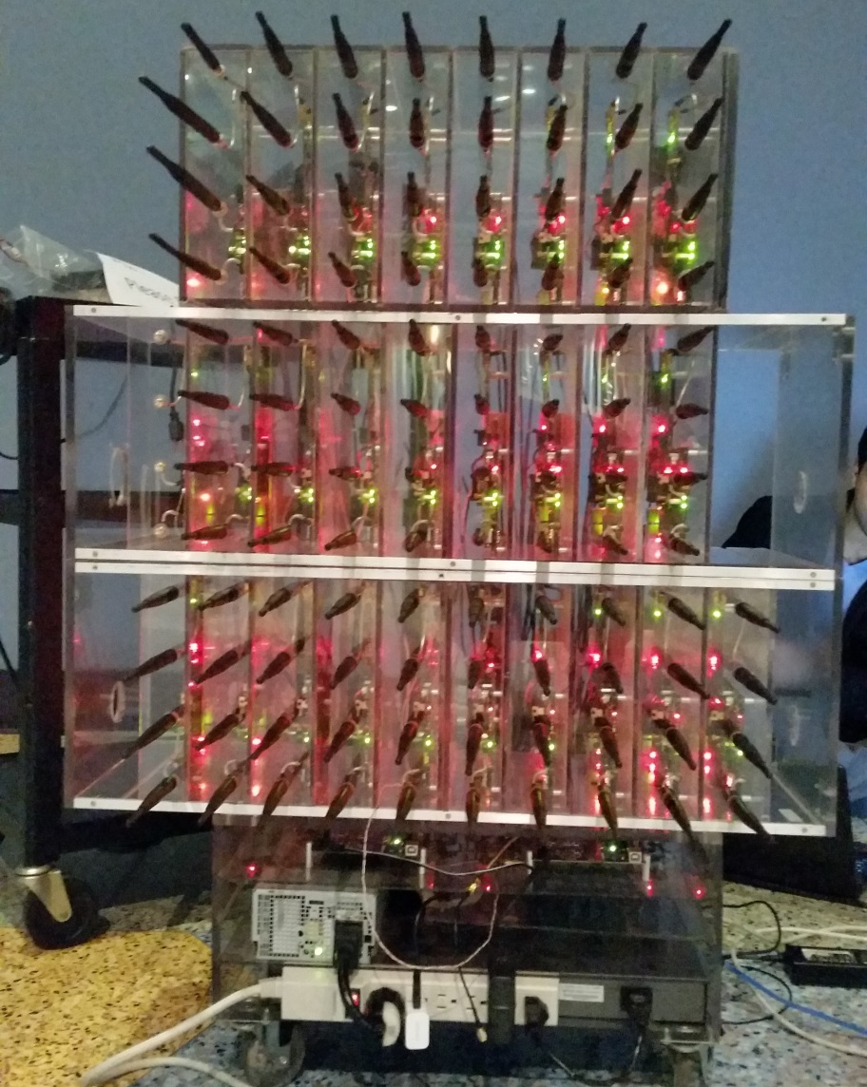

Slide 36
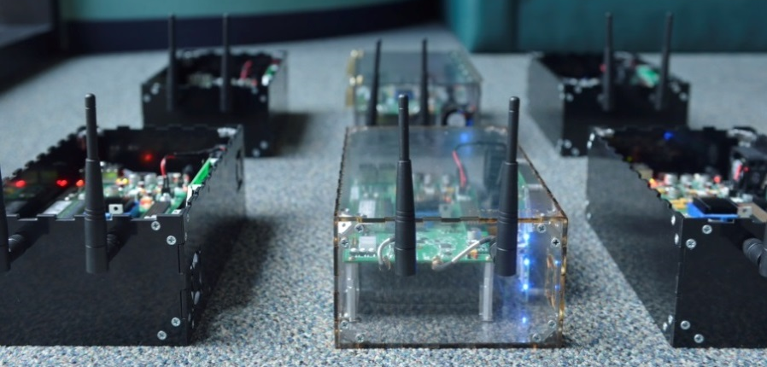

Slide 37
Method Selection
Hadamard beamforming weights
Full spatial coverage
Kasami psuedo-orthogonal coding
Encode base station ID and user ID
Low (bounded) streaming correlation
Notes:
The Faros system design is agnostic to the specific open-loop beamforming and coding techniques employed.
However, we found that Hadamard open-loop beamforming is a good choice, as it provides a perfect PAPR and complete spatial coverage without requiring any calibration of the array or for the environment.
We also find that Kasami sequences (including Gold sequences) are a good choice for encoding the Beacon and Paging sequences, as they provide a low, bounded, streaming correlation with both themselves and other sequences and provide a significant coding gain while still being able to convey a small amount of information.

Slide 38
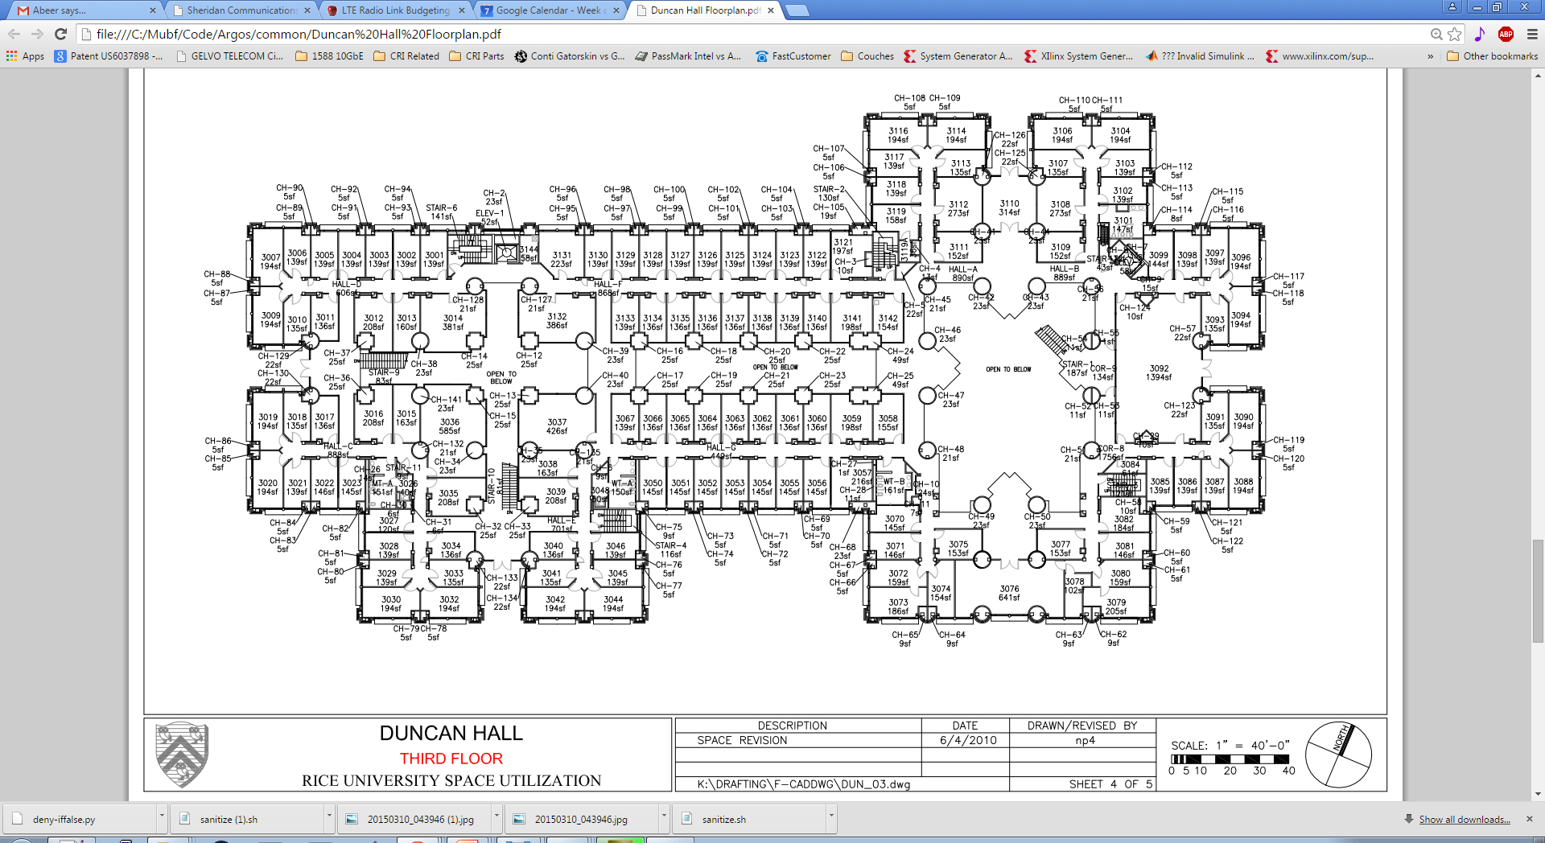
Base-station Locations
User Locations
’
’
’
’
’
’
68 Indoor User Locations
32 Anechoic User Locations
5 Base-station Locations
Over 1, 400,000 Measurements
Notes:
5 base station locations (1 anechoic, 4 indoor).
100 user locations (68 Indoor, 32 Anechoic).
Over 14,000 measurements at each location (3 iterations, 6 methods, M beams, K paging signals + K beacons).
No false positives.

Slide 39
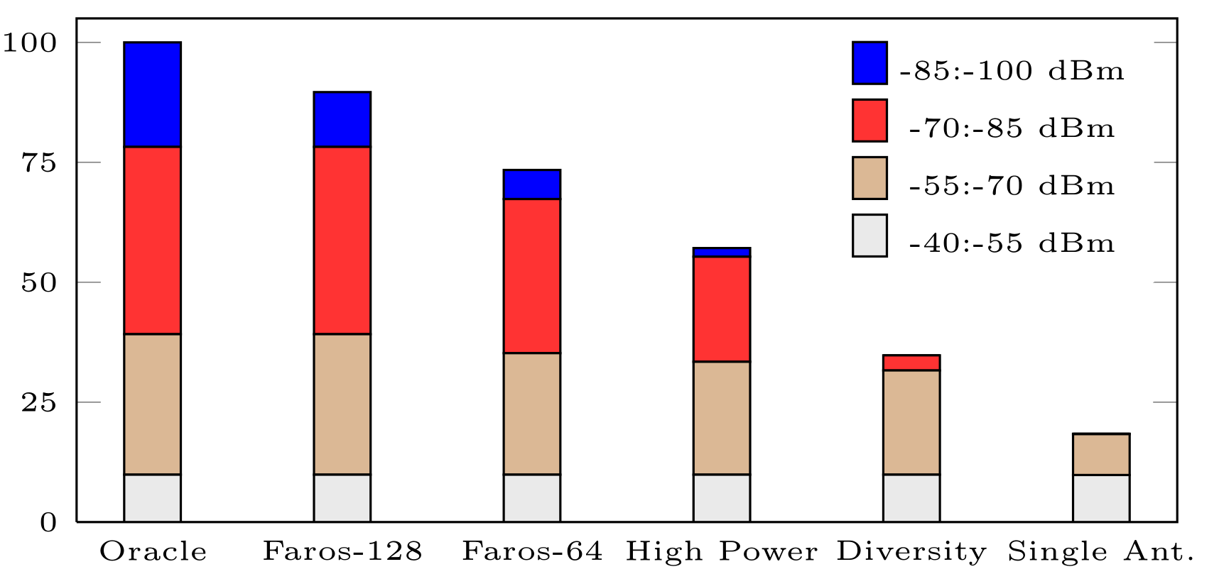
Faros Drastically Increases Range
Beacon Sweeps Detected (%)
Method
Notes:
Based on average uplink RSSI to all base station antennas. 100 locations: 32 anechoic, 68 indoor.
The Oracle represents all locations that were represented by any one of the methods.

Slide 40
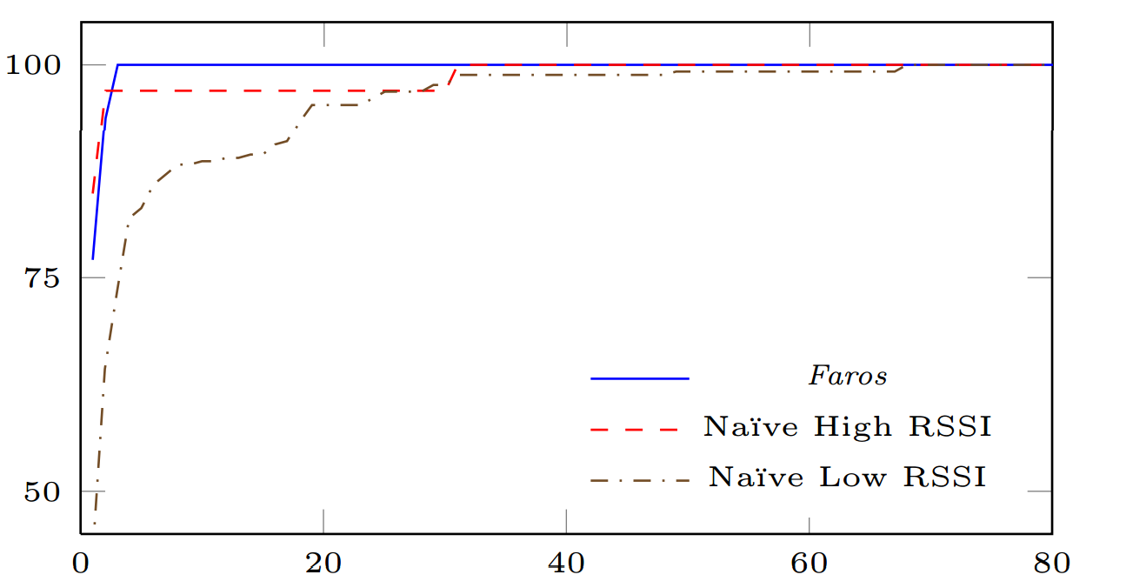
Faros Decreases Paging Delay 4x
CDF of First Detection (%)
Delay (Frames)
Notes:
Low-high RSSI is split at -70 dBm. These results only use the last 44 indoor locations with the 108-antenna base station, as we changed the paging search metric.
Worst case improvement of 68 to 3, over 20x.
Note that we have to pause after every beacon/paging symbol to collect statistics, which drastically reduces performance.

Slide 41
Broader Implications
250 m range line-of-sight with 10 mW power
Used as realtime framework for Argos
Faros allows space-time-code resources to be traded off for desired performance and coverage
Notes:
Enabling base stations to leverage previous information about user location to optimize network performance, as well as extend range
Which enables high resolution channel measurements to all antennas simultaneously with up to 100s of users.
Tested outdoors and walked 250m LoS with 100uW per antenna (10mW total), and only stopped when we went behind a building.
Enables:
High-resolution channel measurements
Fully wireless operation
Multi-base station
Very flexible system
Fine grained control over coverage area
Reduced/stable network interference
Reuse MU-MIMO hardware
Cheaper clients (higher tolerable receive sensitivity)
Tailor overhead
Accommodates Synchronization (no time-distortion)
Potential coverage area grows with M (or reduce power per antenna by M²)
Spread power dissipation across wider space, less total TX power required (makes passive cooling easier)

Slide 42
Conclusion
Faros is a highly efficient from-scratch control channel design for MU-MIMO
Faros operates in realtime and provides over 40 dB of gain on a 108-antenna array
Faros solves a critical barrier to the implementation and adoption of massive MIMO
http://argos.rice.edu
Notes:
Faros leverages open-loop beamforming and coding to fully close the MU-MIMO gain gap

Slide 43

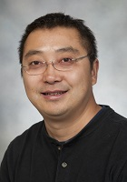





Acknowledgements
Abeer Javed
Lin Zhong
Eugenio Magistretti
Evan Everett
Hang Yu
Eugenio Magistretti
http://argos.rice.edu
Notes:
We thank:
Eugenio Magistretti for his work on 802.11ec, which provided the initial simulation and codebase we modified for testing, as well as insightful discussions regarding pn-sequences and CFO correction.
Evan Everett for his help with experimental setups.
Hang Yu for his initial work on developing the Argos framework.
Ashutosh Sabharwal for insightful theoretical discussions.
Nathan Zuege for help in constructing the base station.
NASA, JSC for the use of their Antenna Test Facility.
We thank the reviewers and shepherd for their constructive input; we especially thank Reviewer B for correcting a mistake in our original uplink gain gap analysis.

Slide 44
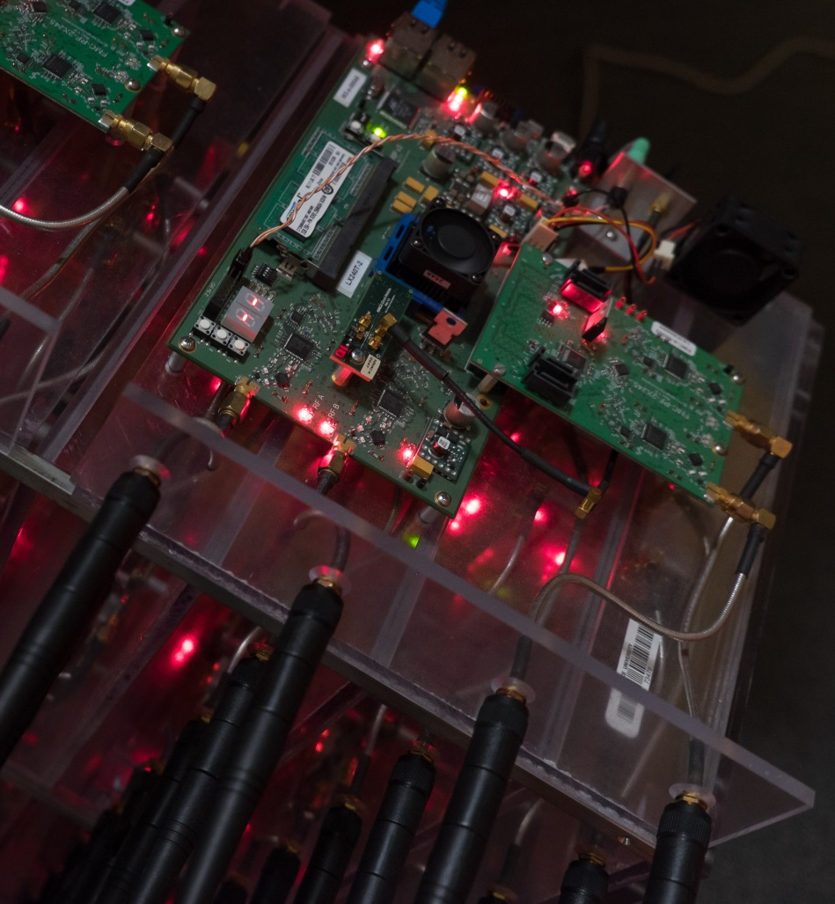
Faros Control Channel Design
Highly-Efficient Design
Realtime Implementation
Solves Critical Barrier
http://argos.rice.edu

Slide 46
Bonus Slides

Slide 47
Single User Beamforming Gain Gap
Single Antenna
MU-MIMO
Single User Beamforming
Notes:
MU-MIMO base stations can serve a variable number of users, including just a single user. Since the power is no longer split between multiple users, the range for a single user is actually even longer than MU-MIMO.

Slide 48
What about the users?
User Power ≈ Base Station Power
Traditional Sync
MU-MIMO
Client
Faros
Notes:
The total power of the client is in a single antenna. It is reasonable to assume that the total transmit power of the user is on the same order as the total transmit power of the base station. There is still a residual gain gap, which Faros resolves with OFDMA and a coding gain.

Slide 49
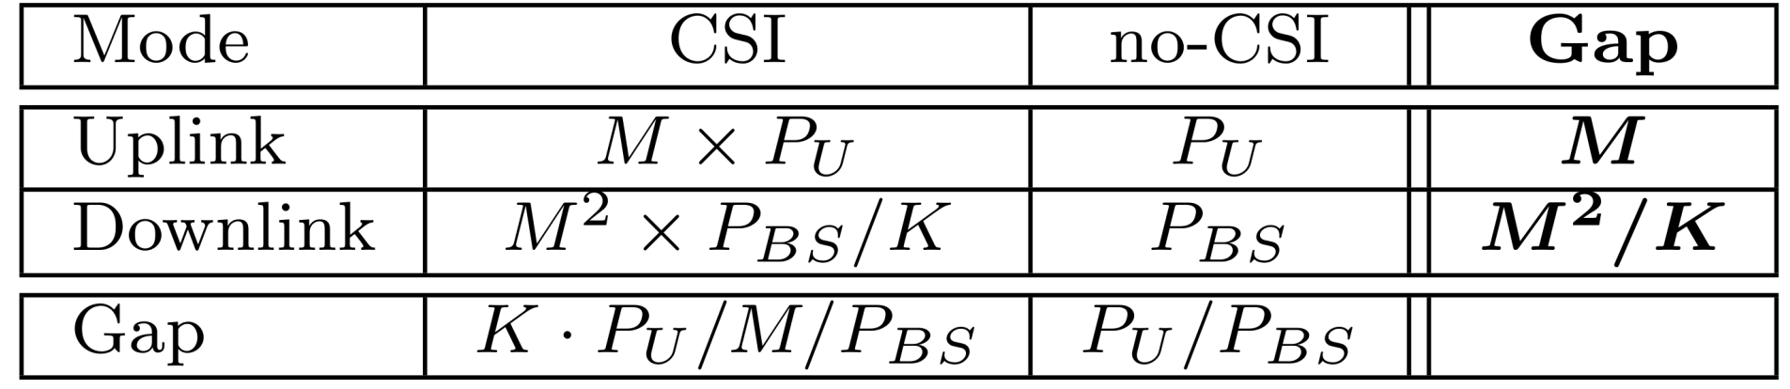

Gain Gap Characterization
M | Base Station Antennas
K | Users
P_{BS} | Power of Single Base Station Antenna
P_{U} | Power of User Antenna
Notes:
Under a peak-power per antenna constraint the downlink gain scales with M². Under a total power constraint, typically assumed in theoretical work, the gain gap scales with M.
However, it is important to note, that even with a total power constraint, using Faros means that each antenna can be provisioned with proportionally less transmit power.

Slide 50
Soft Association
Random Access Request (CSI)
Random Access Request (CSI)
Notes:
Base station ID is encoded in beacon
Beacons are beamswept and use coding gain
User waits to hear all nearby base stations, and looks at aggregate power of all beacons (and number).
If it isn’t clear which base station is stronger, it will soft-associate to both to determine signal quality (and other details, such as authentication and full SSID).

Slide 51
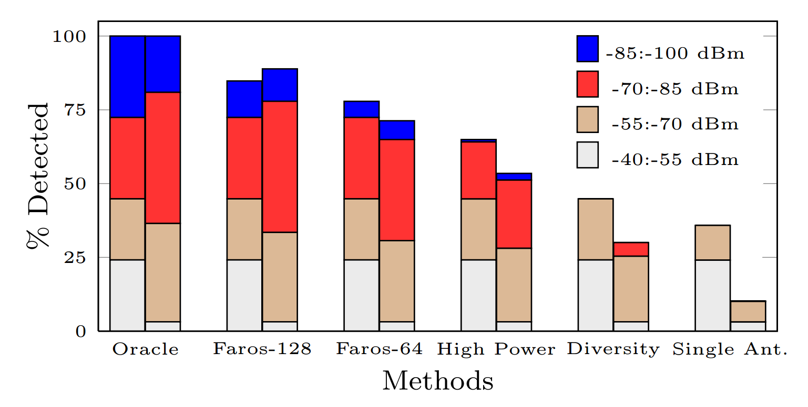
Faros Drastically Increases Range
Notes:
Based on average uplink RSSI to all base station antennas. 100 locations, 32 anechoic on left, 68 indoor on right.
Note that we stop after every beacon/paging sequence to record statistics, which makes it actually underperform.
Took it outdoors and walked 250m LoS with 100uW per antenna (10mW total), and only stopped when we went behind a building.

Slide 52
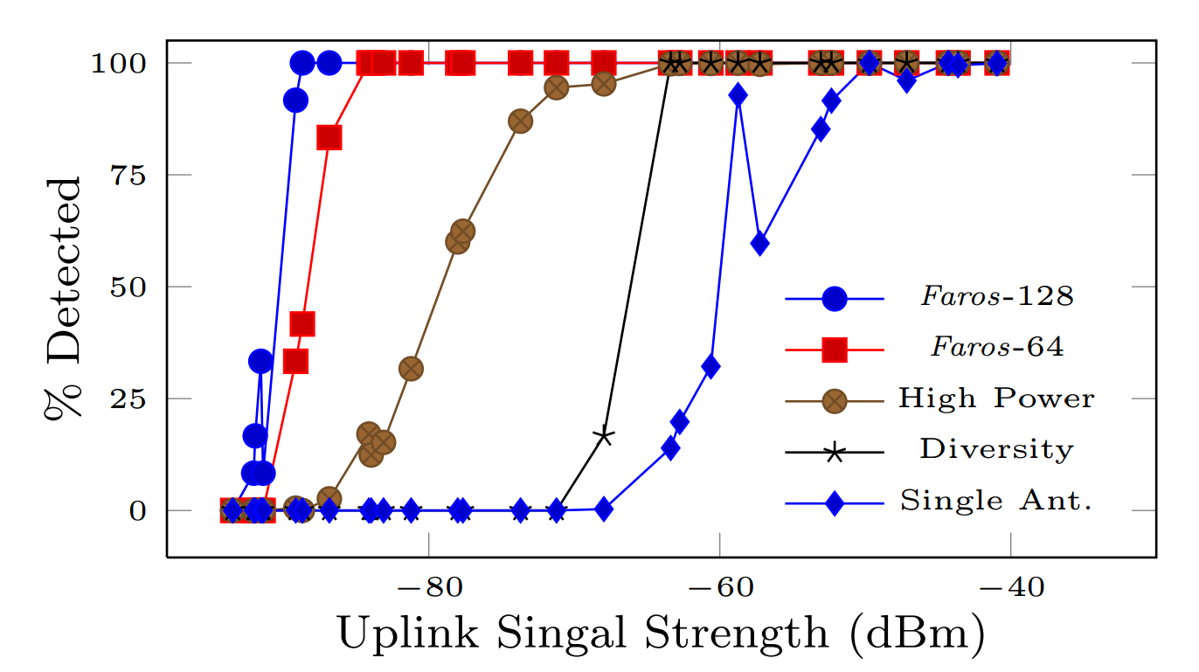
Faros Provides Over 40 dB Gain
Faros Outperforms Traditional by 40 dB
Notes:
This is performed in the anechoic chamber, since multipath indoors makes performance not scale with RSSI.
We do not know for sure what the irregularity is. Since many of the curves have a small irregularity, it seems that one mobile may have slightly better rx performance, and in one case during a single-antenna transmission it just happened to correctly identify a very noisy beacon.

Slide 53
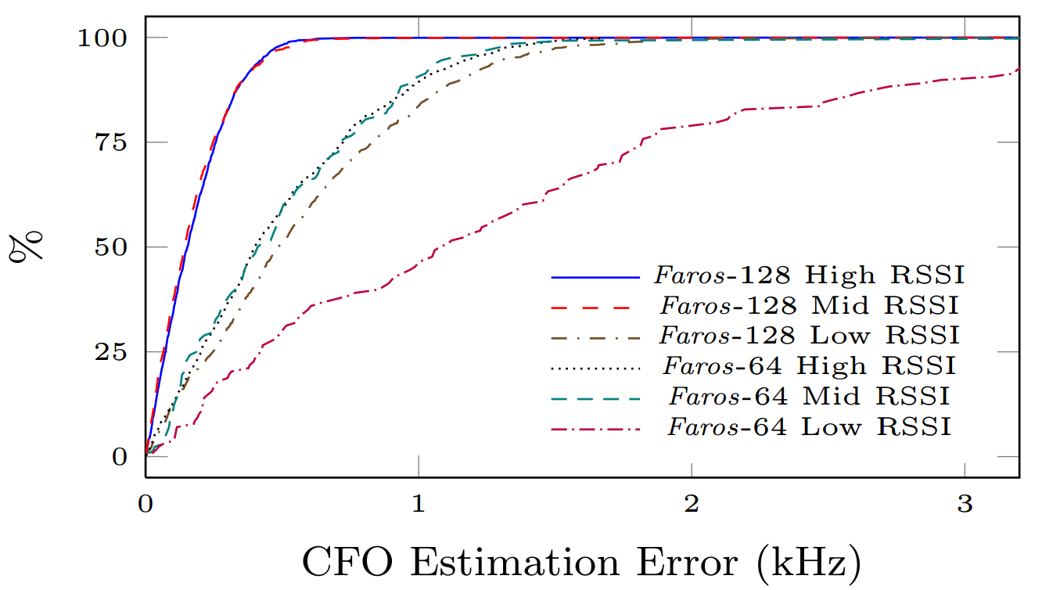
Faros Reliably Corrects CFO
Notes:
CFOs from from -10 kHz to 10 kHz
60 dBm (High), -75 dBm (Mid), and -90 dBm (Low) RSSIs

Slide 54
Faros Example
Notes:
This is a picture since the animation didn’t work well otherwise. Original at end. Picture has artifacts which need to be fixed.
All MU-MIMO has some form of beacon/preamble to advertise the base station and establish synchronization.
They also have to collect CSI for the users
And finally send/receive data to some subset

Slide 55

Synchronization
Widely adopted/efficient technique is correlation
Where R is the received samples and S is the transmitted sequence
$$\sum_{i=1}^{n}{(r_{t−i}×{s_{i}^{}}^{∗}})$$
for every received sample r_{t} given transmitted sequence S.

