Slide 1

Networking with massive MU-MIMO
Lin Zhong
http://recg.org

Slide 2
Guiding Principles
Spectrum is scarce
Hardware is cheap, and getting cheaper
Notes:
Looking at wireless today, we see that
-Spectrum is scarce, and demand is growing exponentially.
-Hardware is cheap, and getting cheaper.

Slide 3
Antennas

Slide 4


Omni-directional base station
Data 1
Poor spatial reuse; poor power efficiency; high inter-cell interference

Slide 5
Sectored base station
Data 2
Data 1
Data 3
Better spatial reuse; better power efficiency; high inter-cell interference

Slide 6
Single-user beamforming base station
Data 2
Data 3
Data 1
Data 5
Better spatial reuse; best power efficiency; reduced inter-cell interference

Slide 7
Multi-user MIMO base station
Data 2
Data 3
Data 1
Data 4
Data 6
Data 5
M: # of BS antennas
K: # of clients (K ≤ M)
Best spatial reuse; best power efficiency; reduced inter-cell interference

Slide 8
Key benefits of MU-MIMO
High spectral efficiency
High energy efficiency
Low inter-cell interference
Orthogonal to Small Cell solutions
  Centralized vs. distributed antennas

Slide 9
Why massive?
More antennas ➔ Higher spectral efficiency
More antennas ➔ Higher energy efficiency
Simple baseband technique becomes effective
T.L. Marzetta. Noncooperative cellular wireless with unlimited numbers of base station antennas. IEEE Trans. on Wireless Comm., 2010.

Slide 10
Background: Beamforming

Slide 11
Background: Beamforming
Constructive Interference
=

Slide 12
Background: Beamforming
Destructive Interference
=
Constructive Interference
=

Slide 13
Background: Beamforming
Constructive Interference
=
Destructive Interference
=

Slide 14
Background: Beamforming
?

Slide 15
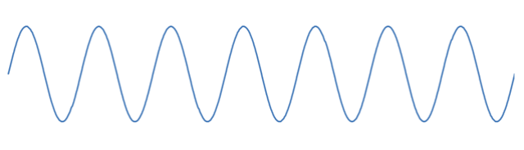
Background: Channel Estimation
Due to environment and terminal
mobility estimation has to occur
quickly and periodically
Path Effects (Walls)
The CSI is then calculated at the
terminal and sent back to the BS
Align the phases at the receiver to
ensure constructive interference
For uplink, send a pilot from the
terminal then calculate CSI at BS
Uplink?
A pilot is sent from each BS antenna
BS
+
+

Slide 16
Background: Multi-user MIMO
BS
M: # of BS antennas K: # of clients
K ≤ M

Slide 17
Multi-user MIMO: Precoding
(Kx1 matrix)
(M x 1 matrix)
BS
M: # of BS antennas K: # of clients
K ≤ M

Slide 18
Linear Precoding
(Kx1 matrix)
(M x 1 matrix)
BS
M: # of BS antennas K: # of clients
K ≤ M

Slide 19
Background: Zeroforcing Beamforming
Null
Null
Data 1
Null
Null
Null

Slide 20
Background: Zeroforcing Beamforming
Data 2
Null
Null
Null
Null
Null

Slide 21
Background: Zeroforcing Beamforming
Data 2
Data 3
Data 1
Data 4
Data 6
Data 5

Slide 22
Background: Conjugate Beamforming
Data 1

Slide 23
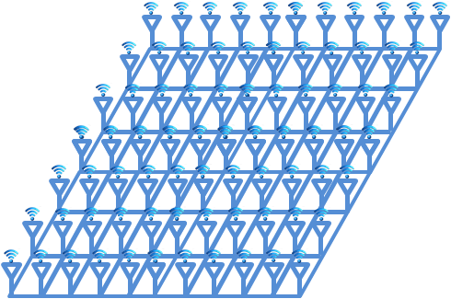
With more antennas
Data 1

Slide 24
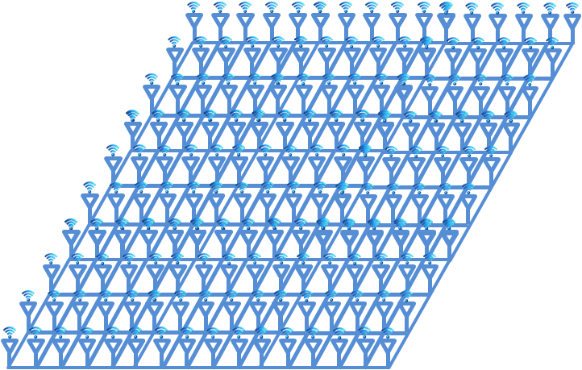
With even more antennas
Data 1

Slide 25
Conjugate Multi-user Beamforming
Data 2
Data 3
Data 1
Data 4
Data 5
Data 6
Conjugate approaches Zeroforcing
as M/K➔∞

Slide 26
Conjugate vs. Zeroforcing
Trivial computation
Suboptimal capacity
Scalable
Nontrivial computation
Close to capacity achieving
Not scalable

Slide 27
Recap
Estimate channels
Calculate weights
Apply linear precoding

Slide 28
Scalability Challenges
Estimate channels
  M+K pilots, then M•K feedback
Calculate weights
  O(M•K²), non-parallelizable, centralized data
Apply linear precoding
  O(M•K), then O(M) data transport

Slide 29
Argos’ Solutions
Estimate channels
  New reciprocal calibration method
Calculate weights
  Novel distributed beamforming method
Apply linear precoding
  Carefully designed scalable architecture
O(M•K) → O(K)
O(M•K²) → O(K)
O(M•K) → O(K)
C. Shepard et al. Argos: Practical many-antenna base stations. ACM MobiCom, 2012.
Notes:
The point here is that we can increase the number of basestation antennas arbitrarily, with monotonically increasing performance (there is no additional overhead).
Be sure to stress that it is per-radio though – each radio can support a given number of users, but you can have as many as you want on the base station.

Slide 30
Solution: Argos Architecture
Central Controller
Data Backhaul
…
Argos Hub
Argos Hub
Argos Hub
…
Module
Module
Module
Module
Module
…
…
Module
Radio
Radio
Radio

Slide 31
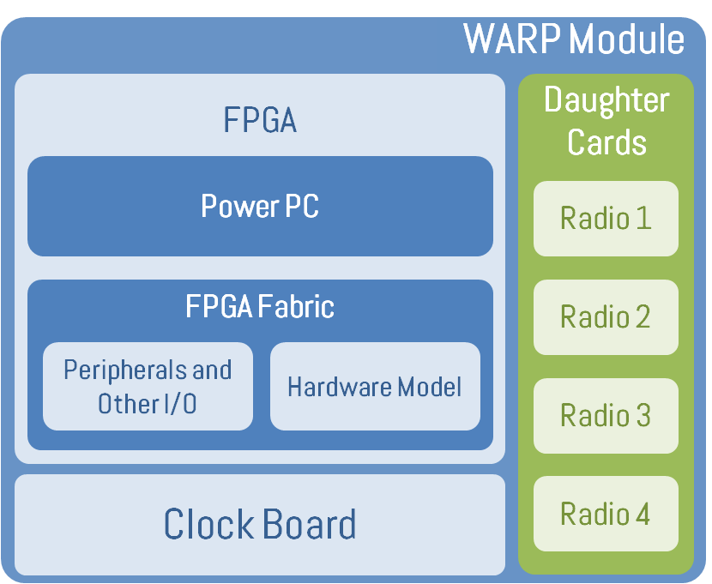
Argos Implementation
WARP Module
…
…
Central Controller
(PC with MATLAB)
Central Controller
FPGA
Daughter Cards
WARP Module
WARP Module
FPGA
Daughter Cards
Ethernet
Power PC
FPGA
Daughter Cards
Radio 1
Argos Hub
Power PC
Argos Hub
Power PC
Radio 1
FPGA Fabric
Radio 1
Radio 2
Ethernet
Peripherals and Other I/O
Hardware Model
Argos
Interconnect
FPGA Fabric
Radio 2
Argos
Interconnect
Radio 3
Module
FPGA Fabric
Radio 2
Peripherals and Other I/O
Hardware Model
Sync Pulse
Peripherals and Other I/O
Hardware Model
Radio 3
Module
Clock Board
Radio 4
Radio 3
…
Clock Board
Radio 4
Clock Distribution
Clock Board
Radio 4
…
Module
16

Slide 32
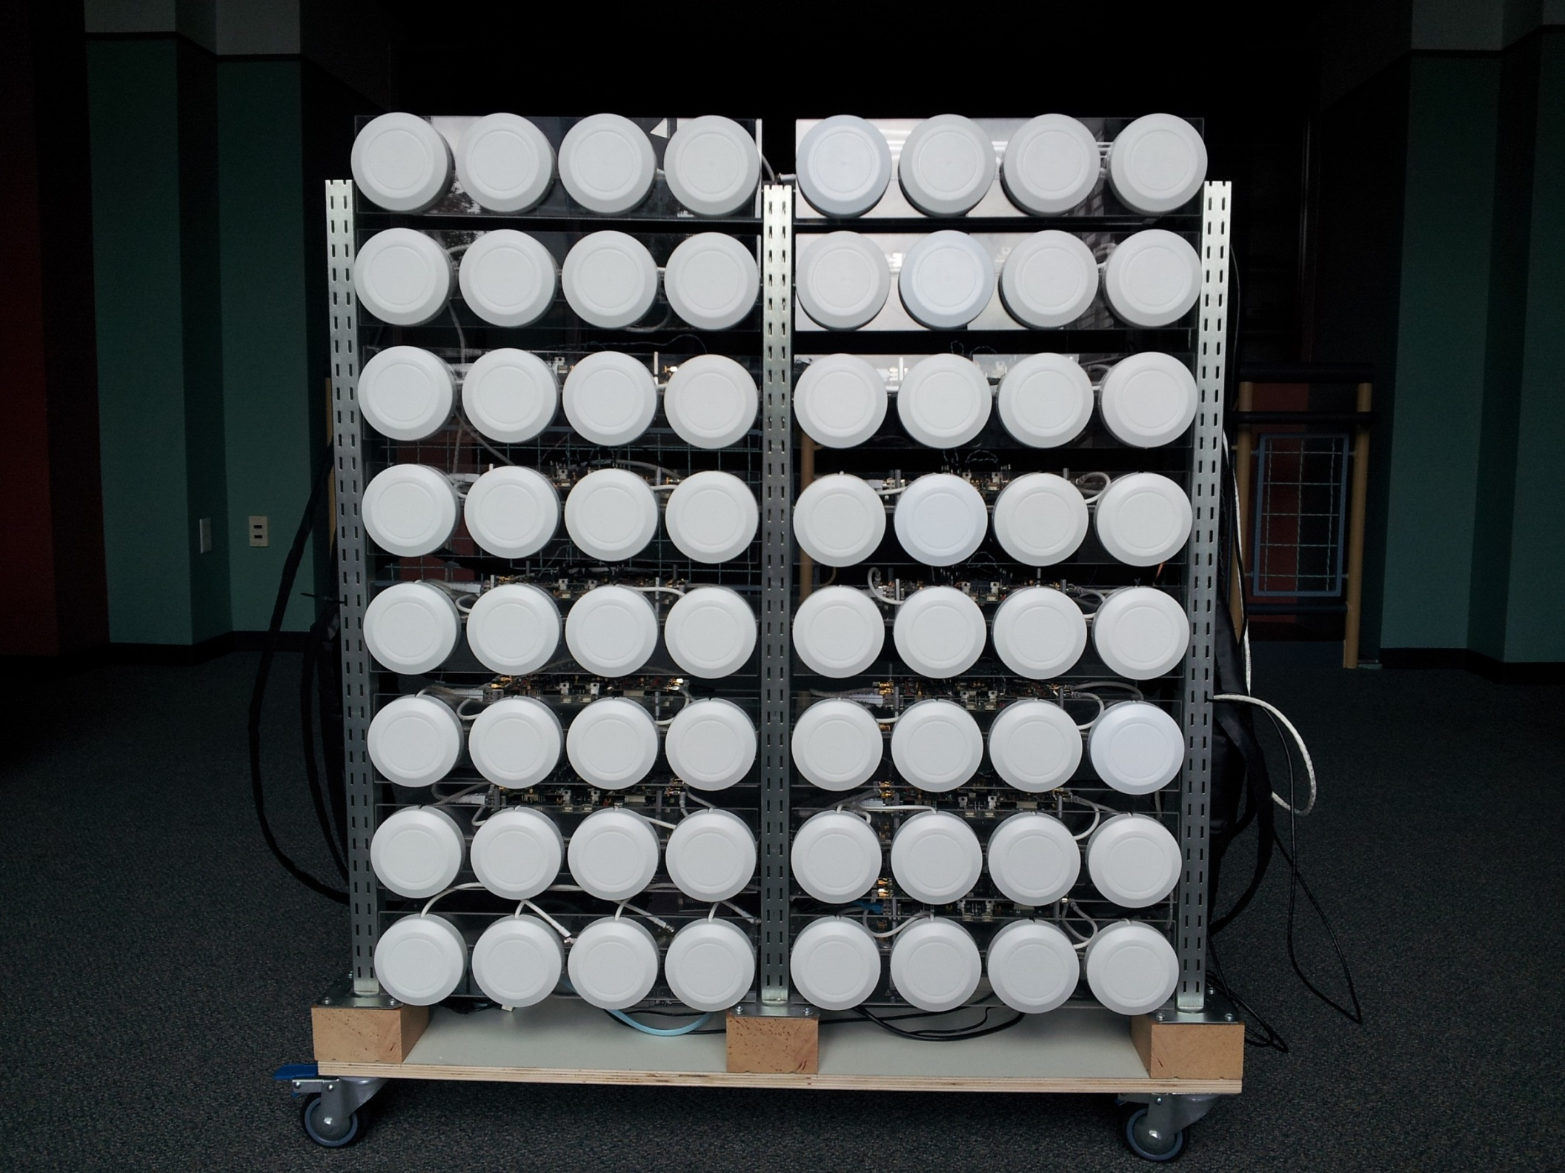

Slide 33
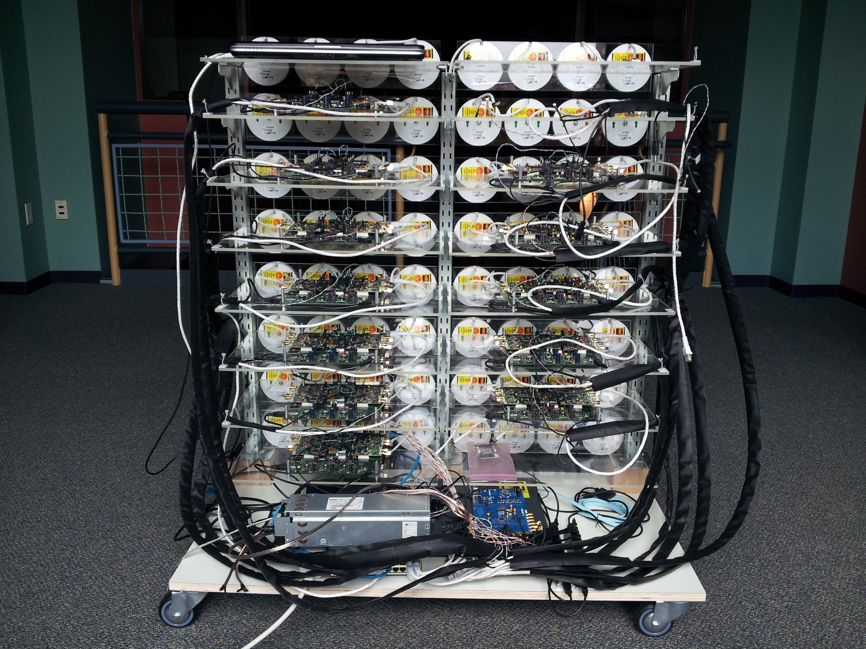
Central Controller
WARP Modules
Argos Interconnects
Sync
Distribution
Clock Distribution
Argos Hub
Ethernet Switch

Slide 34
Experimental Setup
Time Division Duplex (TDD)
  Uplink and Downlink use the same band
Downlink
Listen to pilot
Send data
Calculate BF weights

Slide 35
Conjugate vs. Zeroforcing

Slide 36
Without considering computation
Listen to pilot
Send data
Calculate BF weights

Slide 37
Linear gains as # of BS antennas increases
Capacity vs. M, with K = 15
Notes:
Power is 1/# base station antennas

Slide 38
Linear gains as # of users increases
Capacity vs. K, with M = 64

Slide 39
Considering computation
Listen to pilot
Send data
Calculate BF weights

Slide 40
M = 64 K = 15
Zeroforcing with various hardware configurations

Slide 41
Conclusion
First many-antenna beamforming platform
  Demonstration of manyfold capacity increase
Devised novel techniques and architecture
  Unlimited Scalability
Simplistic conjugate beamforming works
Need adaptive solutions

Slide 42
Ongoing work
Inter-cell interference management
Pilot contamination
Client grouping & scheduling
A network of massive MU-MIMO base stations

Slide 43
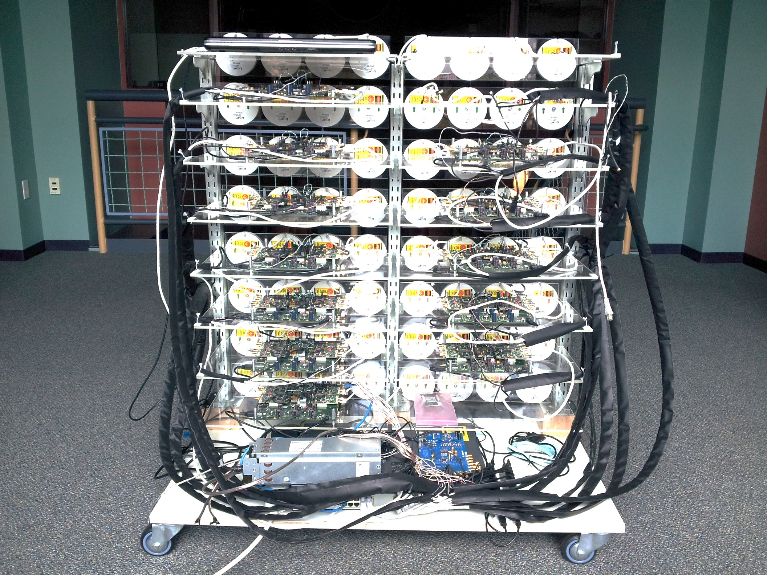

Slide 44
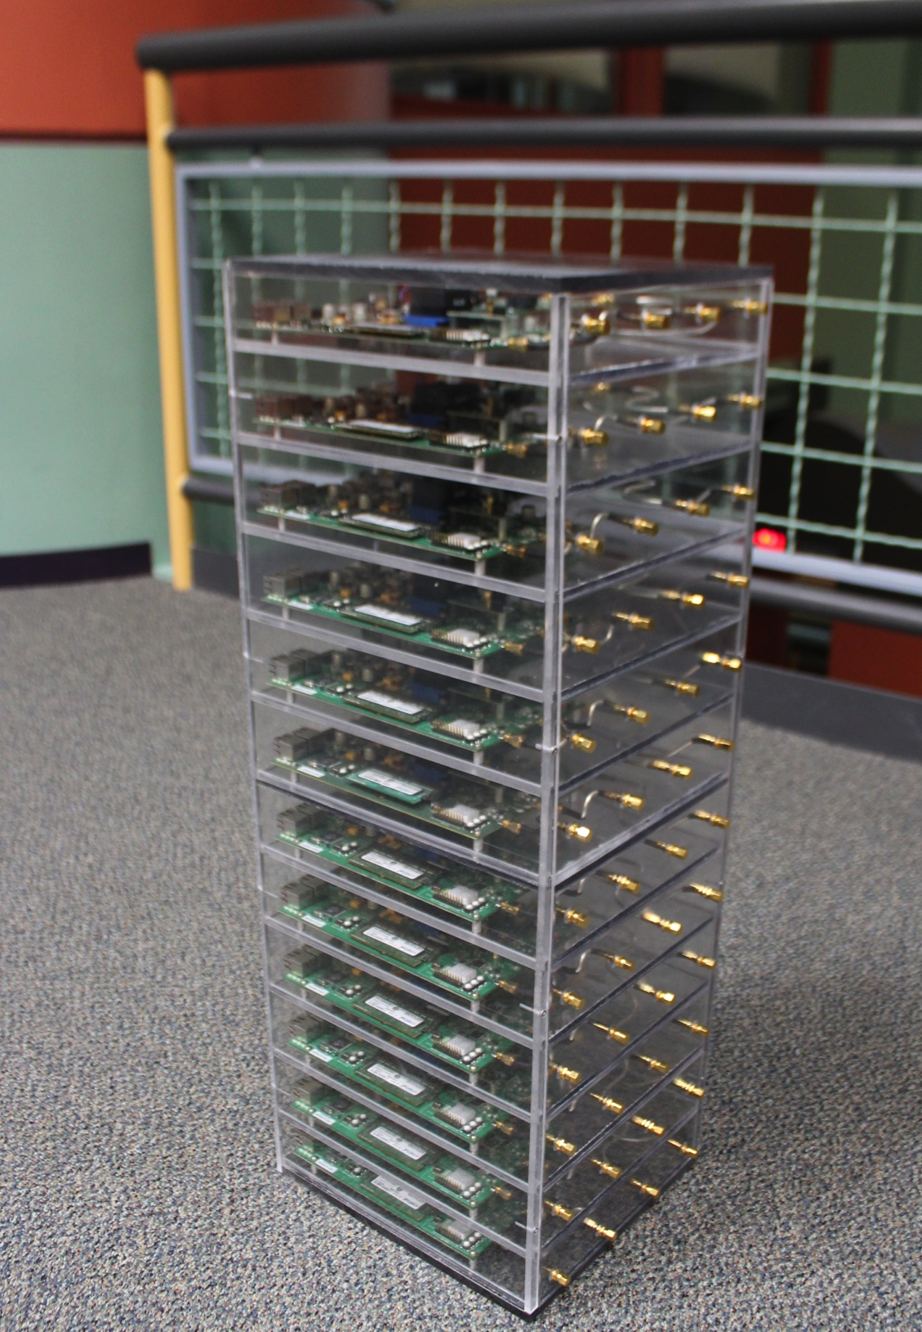
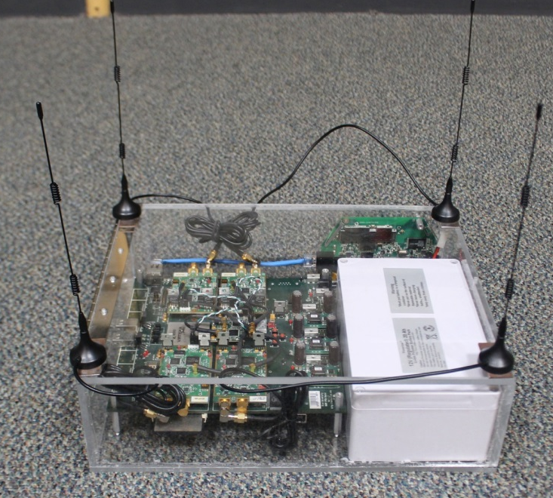
~$2,000 per antenna

Slide 45








Acknowledgments
http://argos.rice.edu

Slide 46
More BS antennas + MU-MIMO➔
Higher efficiency & lower interference
Data 2
Data 3
Data 1
Data 4
Data 6
Data 5

Slide 47
More BS antennas + MU-MIMO➔
Higher efficiency & lower interference
Data 4
Data 2
Data 3
Data 5
Data 1
Data 6
Data 12
Data 7
Data 9
Data 11
Data 8
Data 10

